Slide 1
THE TOOLBOX Culture beats strategy – Workshop summary

Slide 2
1 How do you grow intrapreneurs?

Slide 3
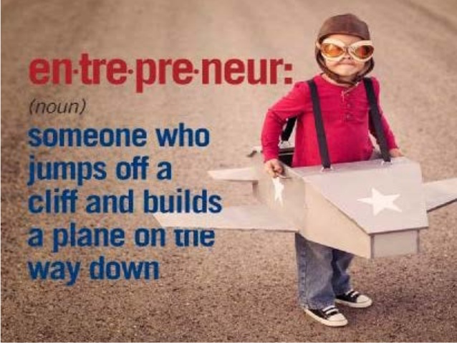
How do you grow intrapreneurs?

Slide 4
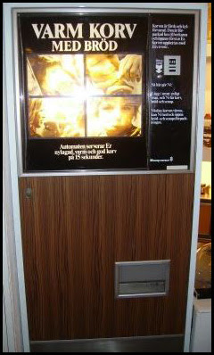
The intrapreneur
A free radical who
creates her/his own role
get things done anyway
knows how to navigate internally

Slide 5
Human Resources
Look for and identify intrapreneurs:
the individuals who make things happen
Support intrapreneurs over time
Mentorship

Slide 6
Management support
Managers should understand who the intrapreneurs are and make sure they have to bang their heads against different walls as little as possible, since intrapreneurs will do things regardless of processes, structures and limitations

Slide 7
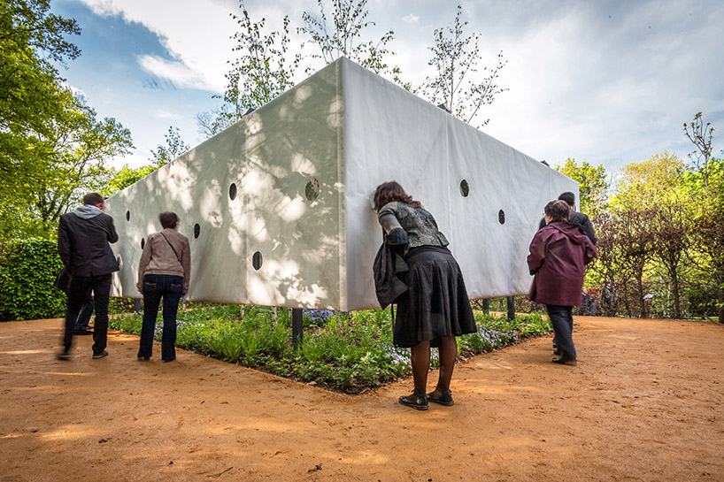
Leadership
Clear framework for ideas outside current business, but still within the explorative scope
Openness for new initiatives

Slide 8
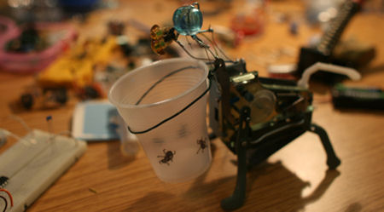
Process
Assign budget and time for development and rapid prototyping

Slide 9
Training and education
Identify need for intrapreneurs
Train and educate both managers and employees

Slide 10
Structure
Separate company
Grow using parent company infrastructure
No history of how things must be done
Incorporate in core business if successful or
Sell company

Slide 11
Contacts
HR as an important function for supporting intrapreneurs
Erik Ronne, SP
Corporate Venturing & separate companies
Jan Sandqvist, Googol & Erik Ronne, SP
Education for Management & intrapreneurs
Toni Sigmundsson, Uponor

Slide 12
2 How do you execute an innovation event?

Slide 13
How to execute an innovation event (Google) Design sprint
Kind of event
5 day event
Purpose
Focused and effective process from problem statement to tested (prototype) solution
How to do it
Structured process 5 days
Get test persons in (users)
Build common understanding of the problem
Gather consumer insight, get a common understanding
Idea generation, (single persons)
Prioritize the solutions to develop further
Build prototypes (testable)
Test on selected test persons
How to get sustainability
Works great for a limited problem. You build a testable shell rather than release it live.
This is a way of working, when you see the result you want to do it again. This builds culture.
Read more at http://www.gv.com/sprint/
Feel free to contact Jesper Brink at Daytona jesper.brink@daytona.se

Slide 14
How to execute an innovation event FedEx Day
Kind of event
24h Event
Purpose
Get new ideas quick test
Give freedom to employees (Motivation boost)
Build culture
How to do it
Startup meeting (present the meaning and rules for the FedEx day, time to start registering your Ideas.)
Go through the list of ideas and approve/reject any money needed
Run the day (24h e.g. lunch to lunch)
Present to the rest of the FedEx participants (5min presentation)
Exhibition of concepts.
Vote for best project
Award ceremony (prize e.g. continue project, day off, movie ticits)
How to get Sustainability
Run as an yearly event (or several times / year) Make sure the best ideas are turned into projects
Issues: Not all ideas are realistic to continue with Difficult to administrate when bigger that 50 participants
Feel free to contact Patrik Jägenstedt at Husqvarna patrik.jagenstedt@husqvarnagroup.com or Leif Schweitz at AstraZeneca leif.Schweitz@astrazeneca.com

Slide 15
How to execute an innovation event ID days (Information days)
Kind of event
2 day event
Purpose
Support development
Increase knowledge
How to do it
Rent a large areas
Clear mix of participants (Large companies, start ups, Institutes, municipalities)
Invite people within the business (fee size after capability to pay)
Follow up next year
How to get sustainability
Yearly event that is followed up
Feel free to contact Oskar Jonsson oskar.jonsson@mfd.se

Slide 16
How to execute an innovation event Innovation Expo
Kind of event
1 day event
Purpose
Expose Innovation
Build innovation pride
Cross discipline knowledge sharing
How to do it
Rent a large area
Invite people within the business
…
How to get sustainability
Make sure it is highlighted within the organization
Get management to attend the Expo
Develop the concept, make sure that different concepts are presented
Feel free to contact Johan Hallendorf at Husqvarna johan.hallendorf@husqvarnagroup.com

Slide 17
How to execute an innovation event Innovation camp
Kind of event
24h event (Hackathon)
Purpose
Brand building
Idea generation
How to do it
Invite student (100)
Sped 24h from Idea to concept (business case)
Selection of the best business case External/ Internal experts
Monetary rewards (in proportion to students)
How to get sustainability
Building culture by acknowledging innovation
Please feel free to contact Ingela Lindahl at Tekniska verken Linköping ingela.lindahl@tekniskaverken.se

Slide 18
How to execute an innovation event Innovation journey
Kind of event
4 day event (spread over a year)
Purpose
Learn Innovation process
Idea generation
How to do it
Four WS at different inspiring locations A number of companies (may be competitors)
WS Ideation
WS Customers perspective (design and selection)
Make a commercial
Show case
How to get sustainability
Collaborative thinking is a key
Please feel free to contact Pia Wågberg at Innventia pia.wagberg@innventia.com

Slide 19
3 How to create belief in the future?
Initiatives | Purpose | How to do it? | How to get sustainability of initiative effect?
Know the future – adopt to change | Be flexible for changes in technology, human behavior, politics…. by knowing your eco-system. If you are aware of the future you will be able to act fast and correct as the world is changing around you. | - Know the future by trend forecasts. - Iterate the future continuously. - Back casting
Visualize future visions | Make a vision tangible and real, ”bring to life” by include it i a product concept | Initiate this type of projects to different parts of the organization | Make sure that concepts, or parts or concepts, are used for further development and at the very last end are launched. Invest in research that is required to make the concept real.
Knowledge | Secure correct knowledge for the future. Plan ahead to be “on top of things”. | - Invest in research - Make sure to share knowledge in required areas by different means (e.g. digital tools, meetings, educations). | Make sure to use the knowledge within a finite time. New knowledge creates possibilities for development teams. Important to have e.g. 5 % of all resources dedicated to the initiatives.
Sustainability | Make sure people feel that they contribute to the future of the earth instead of eroding it. | Work with products and services that are sustainable for the future.
Contacts: Future roadmaps: Johan Hallendorff (Husqvarna AB) & Niclas Ingeström (Stena) & Eric Ronne (SP tidigare Akzo Nobel) Back casting: barbro.lagerholm@swerea.nu Trend forecasting: Daniel Höglund (Veryday)

Slide 20
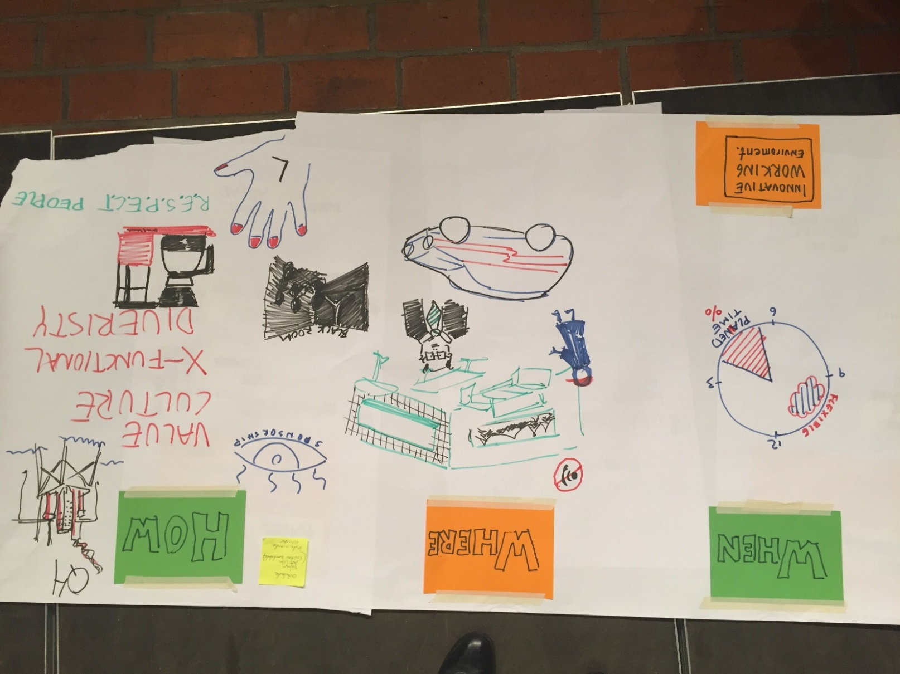
How do you create an innovative working environment?
4
HOW
- Sponsorship – requires support from top management
- Create a platform for communication, both offline and online.
- Cross-functional teams
- Diversity – one of the most important factors for a innovative working environment
- Find places where you could meet for innovation, e.g. the coffee machines
- Break patterns, e.g. use your left hand to say hello
- RESPECT people. Then you dare to be open with your ideas.
WHEN
- Allocated time. Both in office hours or outside.
WHERE
- Creative space – space for creativity, that is relaxing, e.g. sofas and a good view
- No telephone contacts and distractions
- Cross-functional and meetings between departments and roles
- Possibility to write on walls, whiteboards or tiles
- Black Room to focus only the word, not body-language

Slide 21
5 How do you get a collaborating culture?
Initiatives | Purpose | How to do it? | Challenge | What culture effect do you get?
Collaborative knowledge building forum | - Build knowledge - Connect people - Use knowledge - Do stuff | - Weekly 1 hour meetings - Not mandatory - A guiding chairman - Have a own agenda | Balance between structure and adhoc ability and creative oasis | - Creative oasis - Peers sees you - Explore possibilities
Innovation masters | - Create engagement - Connect people / ideas - Inspire people - Support in evolving innovations | - Dedicated individuals facilitating the online idea management platform - Holding innovation cafés to pitch opportunities for business-owners. | How to ensure / maintain a sustainable level of engagement in the organization? | - People becomes aware of innovation - Clear supporting innovation structure to push innovation - Visible commitment for innovation by the organization / leadership.
Growing by sharing (B2B sharing platform) | - Networking - Learn and practice to be open against others - Share experiences and information - Help each other | - Get-togethers at different locations - Digital platform - Assign the task of organize of the network to a group | Keeping the network alive and somewhat structured | - Openness - Feeling that it is ok to reach out to others - Habit of reaching out
Open innovation lab | Value chain workshop | Learning from outside | Address common challenge | Can we scale it?

Slide 22
How can you work with rewards and recognition?
6
General comments
Recognition is a reward!
Difference Invention awards & Innovation awards. Invention awards to stimualte creativity and innovation to stimulate the whole chain of coworkers that is needed to create value.
Invention reward-opportunity to work on my invention + some budget.
Reward-One day of work. Often creativity is stimulated when you do something of regular tasks.
Is there a committee in your org that can and is suitable to judge ideas ? Fast and fare feedback /clarity on ideas is recognition and is essential.
Reward good ideas but also those ideas that did not go all the way. If not you will only reward low risk projects.
Type of reward; Time for personal development of employees own taste.
Reward individual or team effort. In my team on Husqvarna we measure no of patents not on individual level but on team level to stimulate sharing of ideas and cooperation.
Career ladder. To be able to make a carrier and get recognition as a specialist not having to be a manager.
Don’t forget that just plain daily feedback is recognition. Even only constructive feedback is better then no feedback at all.
If top management don’t recognize your team effort. Take the initiative to invite them for a presentation.
Create opportunities for inventors to follow their idea all the way to market launch.

Slide 23
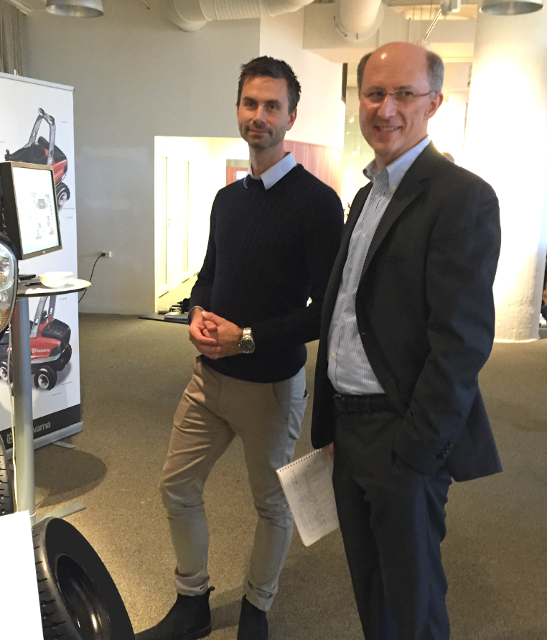
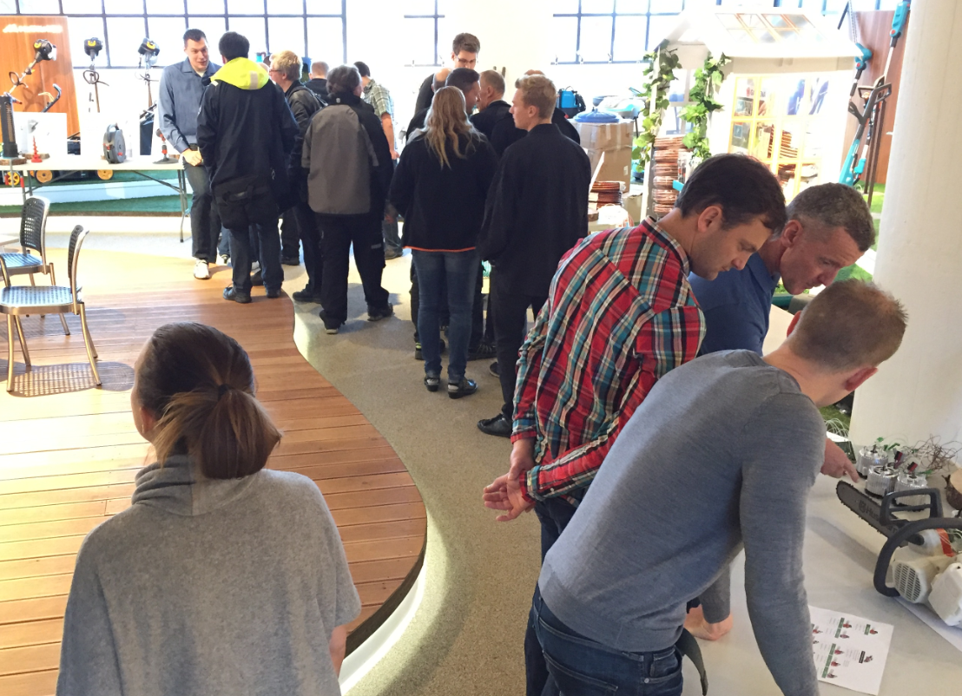
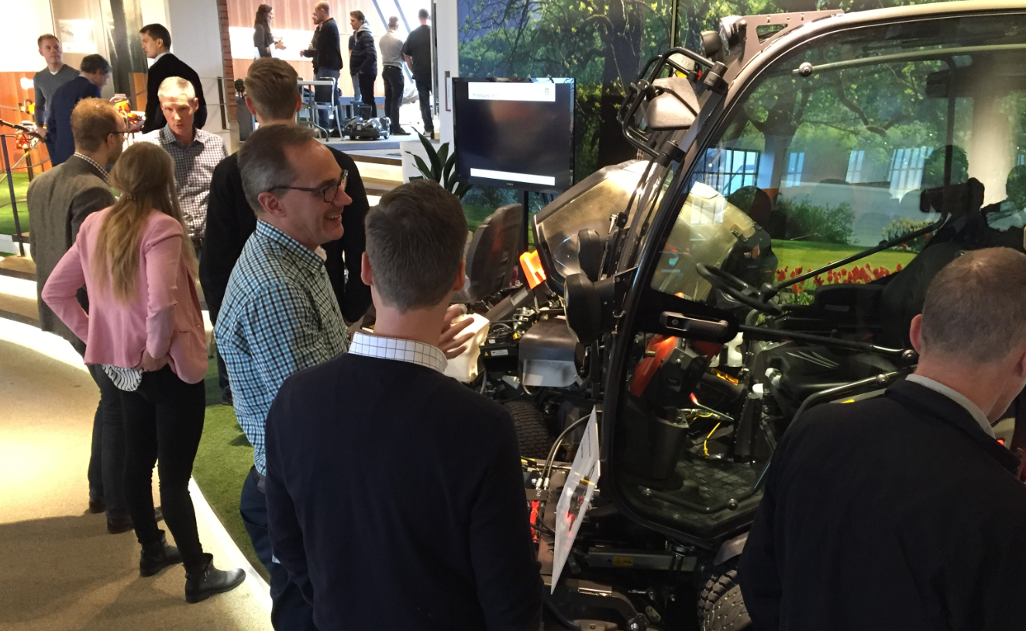
Rewards and reqognition Innovation Expo
Kind of event
8h internal innovation fare
Purpose
Sell creations and innovations internally
How to do it
Prepare simple presentation materials and prototypes.
How to get sustainability
Write articles for intranet and evolve event every year. Invite all R&D functions to participate.
Please feel free to contact Johan Hallendorff at Husqvarna: johan.hallendorff@husqvarnagroup.com
Networking
Invite coworkers and top management ( in Husqvarna 350 visitors incl CEO and top management and 35 projects)
Plan for yearly events, sim dates.
Recognition for inventors and possibility to directly approach decision takers, sponsors and top management in a organized way.

Slide 24
Rewards and recognition Volvo innovation award
Kind of event
Different kind of rewards for different stages in the process.
Purpose
Technology awards
How to do it
How to get sustainability
Please feel free to contact Karin Andre. Karin.andre@volvocars.com

Slide 25
Rewards and recognition Husqvarna innovation award
Kind of event
Innovation award to everybody that helped out to get a new successful product or service on the market.
Purpose
Award organization as soon as we can launch something new to the market.
How to do it
Annual award of 25 000 dollars, price cup, dinner with committee and top management incl CEO.
How to get sustainability
Annual event!
Please feel free to contact Patrik Jägenstedt: patrik.jagenstedt@husqvarnagroup.com
Recognition on intranet, papers and presentation of team/project on general meeting.
http://www.husqvarnagroup.com/sv/utmarkelsar
Nominees to be handed in to a committee every year.

Slide 26
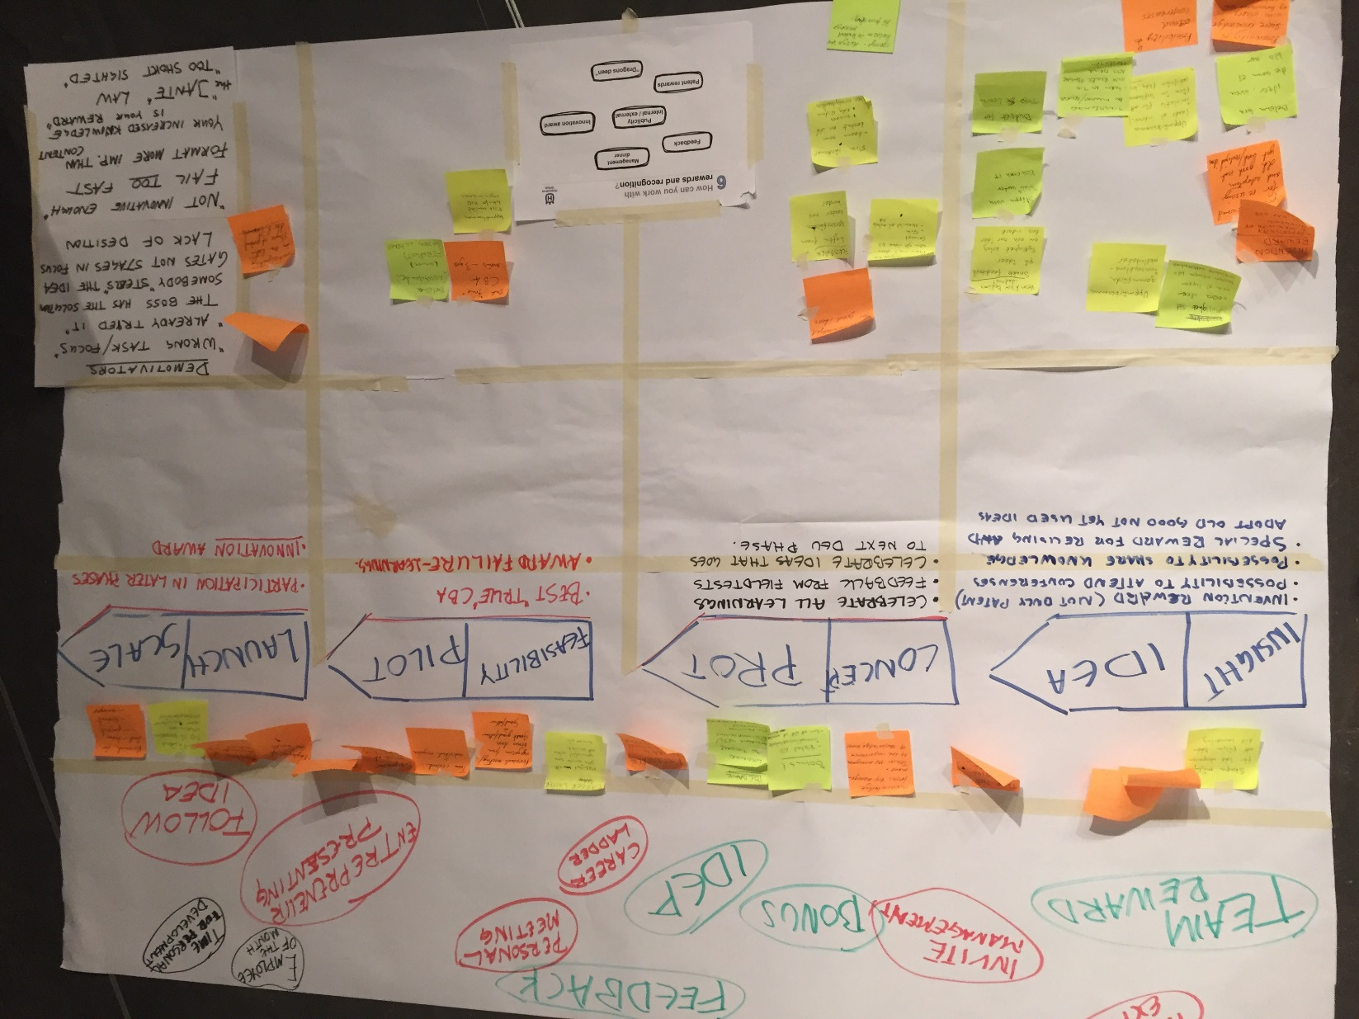
Rewards and recognition

