Slide 1
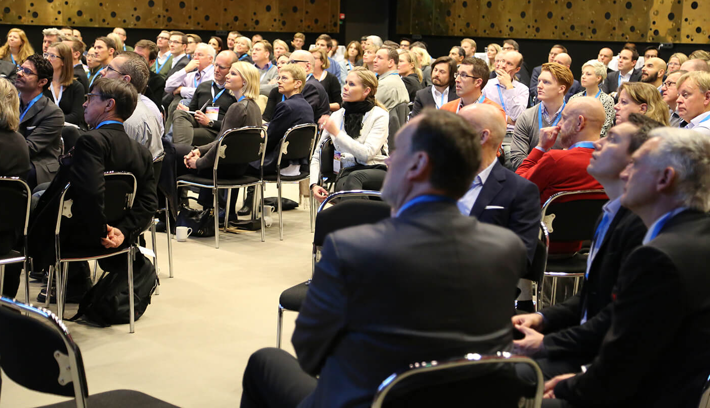
Innovation in Action 2016
This presentation includes key takeaways from this years Thought Leaders 2016.

Slide 2
Pär Larshans CSO of Ragn Sells
Topic: World is Changing
Purpose:
The aim of Pär Larshans presentation was to share his experience in successfully building an extreme fan base. How to turn fans into customers and customers into fans. This based on the work and the launch of the sustainability work at MAX. Today, Larshans uses these experiences in Ragn Sells where he works as CSO.
Message:
When working for Max Pär noticed that the effects of global warming would be devastating for the beef industry. He created a campaign where Max’s awareness of this problem was communicated to the customers and offered them the opportunity of burgers without beef. Max also communicated their activities such as using wind power, carbon offsetting and reforestation. Max’s environmental work went viral and the campaign was highly successful. Pär applies his experiences to his current position at Ragn Sells and collaborate closely with the government to ensure sustainability regulations are viable both for corporations and the environment.
Learnings:
Pär highlighted the importance of focusing on sustainability when setting a business strategy. Organizations also need to change the mindset of managers, to make them see the abilities over the inabilities of people with disabilities. This in turn, will ensure that talented people from this large population group are hired. Furthermore, transparency and honesty gains the trust of customers and if sustainability thinking is brought into the core of the company- sales will be increased. Laws and regulations will change and organizations will need to be more sustainable. Large organizations therefore need to base their strategy on sustainability and communicate closely with the government.
5 Key Takeaways
It is essential to build a strategy based on sustainability
Honesty and transparency wins the customers trust and increases profit
Companies need to realize that they are selling ideas, not just products
Hire people based on their abilities, don´t reject them because of their disabilities
Large corporations need to work closely with the government on sustainability goals

Slide 3
Elin Elkehag Founder and CEO of Stilla
Topic: 100 days
Purpose:
Elin shared her experience of creating the hardware company Stilla from scratch in 100 days. She also shares the key learnings she acquired along the way.
Message:
Speed beats perfection - The world is moving fast, and so should you. Get things 80% right, test with customers early, and iterate rapidly.
Hungry beats smart - Dare to ask tons of questions. The one who learns the most the fastest, wins.
Tribe beats comfort - Find your tribe, even if they are outside of your comfort zone, and build a team of “rockstars”.
Creativity beats resources - Money and resources shouldn’t be a limiting factor, learn as much as you can with what you have.
Focus beats force - Remind yourself of what goal you want to achieve, and why. Take small steps of imperfect action everyday, to get there.
Learnings:
There are many things large corporations can learn from startups, for instance how they make use of crowdsourcing. It is not only about receiving funds, it is about marketing, creating hype, gather feedback and measure the interest. Elin’s last encouraging words were “Go out and talk to customers and don’t be afraid of failing!”
Read more about this topic in Elin’s blog.
5 Key Takeaways
Speed beats perfection
Hungry beats smart
Tribe beats comfort
Creativity beats resources
Focus beats force

Slide 4
Filistin Aloul and Amjad Aloul Founders of Crossborder Communication
Topic: The forgotten 280 billion - The power of purchase among the immigrant groups in Sweden
Purpose:
Filistin and Amjad Aloul shared insights into the large untapped customer segment made out by non-native Swedes and this segments great potential.
Message:
Filistin highlighted the huge commercialization opportunities for companies and organizations available in Sweden that are currently overlooked. Traditional customer segmentation research does not distinguish between ethnical background and tends to use parameters such as gender, age, income etc. As a consequence, many companies miss out on the great potential of the growing foreign population in Sweden. If companies re-think their current marketing strategies and engage in communication efforts that target this customer segment they will expand their customer base and win market share. One observation was that Immigrants in Sweden acts just like Swedes living abroad – we tend to ask close friends for advice and prefer products that reminds us of home.
Learnings:
The foreign population in Sweden represents an attractive customer segment with great purchasing power. The segment is to a large extent “un-touched” which opens up for the potential to build brand loyalty before competitors. However, companies must reconsider their communication strategies in order to reap the benefits. This includes studying purchasing habits, traditions, use of communication channels etc. in order to succeed in targeting the growing population of non-native Swedes and in designing an attractive customer value proposition. Food and grocery companies have already started seeing the potential linked to new consumption patterns but many companies are falling behind.
5 Key Takeaways
The large group of non-native Swedes amounts to 280 billion of potential revenue
The segment does not have a relationship to traditional brands, hence companies that interact with the segment early have the opportunity to build trust and brand loyalty
Re-design the customer value proposition e.g. products and services might need to be adapted or rebundled
Avoid stereotyping and base marketing decisions on facts e.g. use tools such as EtnoPoll and EtnoSurvey
Expand traditional communication channels to include radio stations, social media pages, etc. that target the foreign population in Sweden
Notes:
The forgotten 280 billion – see the potential of immigrants instead of the challenges
Question: how do we behave when we are in another country, how do we socialize, how do we act, lets discuss after the session
Tools in the communication industry didn’t exists so we had to create them in order to reach the target group – immigrants
EtnoPoll
EtnoReach
Immigrant groups in Sweden
Mixture of highly diversed groups
Mixture of new and more establihshed
Several areas with a concentration over 50%
Mainly: middle east, yugoslavia, latin america, southern europe
Immigrants and brands
Unaffected and open to new brands
More loyal to brands
Creating opinion, especially among the younger – an important target group, gatekeeper to the parents, parents reach out to the children to ask for advice etc.
If you want to reach out to the immigrant groups you need to reach out to them early – introduce yourself to build brand loyalty example is Comviq, Swedbank (communicate with foreigner groups), Folksam
Many foreigners dream of going back and don’t necessarily want to be fully rooted in Sweden e.g. in terms of food (analogy to Swedes on Grand Canaria, they also live together, eat waffles, marry in a Swedish church)
Why are all the goldfish sold out March 21 every year? Naroush – Persian New Year – a lot of money in the foreign traditions and celebrations e.g. Rammadahn
Example of Posten – Happy New Years, McD
How to reach out to foreigner groups
Get to know their lifestyles, needs, consumption, habits, traditions media consumption
Identify primary target group
Customize product if needed
Adapt the communication
Draw attention
…
Avoid national romanticism and stereotypes
Coop case
When asking a hundred ladies, they didn’t have a relationship with any big swedish brands, no marketing towards the immigrant group, sent out survey where women where asked to photograph their food storage e.x. big bags of rice
Did a pilot at coop, new selection called food of the world (världens mat) syncronized with ramadam, highlighted feasts, had a baker in the store, announced when the sun set
Adapted the store to resemble a foreign market
KF contacted coop and integrated with the coop medmera card
Good response
ICA – case
How can we go ahead
Level 1 – new media choices
Level 2 – media choices, communication
Level 2 – media choices, communication, PR
Radio, sent info in Farshi,
Allcompis, paper, radio, website, 130 new unique visits per week, 600 000 followers on facebook
New potential
Substantial volumes linked to new consumption patterns
Presence among a large group
Change and trends
Food companies are aware of the possibilities, authorities are picking up
General increase in this consumer group
Before they did what was though needed and now they want to do it as they see the potential
How do we behave when we visit other countries.
-Our identity is linked to our nationality, we prefer to go to IKEA, buy kanelbullar etc
Socialize with swedes, change pattern eg. go to church
Why do we want to be swedish when we’re not in sweden
Look for a sense of beloning, food is central, gather around food
Security in the own group
How do you do it at home in your organisation
Alfa Laval – diversity challenge – help non swedish born students to get an internship/ position as we sell our products to the world and we see the potential and we need their knowledge, past and experiences. We done it for 4-5 years, 4 students a year and they usually stay with Alfa Laval after the internship is finished
CityMissions, excluded and voluernable groups, a lot of refugees, help them with basic needs food, shelter, legal advisement , how to go to the authorities, we have projects in the socially volnurable regions in stockholm and malmö to help the youth. What are the challenges in doing that, chanllenge of building trust
ImpactApp, incubator for social entrepreneurs, 21 people and 14 nationalities, ongoing thing, open mind and opportunity instead of a challenge, volunteer to host our space. End up creating an amazing buzz
StoraEnso Though, a recommendation adn testimonial has a value when Im abroad more than it has in my native country, it feels like my entire country recommends it, the recommendation has a lot og weight. The big celebrations are not only for the immigrant community but a mean for the foreign groups to include neigbours and share their traditions
Many companies can see the potential of a diverese pool of employees
In your companies what are your perpective in attracting foreign groups.
Why are you in sweden? 1 of 13 siblings, the youngest
Went to saudi arabia, didn’t know anything about sweden where my sisters was, but we saw the eurovision song contest and ABBA and was amazed and decided to go to sweden
Innovation piooneers has donated money for hand in hand organisation for female entrepreneurs in developing countries.
Change the way we build brands, communication, the packaging in order to build trust with new targetgroups within the nation
Example, adapt the packaging, in order to aim the example a new taste of a product, bank account service, more easy today to adapt, the gold fish is a symbol of prosperity, apple a mirror, all begin with s

Slide 5
Randall Wright Senior Industrial Liaison Officer at MIT
Topic: How to be a part of the next wave of disruption.
Purpose:
The purpose of the presentation was to highlight the importance of collaboration between the industry and institutions such as MIT in Boston. The aim of the presentation was furthermore to share Randall’s insights on innovation.
Message:
Randall described his insight on what innovation is and where it comes from. He also highlighted why the industry should be connected to communities and academy such as e.g. MIT. Randall stated that innovation occurs in communities and subcultures. This is why the industry and executives need to be a part of the discourse in these communities. Institutions such as MIT is one example of a community where this valuable discourse is happening. Randall highlighted the only an idea isn’t enough, you also need to demonstrate it. The doers are normally the major thinkers. To really succeed you need to me able to do both.
Learnings:
Innovation should not be defined as an outcome. It is an argument consisting of a proposition (if) and a conclusion (then). The proposition is normally easy to formulate (what are we proposing?). The conclusion (what will this lead to?) is more complex. The reason to connect with institutions such as MIT is to be in the community that is trying to change the world and find the movement that is bigger than your company, that will allow you to grow.
5 Key Takeaways
Demo or Die
The ability to control information is key
Innovation occur in communities
An innovation is not an outcome, it is an argument
The doers are the major thinkers

Slide 6
Johan Ronnestam Global Speaker, Entrepreneur and Creative Director
Topic: 30 minute innovation crash course
Purpose:
Johan shared his view on how to approach innovation work. He stressed the important question of when it is time to innovate. For most companies it often comes down to survival.
Message:
Johan stated that there are three types of innovation:
Efficiency
Evolutionary
revolutionary innovation
You can tackle these types with three different types of strategies:
being first to market (inventive)
being second but best (adaptive)
with low cost production (economy).
Learnings:
Release the creativity, follow the neurons and be prepared by having access to supporting tools. Suggestions of such tools where: mindmeister, Flipboard, Pinterest, OmniOutliner and Thesaurus.
Read more about Johan’s view on innovation on his blog.
5 Key Takeaways
Demand strategic outcome
One “fun workshop” a year is not the answer
Leaders, put your money where your mouth is
Don’t expect to disrupt the world
Think marketing & brand early in the process

Slide 7
Björn Larsson CEO of Zoomability
Topic: A Free Mind in Motion – The Zoomability Story
Purpose:
Björn illustrated the challenges during the commercialization process that occurred when having a disruptive solution that did not fit in the “usual” channels and models of distribution.
Message:
Zoomability was the result of a man who saw his wife being unable to walk in the forest when her sickness made her bound to a wheelchair. He went against the traditional wheelchair design and split the chassis in two, put one wheel in front of another and built in an ability to lean. This would enable the wheelchair to drive wherever a person could walk, including up and down stairs. Toyota heard of the invention and invested enough money for them to develop a first Zoom prototype. When Toyota had to abandon the project Zoomability stripped down their design and went back to their original idea of enabling the wheelchair to drive in forests. When the government refused to buy the Zoom they found 35 ambassadors and multiple companies willing to buy and test the wheelchairs instead.
Learnings:
The path that the Zoom took from idea to design proves that the road from innovation to product can be long and filled with obstacles. It also proves that innovative thinking can help pass these obstacles. Reaching out and finding people willing to collaborate and test the product is key. Unfinished prototypes or small scale testing is sufficient enough as long as it can give the investors an idea of the finished product. Traditional wheelchairs often have negative connotations, but Zoomability decided to create a product which went against this. Zoomability dared to create a product that was different from the standard: faster with bold design, and focused around what the customers needed.
5 Key Takeaways
Don’t let obstacles bring you down, find an innovative way to climb over them
Don’t be afraid of small scale testing or showing an unfinished prototype to investors
Don’t be too protective of your idea, rethinking can be beneficial
Allow your product to go beyond the standard
Dare to look differently at a product to see its possibilities, be a pioneer

Slide 8
Åsa Caap CEO and founder of Our Vodka
Topic: Intrapreneurship and how to run a startup within a large corporation.
Purpose:
Åsa shared her experiences of being a successful intrapreneur within a large corporation. As an employee at The Absolut Company, Åsa manage to successfully launch the startup Our Vodka. The aim of the presentation was to share her experiences and learnings from her journey- which is still ongoing.
Message:
To win you need to have a crazy driver and a brave team. You also need to be prepared that your job description will change form day to day. You will run into problems and difficulties., and it demands flexibility and innovative thinking. What you learn from today’s difficulties is what will make you succeed tomorrow.
Learnings:
By exploring unknown paths you will gain experience that will keep you ahead of competition in the future. The unknown path can be a struggle for the corporation that isn’t used to the uncertainty. To be able to solve unexpected problems, you need all types of competences in your team.
5 Key Takeaways
A startup is not a small version of a large company
An intrapreneur doesn’t have to be corporate
Keep someone in your team outside the corporation
Explore an unknown path
Keep your vision and goal clear

Slide 9
visit innovationpioneers.net

