Slide 1
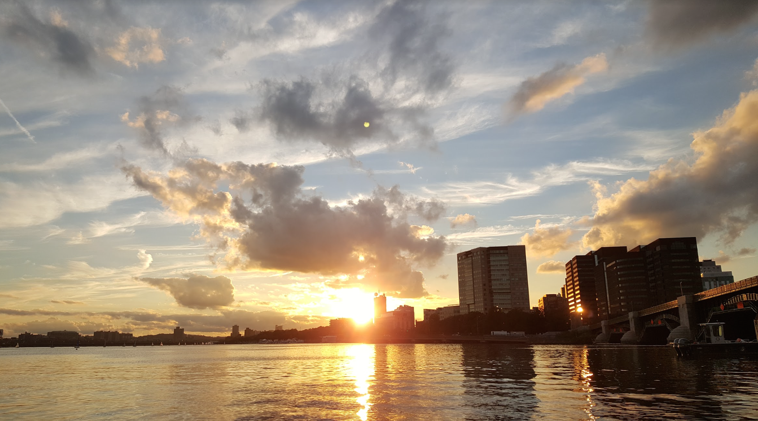
28-30 September 2016
This presentation includes key takeaways from Innovation Pioneers first arranged trip to renowned Massachusetts Institute of Technology- MIT in Boston. This unique opportunity was offered to all member organizations of the network when MIT shared their profound knowledge of entrepreneurship and how a system of partnerships between an institution of Innovation, companies and organizations work.
A presentation by Niclas Ingeström, Stena and Shirine Bauer, Googol

Slide 2
Background
MIT is the center of gravity for entrepreneurship and innovation. The institute opened their doors to 24 professional innovation leaders whom shared their own and MITs deep knowledge of entrepreneurship and system of partnerships.
In the long and impressive list of companies founded by MIT alums contains companies like Dropbox, Bose, Intel and Texas Instruments. Approximately 4,6 million people are employed by the 30,000 active companies that have been started by MIT alumni and of which a numerous are Nobel Prize winners. To fully experience how an institute has created such dynamic and collaborative environment, members of the network went to Boston.
This is our journey!

Slide 3
Visiting Members
 | Alfa Laval |  | Peter Thorwid
 | Alfa Laval |  | Stefan Szepessy
 | CGI |  | Martin Högenberg
 | CGI |  | Conny Svensson
 | Innovation Pioneers |  | Kim Silvasti
 | Innovation Pioneers |  | Dariush Ghatan
 | Stena |  | Niclas Ingeström
 | The Absolut Company |  | Malin Andersson
 | The Absolut Company |  | Eric Näf
 | Volvo Cars |  | Madelene Lindberg
 | Volvo Cars |  | Johan Maresch
 | Husqvarna |  | Johan Hallendorff
 | Husqvarna |  | Patrik Jägenstedt
 | OKQ8 |  | Petra Edlund
 | OKQ8 |  | Björn Perman
 | Innventia |  | Pia Wågberg
 | Innventia |  | Karl Håkansson
 | Innventia |  | Hjalmar Granberg
 | Googol |  | Shirine Bauer
 | Googol |  | Bengt Järrehult
 | IKEA GreenTech |  | Karl Swensson
 | Myndigheten för delaktighet |  | Oskar Jonsson
 | Veryday |  | Daniel Höglund
 | IKEA |  | Christian Appelt

Slide 4
Overview- Martin Trust Center for MIT Entrepreneurship
Mr William Aulet- Managing Director at Martin Trust Center
Elaine Chen- Entrepreneur-in-Residence, Professional Advisor and Senior Lecturer
Sarah Jane Maxted- Executive Director, MIT Regional Entrepreneurship Program (MIT REAP)
5 Take-Aways
If the interior looks like a board room, it defeats innovation and creativity
Create a mix of external and internal people for workshops
The best coffee machine in the world for free
Loud and quiet places
The most important factor for successful entrepreneurship is the team

Slide 5
Overview- Industrial Liaison Program
Mr. Randall S Wright, Senior Industrial Liaison Officer
Mr. Michael Schrage, Research Fellow, MIT Center for Digital Business
Prof. Maria C Yang, Associate Professor of Mechanical Engineering and Engineering Systems
5 Take-Aways
The human capital are the most important
Experiment more
“Think with your hands”
Consider what issues you want to focus on. MIT work with big issues and solving problems with big impact
Prototype fast and cheap

Slide 6
Overview- MIT Media Lab
Kristin Hall- Program Manager, Objective-Based Media & Living Mobile at MIT Media Lab
Ryan McCarthy- Member Manager at MIT Media Lab
5 Take-Aways
Undisciplined research
Students must have an interest for each project
Create meeting points in the building- stairs and coffee machine
Transparency and openness is reflected to the building
Having the right reasons for becoming a member is crucial in order to be accepted. The companies must contribute as well.

Slide 7
Overview- CIC, Cambridge Innovation Center
Mr Stas Gayshan- Managing Director
5 Take-Aways
If you are going to have an office, it needs to add value to the employees and companies.
Open and common areas with many white boards
Events for internal and external people creates audience
Create meeting- and interaction points within the office and the different floors. Different snacks in different areas.
Offices should have the best coffee on the market.

Slide 8
Many thanks to the Chairman of Innovation Pioneers, Niclas Ingeström and Shirine Bauer for summarizing the trip in this presentation!
Another thanks to all participants who joined us on this memorable trip- it would not have been the same without this dynamic, qurious and open group!
However, this trip would not have happened if it was not for Innovation Pioneers Kim Silvasti who made everything happen.

