Slide 1
NIMBY -
not in my back yard

Slide 2
INNOVATING THE FUTURE CITY
UMEÅ

Slide 3
UMEÅ +
LULEÅ
Till år 2050

Slide 4
URBANIZATION

Slide 5
URBANIZATION
One Gothenburg,
every day,
for the coming 20 years.

Slide 6
Sustainability
Environmental
Economical
Social
And for Umeå - Cultural

Slide 7
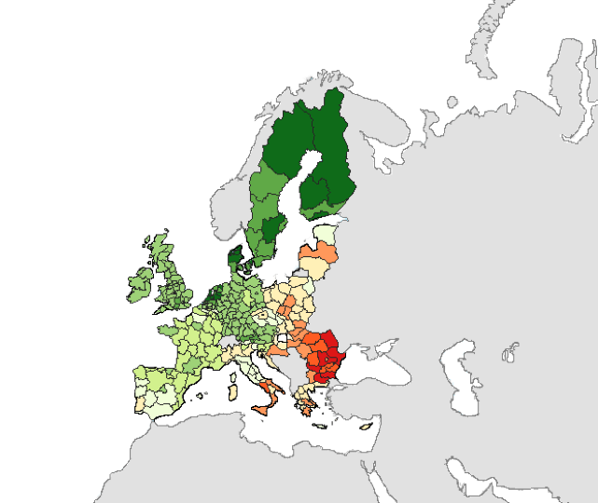
EUs Social Progress Index
#1 Life quality in Europe is found in Västerbotten and Norrbotten Counties

Slide 8
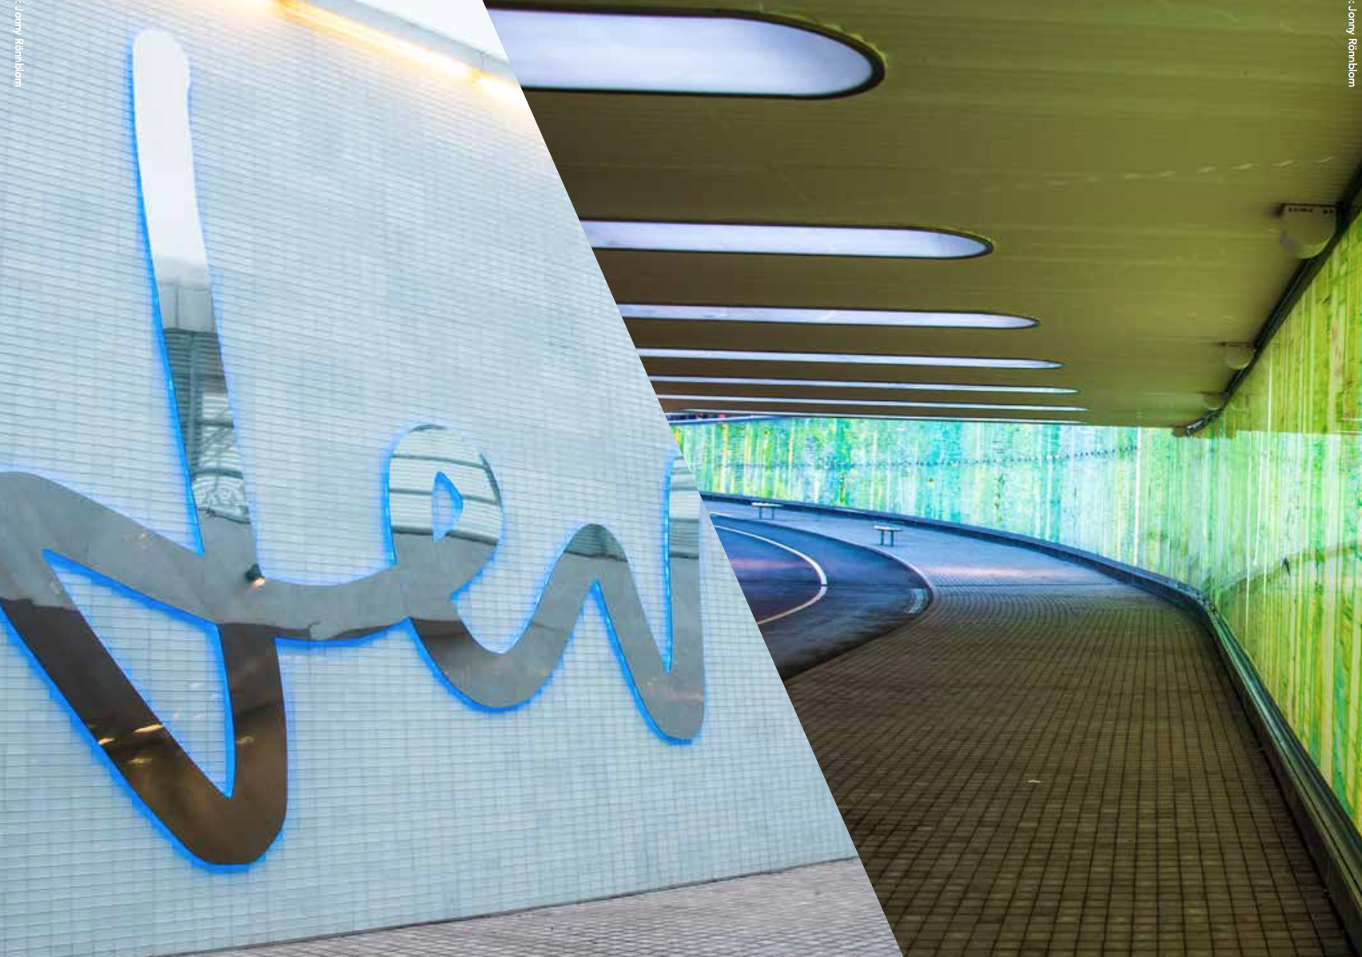

Slide 9
A city needs:
Houses
Business life
Day care
Roads
Parks
Schools
Stores
Airports
Factories
Etc….

Slide 10
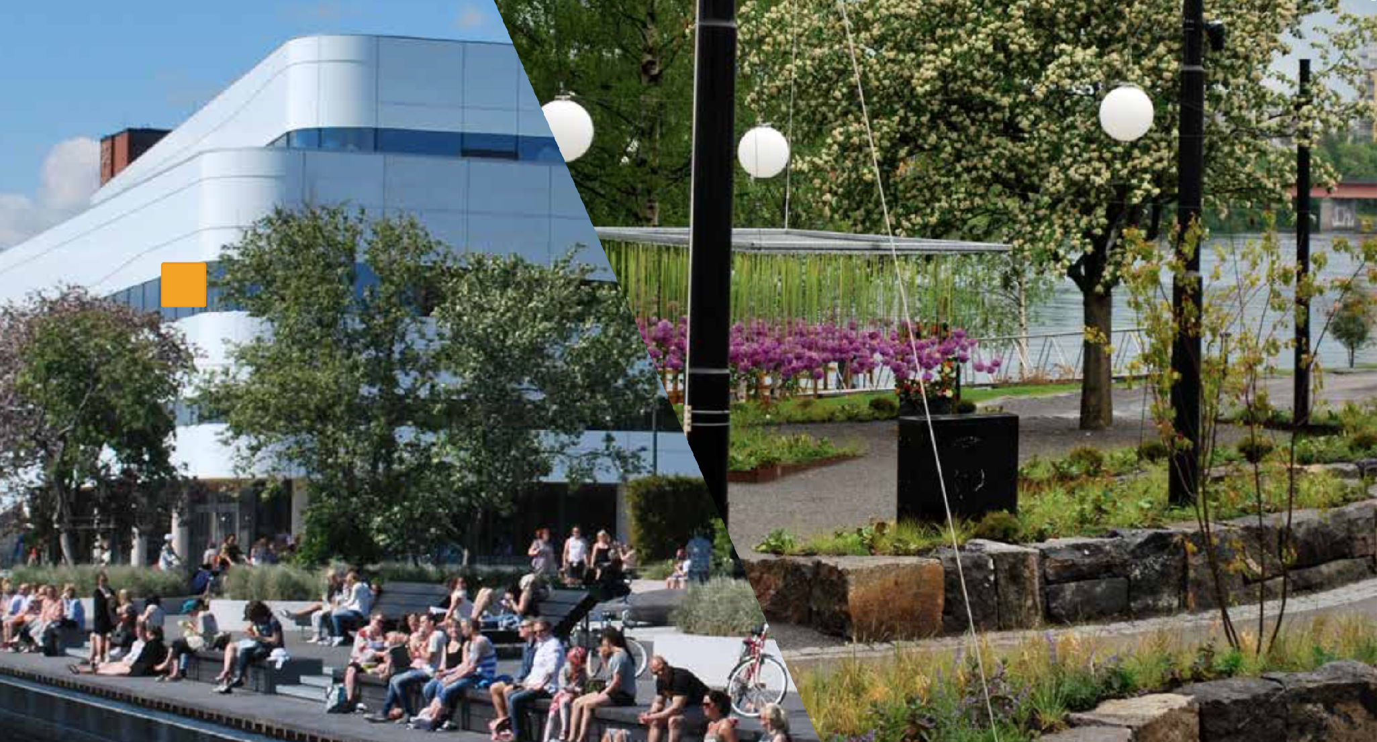
How to talk about cities?

Slide 11
” Swedes DO not feel they can influence how the cities are planned”

Slide 12
”Can we use games to create a better understanding for
city planning?”

Slide 13
GAMES
Including,
Deals with COMPLEX matters,
In a fun way

Slide 14
Can we learn from
game developers?

Slide 15
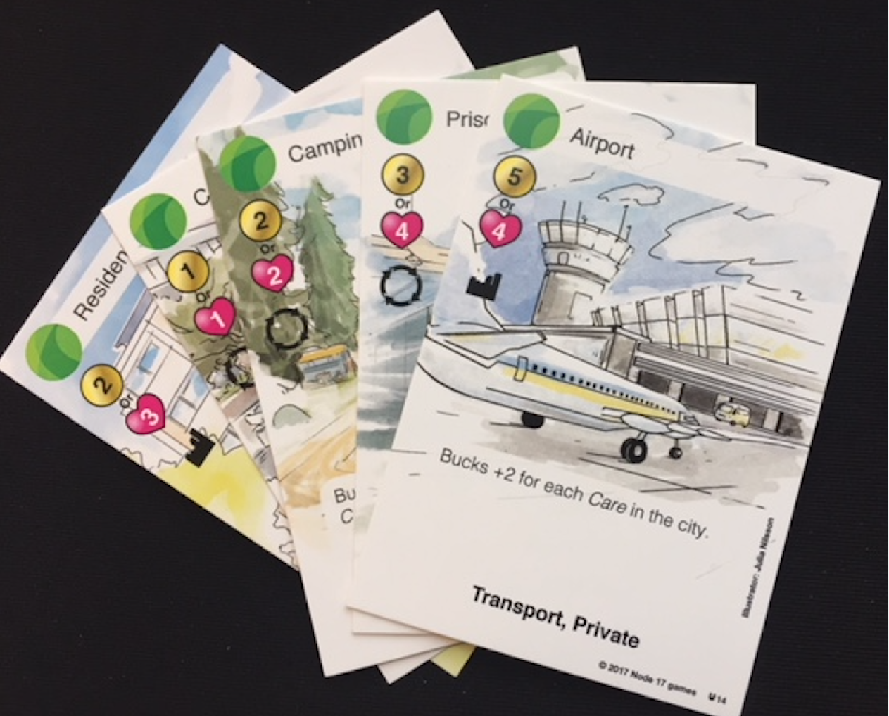

Slide 16
You are a real estade investor with a mission to build an attractive city

Slide 20
You are a real estade investor with a mission to build an attractive city

Slide 21
The investor who, after the 5th round, has the most tokens win

Slide 22
Your trade in tokens
(ie beans).
White for Bucks.
Red for Well-being.

Slide 23
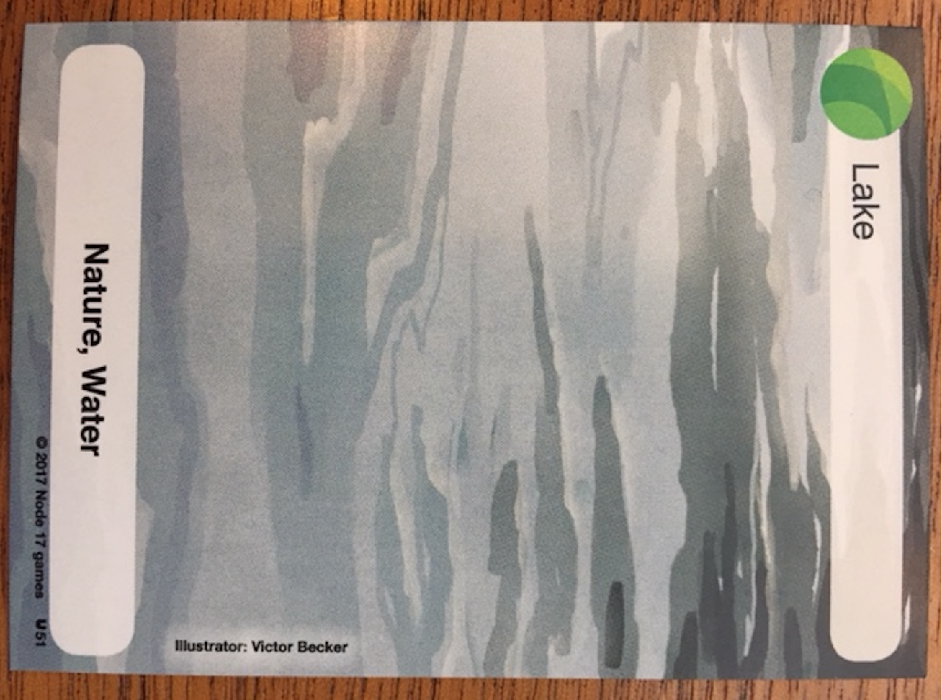
Since most people like to live near water.

Slide 24
Since most people like to live near water.
We all start by playing the Lake card.

Slide 25
Like this..

Slide 26
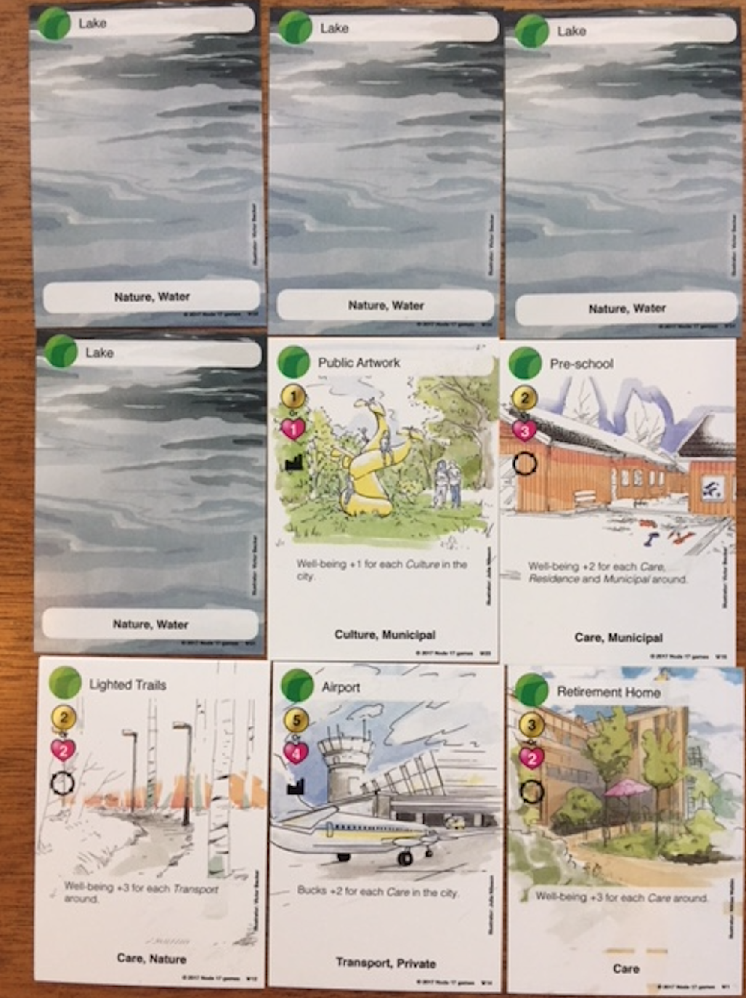
… or like
this…

Slide 27
Cities benefits from diversity!

Slide 28
The rest of the cards come in different categories:
Transport
Private
Care
Culture
Municipal
Nature
Residence

Slide 29
In the game we play our cards next to another cards.

Slide 30
In the game we play our cards next to another card.

Slide 31
The table marks the city limits.

Slide 32
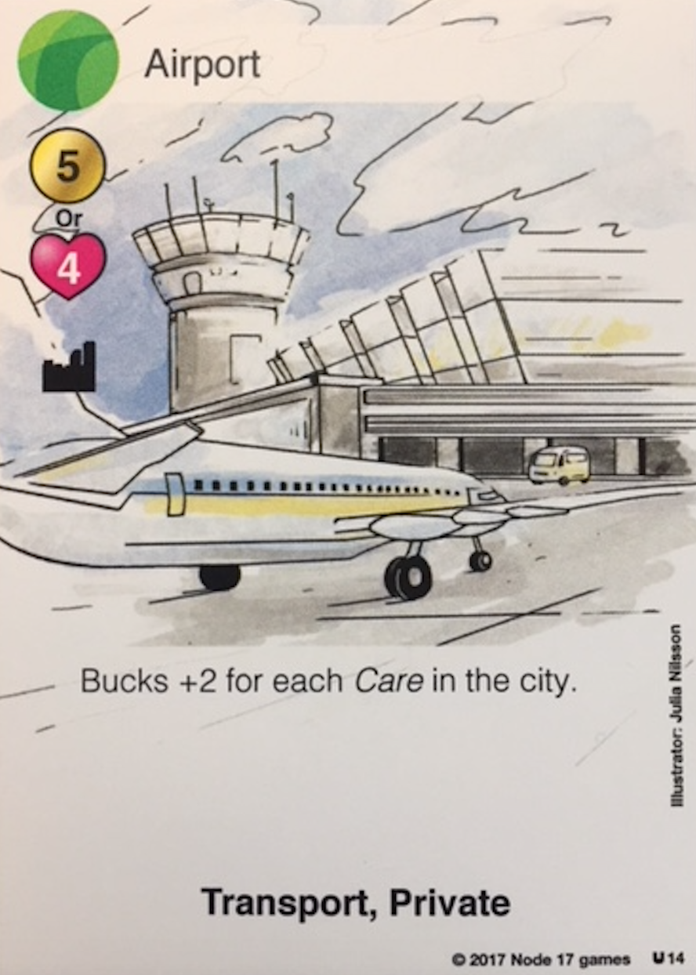
Your cards represents your options.

Slide 33
There are four things to take into consideration when playing a card.

Slide 34
The category.
A city with many different categories will be better, and yield more bucks and well-being.

Slide 35
How much you win when playing your card depends on what is said in the ROI sentence.
Read it carefully.

Slide 36
2 Bucks for every
Daycare
Hospital
Retirement
Home
On the table

Slide 37
Some cards benefit from the cards around.
Then you get revenues from all cards with the right categories around.

Slide 38
Some cards benefit from the cards around.
Then you get revenues from all cards with the right categories around.

Slide 39
Some cards benefit from the cards around.
Then you get revenues from all cards with the right categories around.

Slide 40
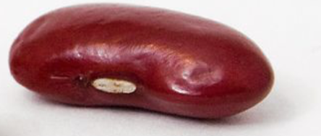
But any investment comes with a cost.
OR

Slide 41
The Game changers!

Slide 42
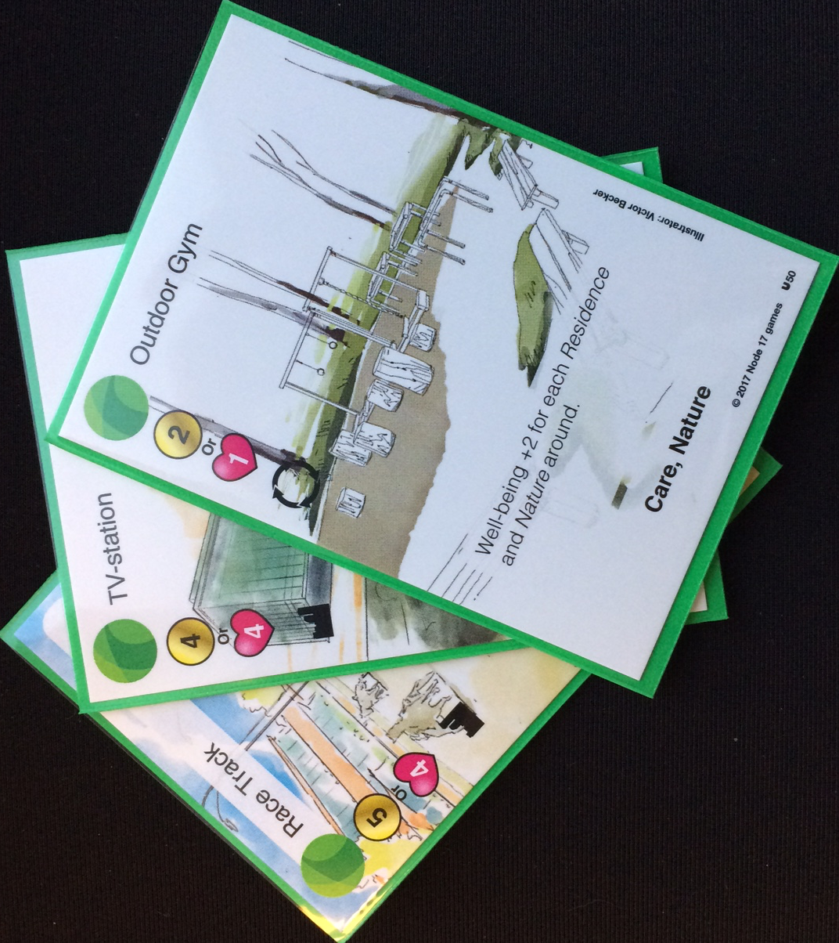
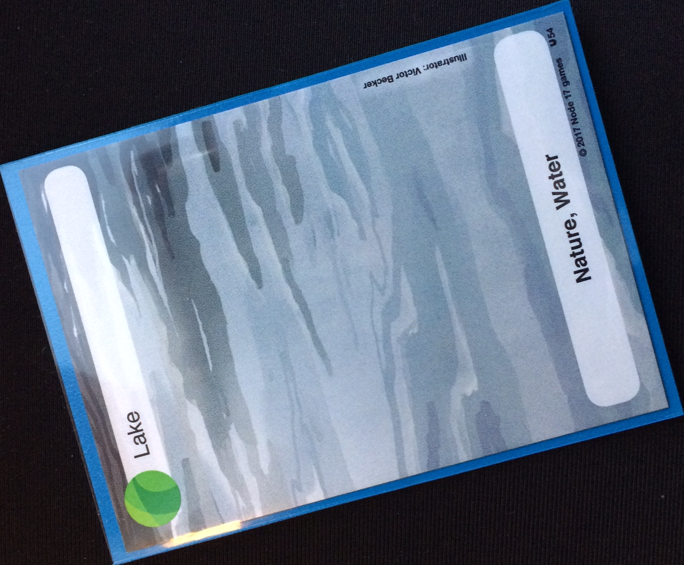
3 cards
Lake card
3 Buck beans
3 Well-being beans

Slide 43
Decide the shape of the lake

Slide 44
The youngest person around the table starts by taking a card from the pile and place it next to any lake card.

Slide 45
He/she then plays one of their own cards
Pays the investment cost

Slide 46
Recieve her/his ROI
If any!

Slide 47
Then take a new card from the pile.
And your turn ends!
The person on your left starts their turn.

Slide 48
The game ends after the 5th round.
(25 cards on the table)

Slide 49
Count your beans.
The one with the most wins.
If tie - the one with most well-being beans win!

Slide 50
Linda Gustavsson

Slide 51
Linda Gustafsson,
Gender Equality Officer

Slide 53
What is
needed in the
Good city?
5 min

Slide 54
Which citizen groups should benefit from the cities we build?

Slide 55
8 cards
Lake card
No Buck beans
No Well-being beans

Slide 56
Decide the shape of the lake

Slide 57
Count your beans.
The one with the most wins.
If tie - the one with most well-being beans win!
Look at your 8 cards.
Discard 4 of them.

Slide 58
The youngest person around the table starts by taking a card from the pile and place it next to any lake card.

Slide 59
He/she then plays one of his own cards
At no investment cost

Slide 60
Recieve the city´s ROI
If any!

Slide 61
The person on your left starts their turn.

Slide 62
The game ends after 3 rounds.
(13 cards on the table)

Slide 63
Count the beans.
The city with the most wins.
If tie - the one with most well-being beans win!

Slide 64
Are we on the right track -
Using games as a tool trying to reach new audiences?
How would games have a place in your organizations ?

Slide 66
2 Bucks for every
Daycare
Hospital
Retirement Home
On the table

Slide 67
The benefit from your investment is counted for when played

Slide 68
Some cards gives benefits if placed
near another card

