Slide 1
28-30 September 2016
This presentation includes key takeaways from Innovation Pioneers first arranged trip to renowned Massachusetts Institute of Technology- MIT in Boston. This unique opportunity was offered to all member organizations of the network when MIT shared their profound knowledge of entrepreneurship and how a system of partnerships between an institution of Innovation, companies and organizations work.
A presentation by Niclas Ingeström, Stena and Shirine Bauer, Googol

Slide 2
- Cambridge Innovation Center
CIC started in 1999 with a vision and a simple idea: “Startups make the world much better. We can help them by setting up and managing their office for them so they can focus on their business.” We believed we could do that better than anyone else and we set out to prove it. Since then, more than 1400 companies have chosen CIC as their home and many have gone on to prove their value to the world as startups. More than $1.8B of venture capital has been invested in companies that were headquartered at CIC. We now house over 800 companies, most of them startups, and we haven’t stopped making CIC better every day.
http://boston.cic.us
Mr Stas Gayshan
Managing Director

Slide 3
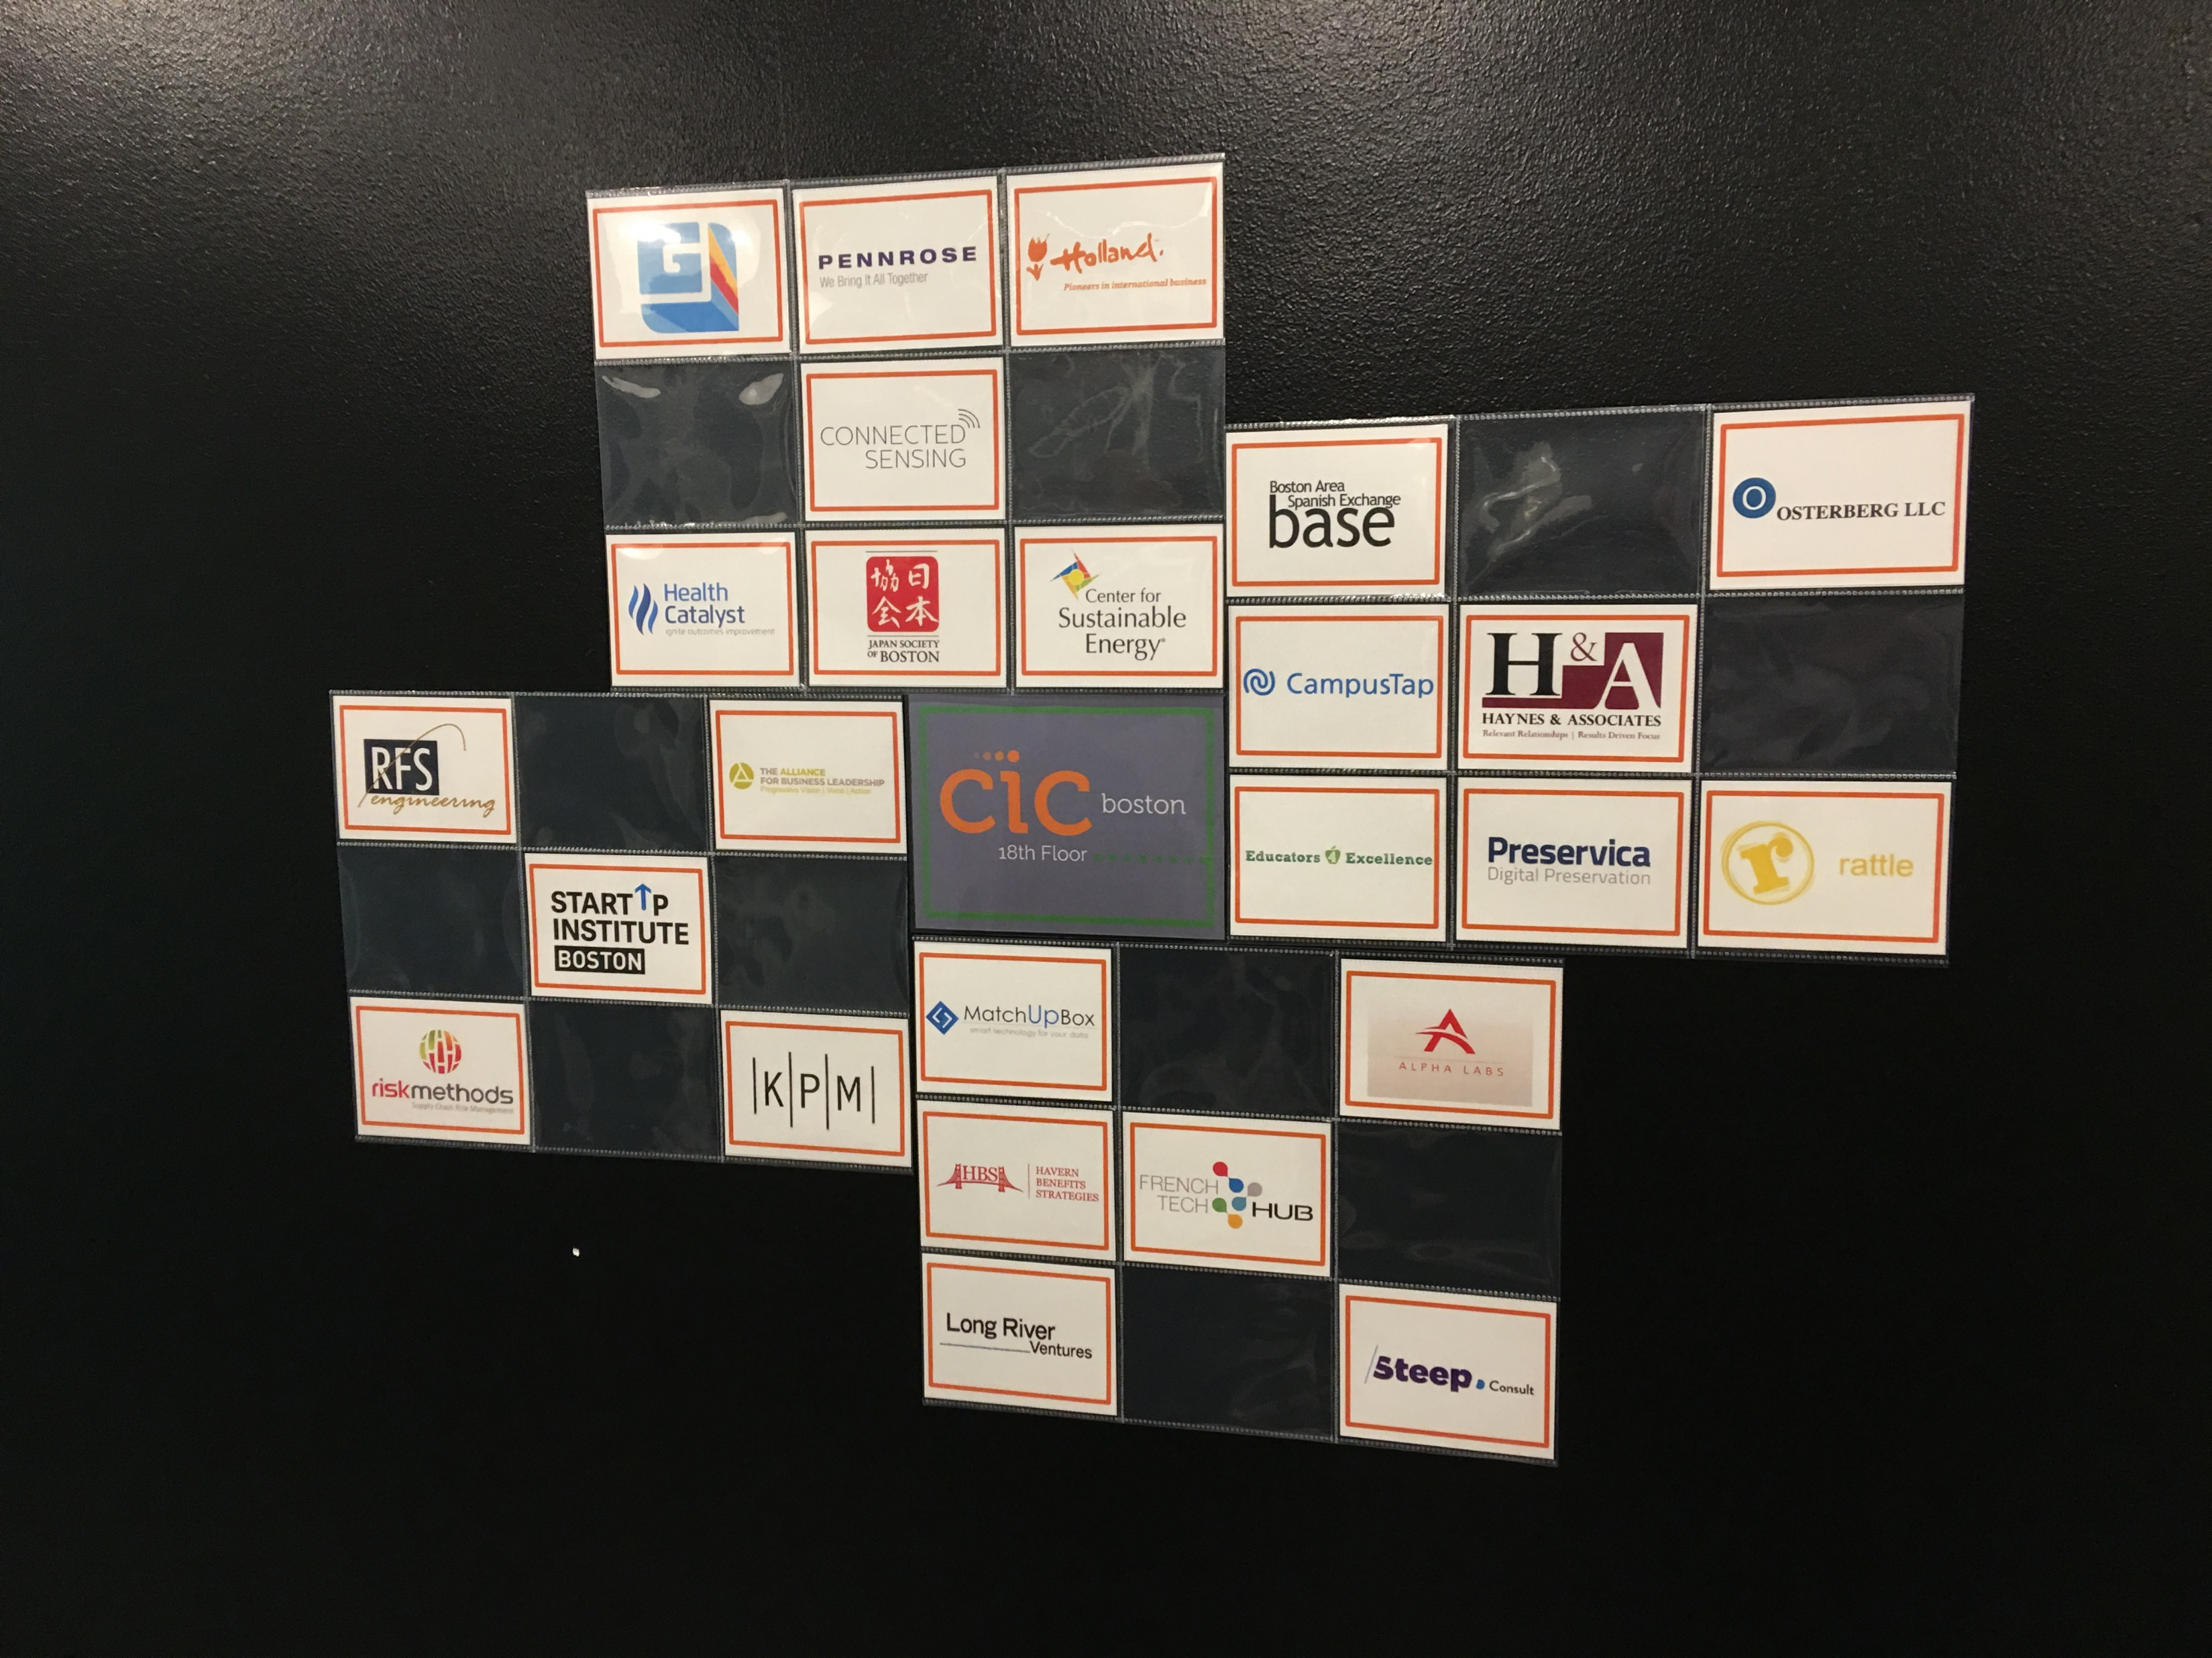
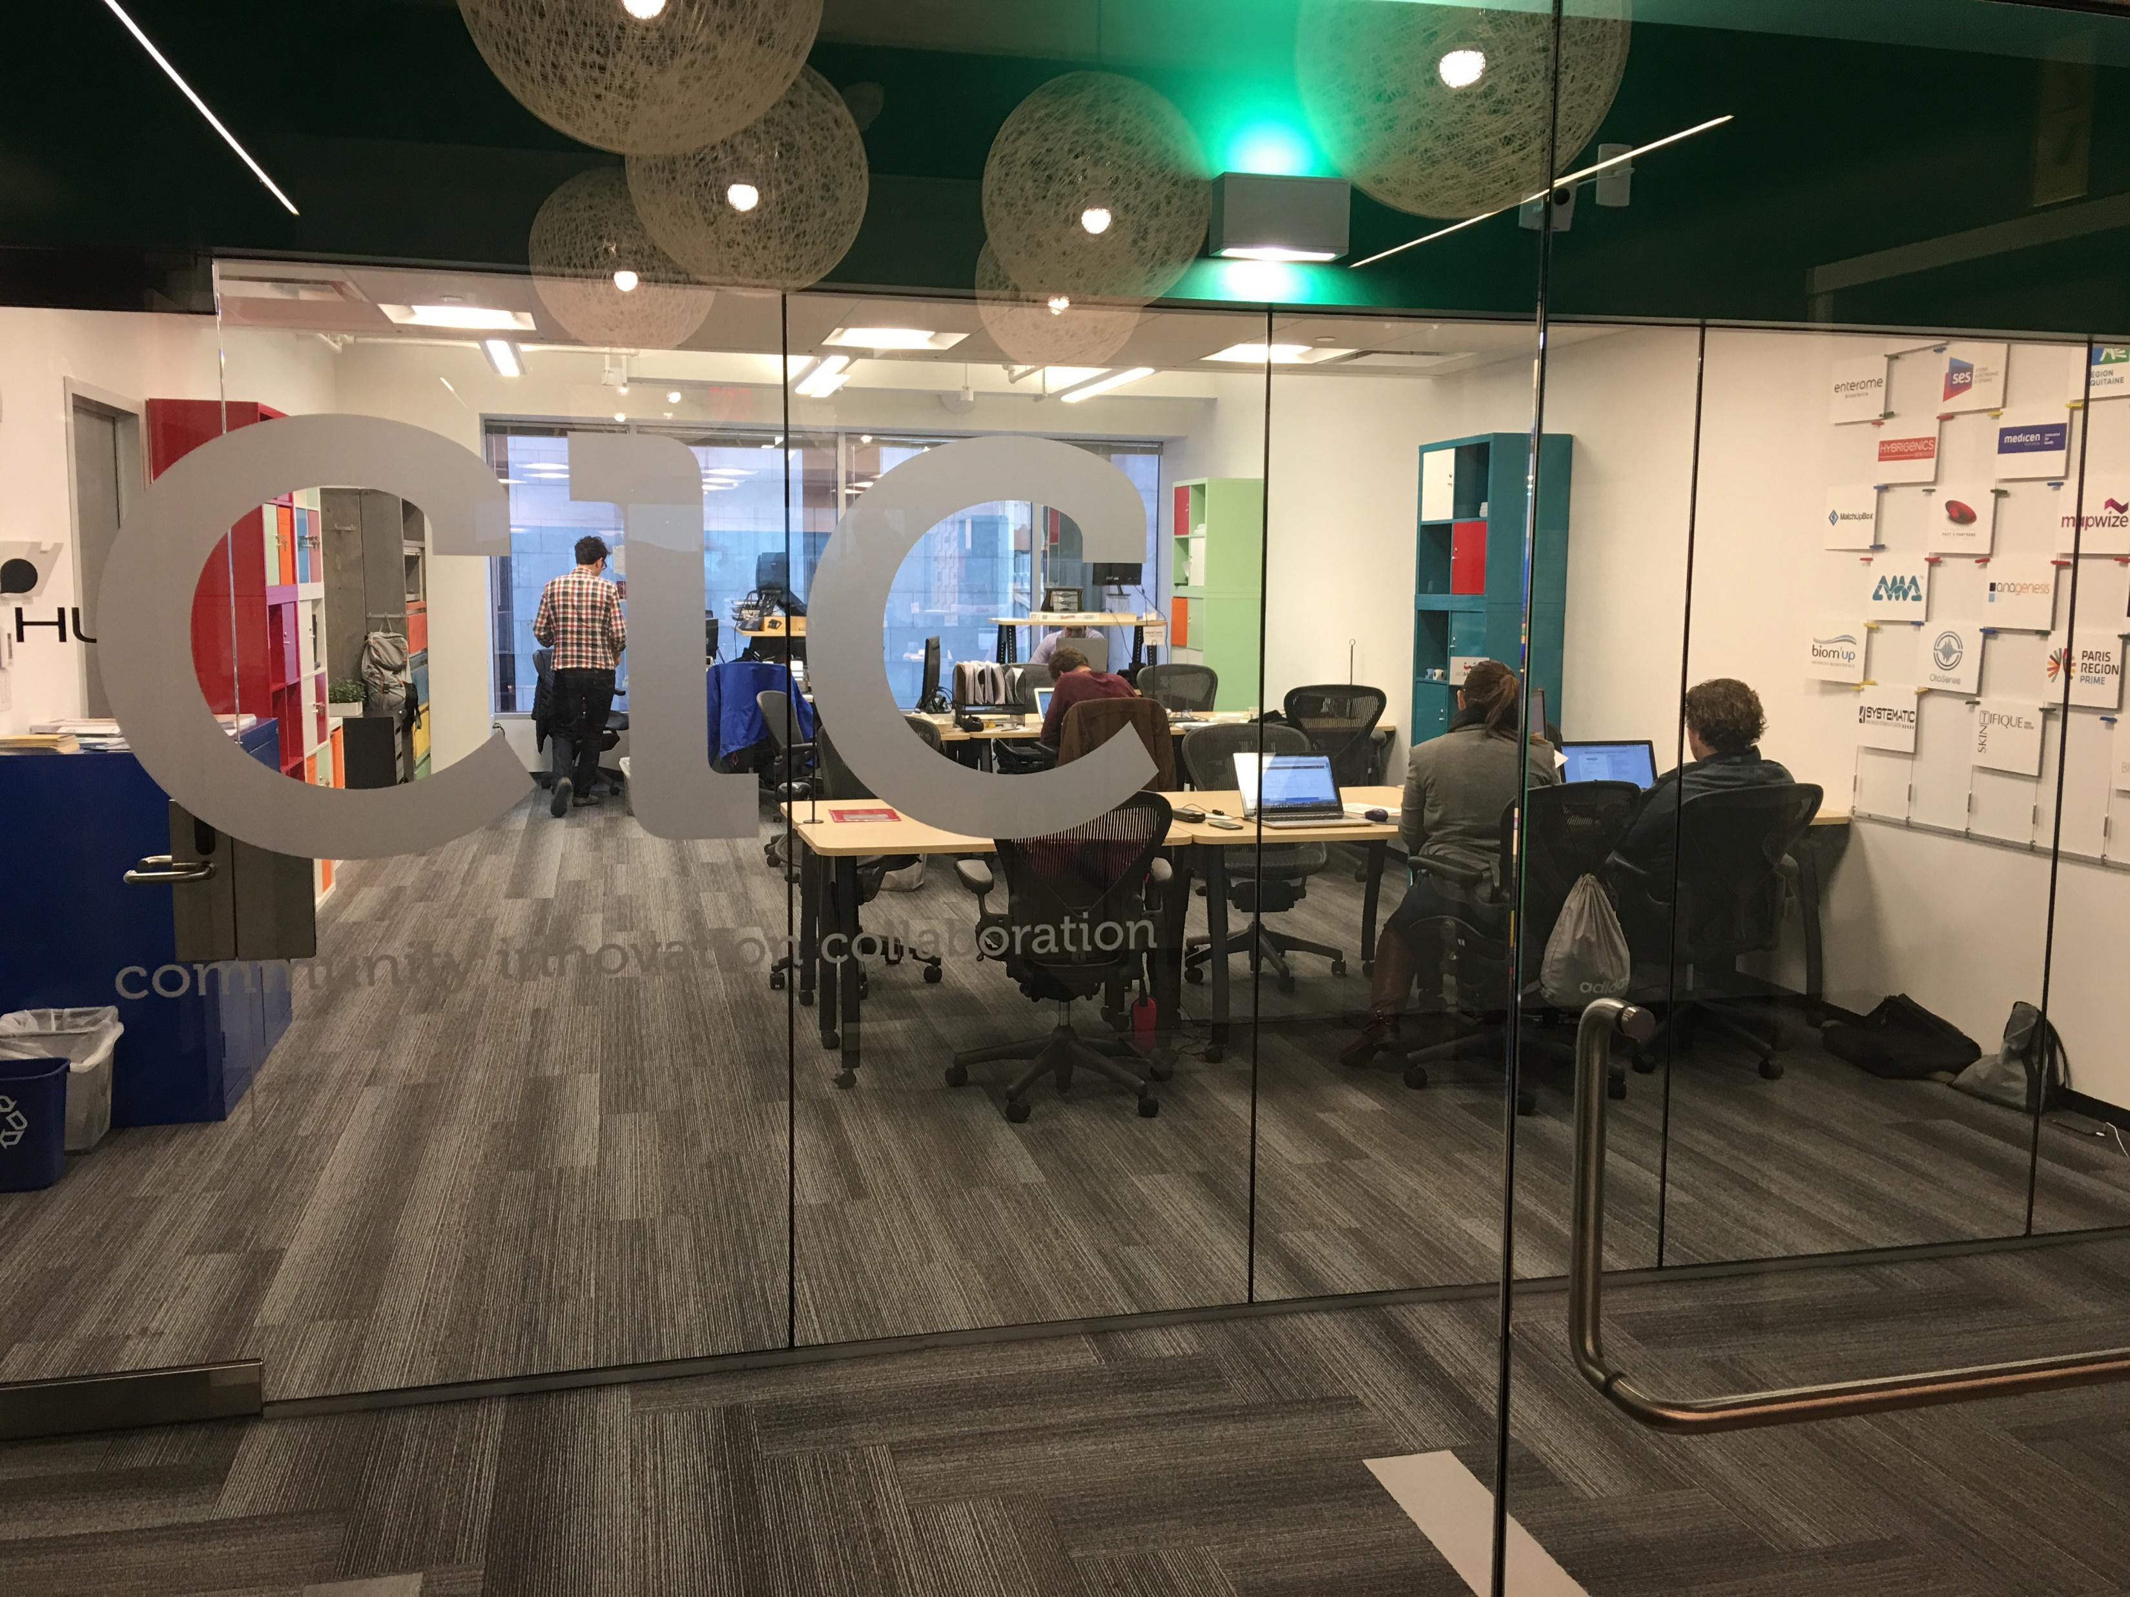

Slide 4
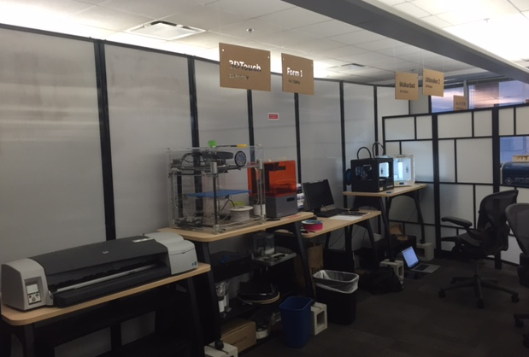
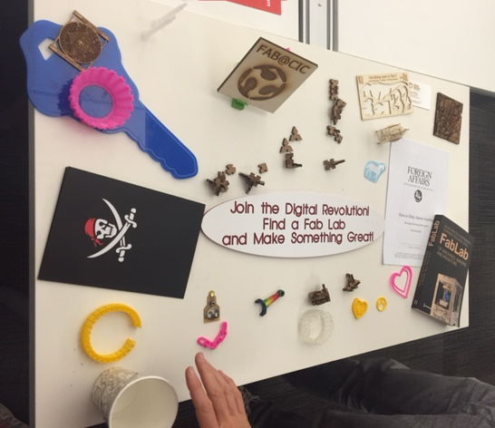
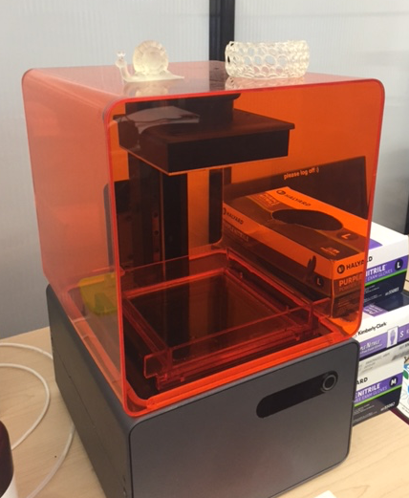

Slide 5
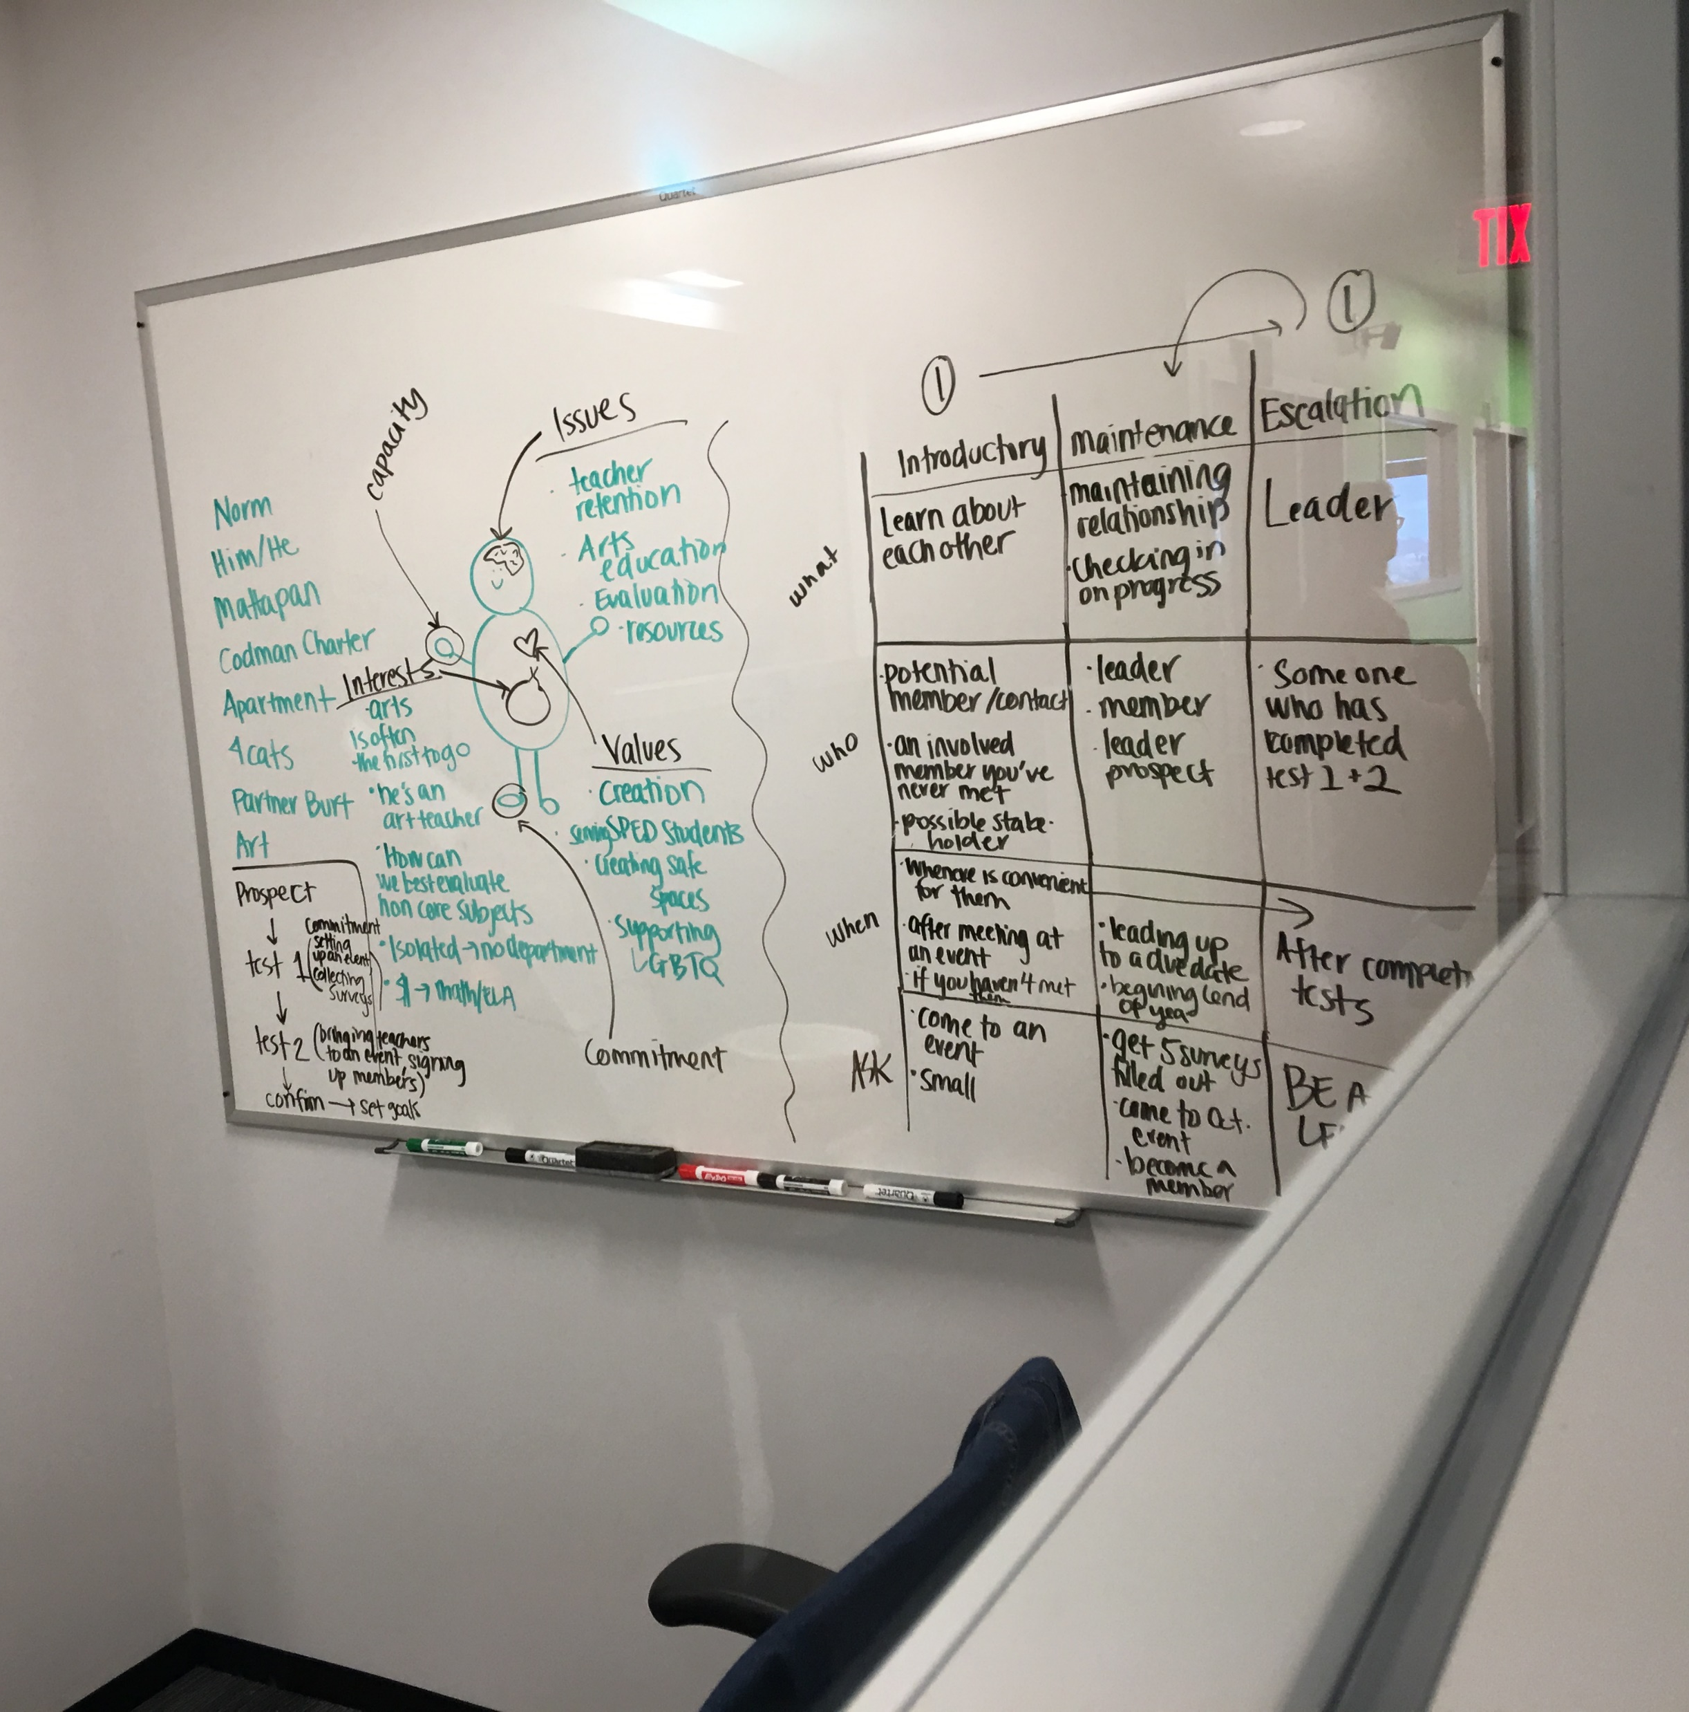
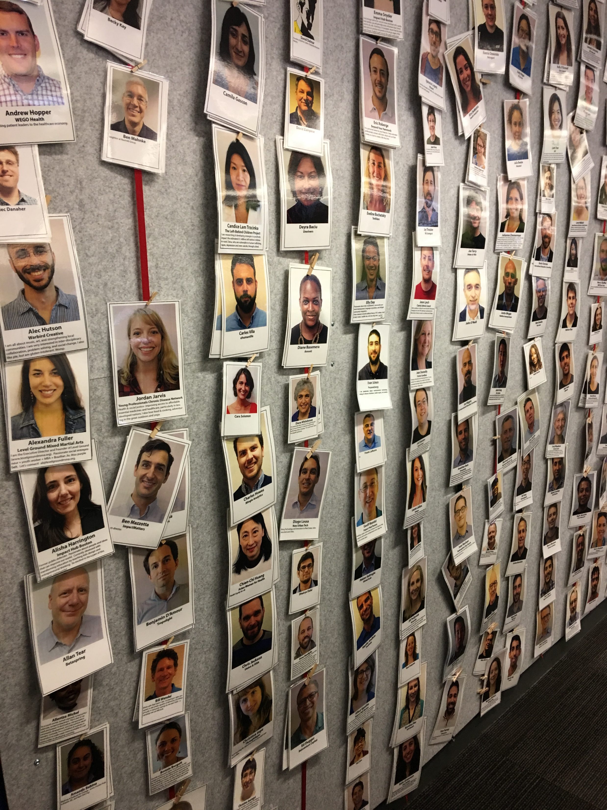

Slide 6
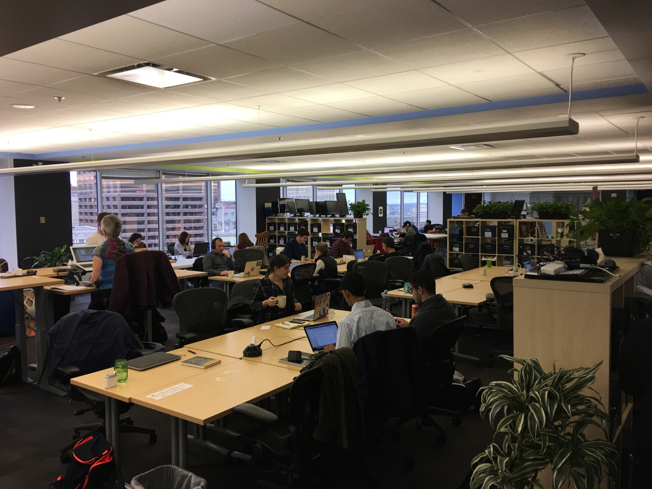
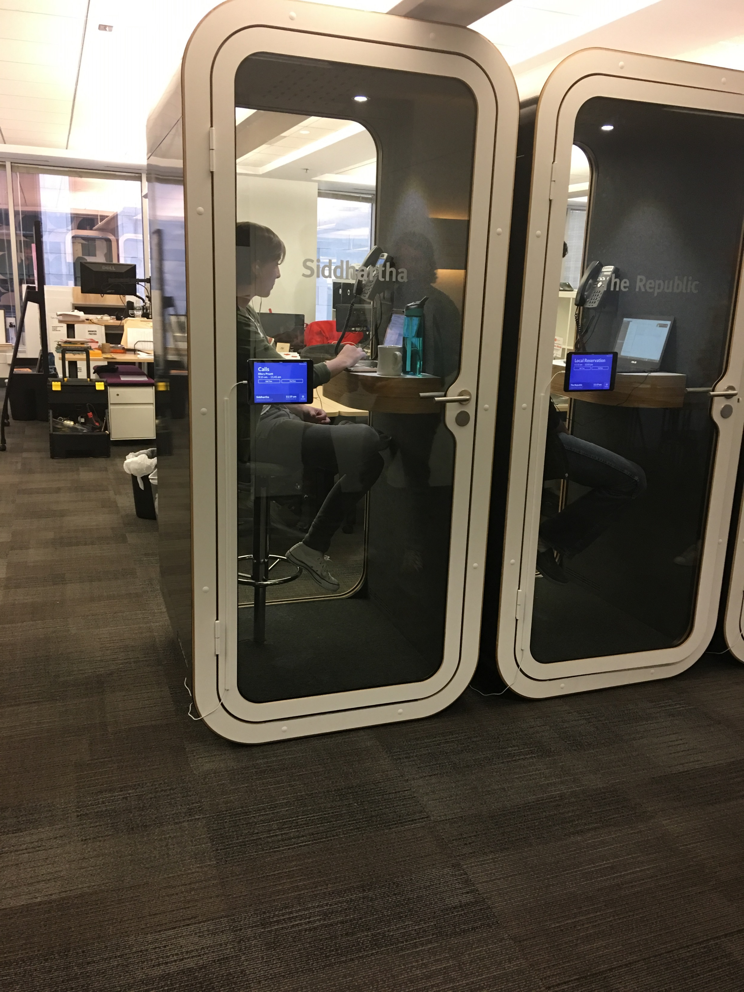

Slide 7
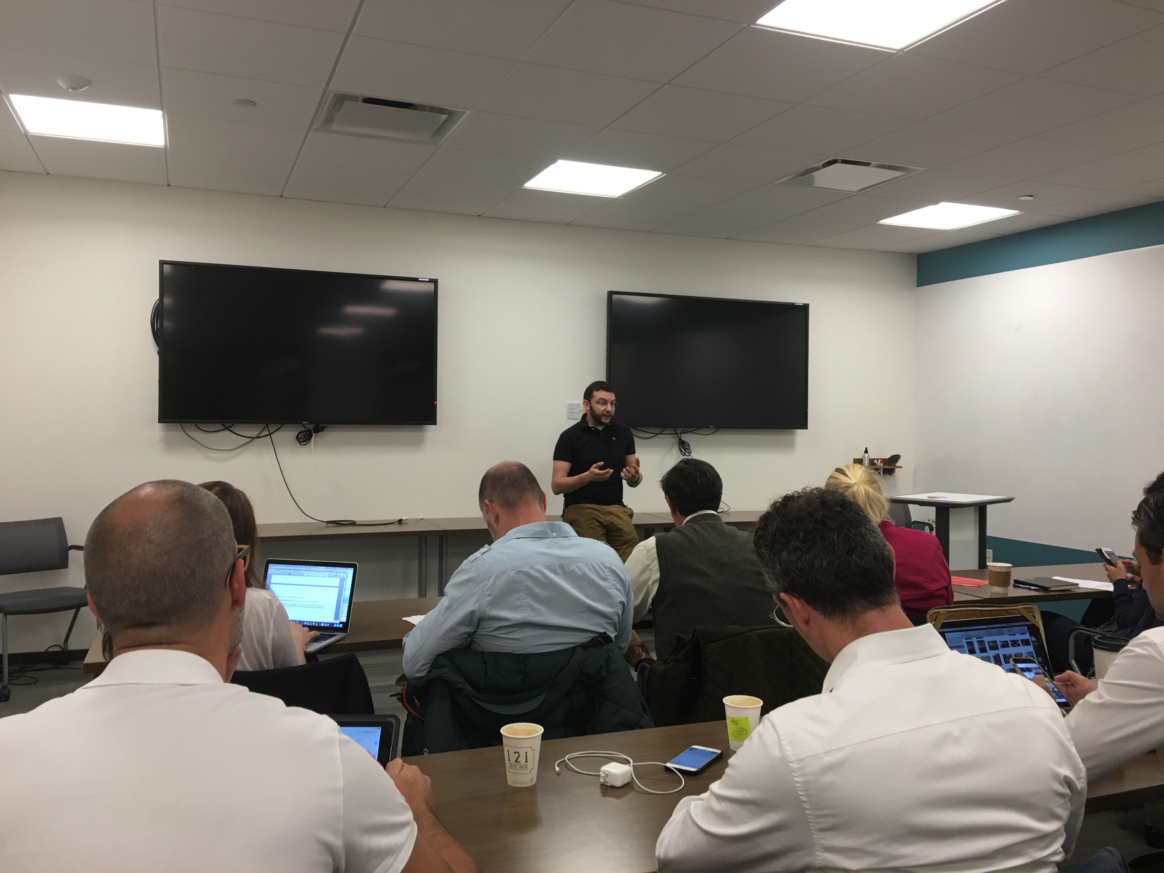
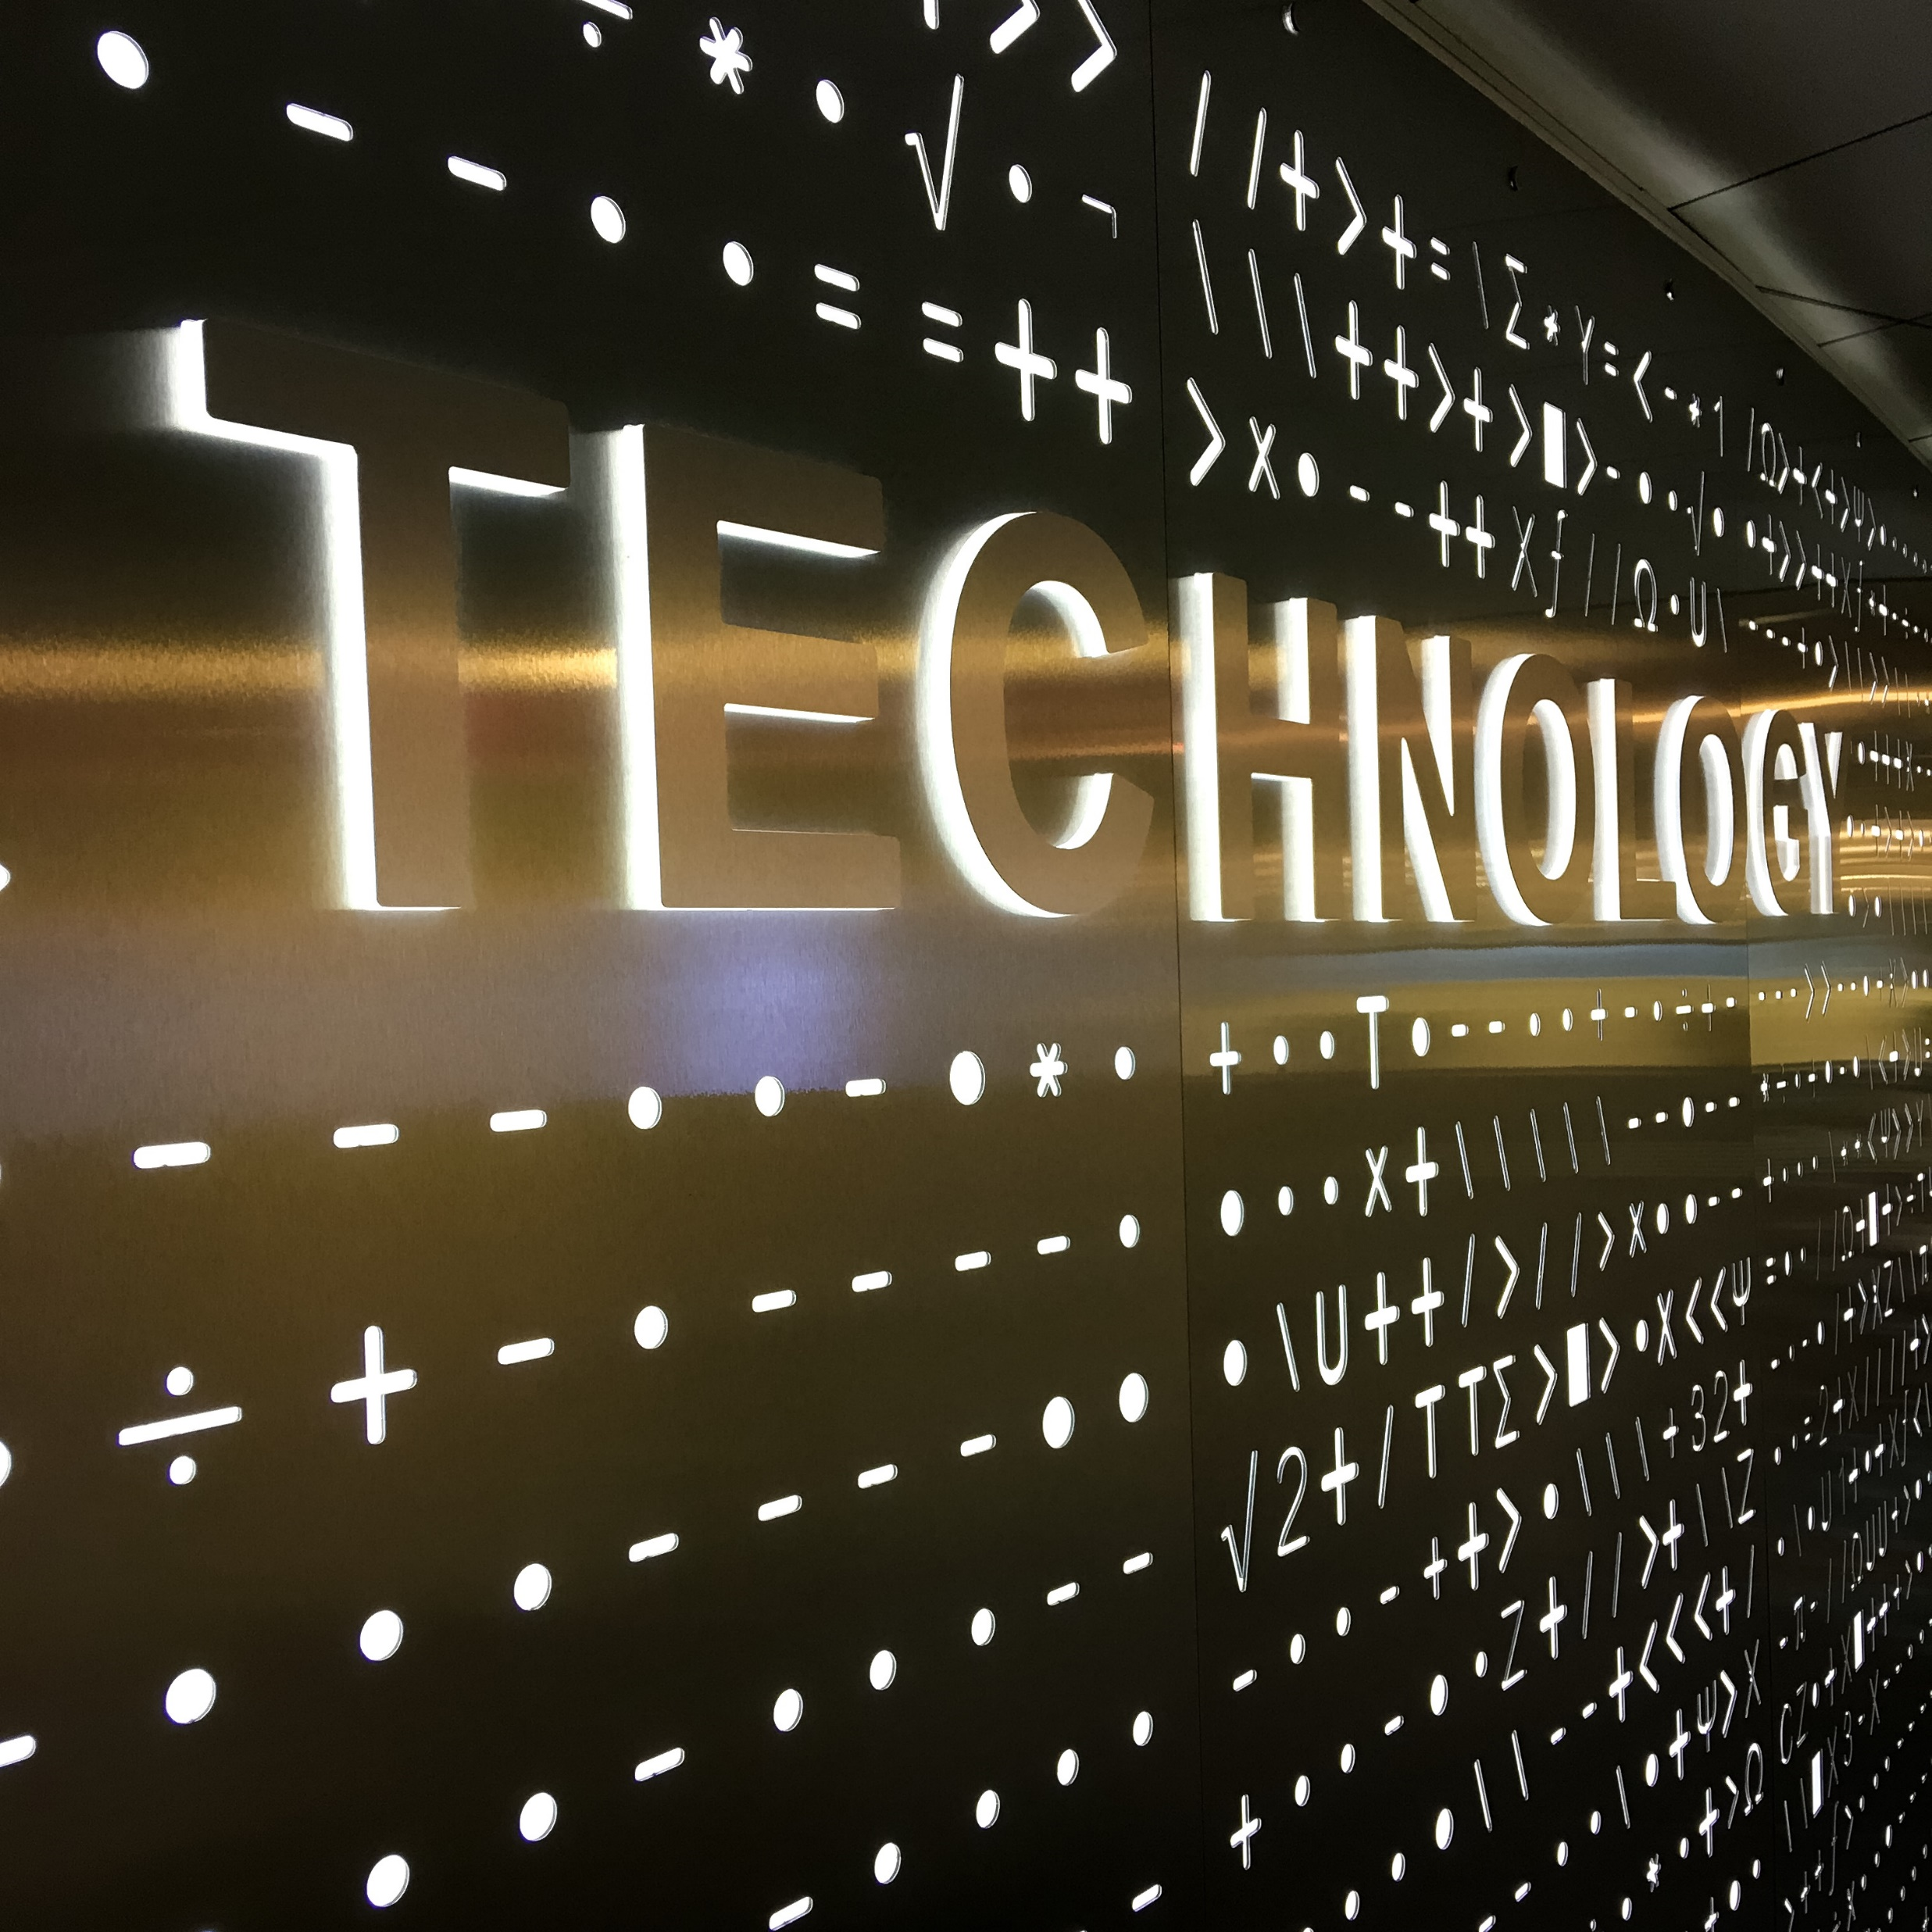

Slide 9
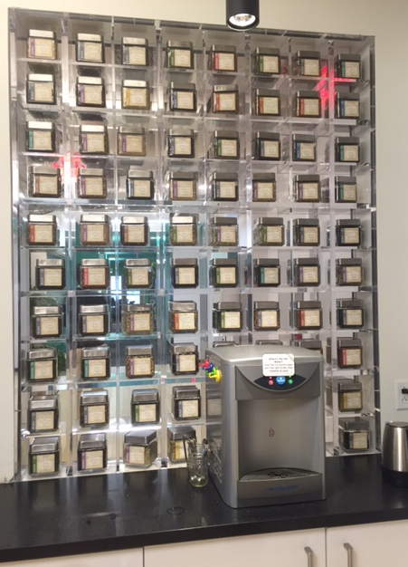
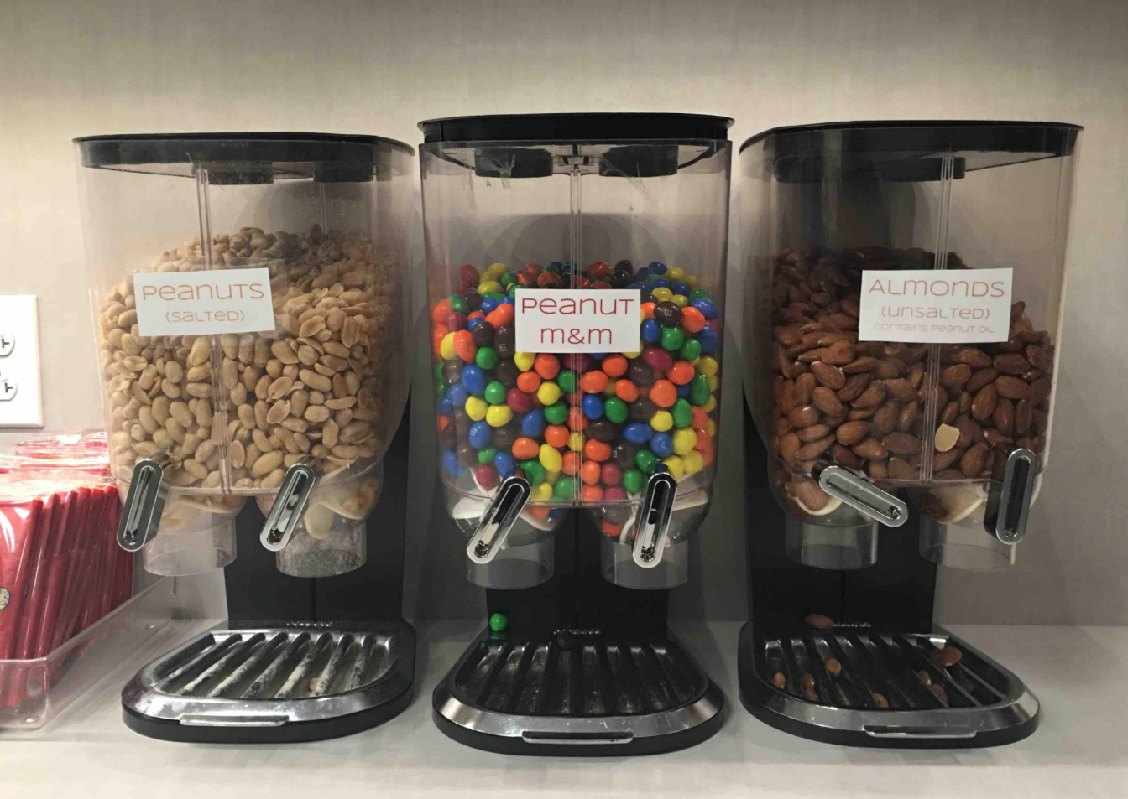

Slide 10
Comments Cambridge Innovation Center
Venture capitalists in the building.
Open areas.
A lot of white boards.
Sharing.
Coffee machine (again) and snacks on different floors.
A lot of common areas like labs, etc.
The most important is to contribute.
Events creates audience.
Help with legal and patents .
The big innovations happen at the universities or at start-ups. One reflection is that it is true.
The building. If you are going to have an office, it needs to add value to the employees and companies.
It needs to be a balance between adding value to myself but also for the company
Inspiration of seeing the companies
The balance of being open, sharing different disciplines, and communication between parts.
The megatrend is that large companies have had an advantage over the small companies. Today, it is the opposite. Today the small companies are given such large opportunities with the spaces that are offered and therefore the large companies does not have chance.

Slide 11
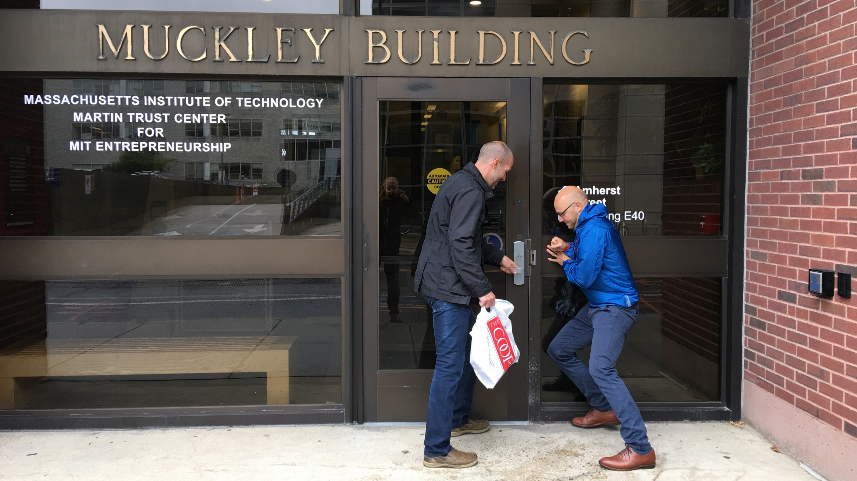
MIT is closed for innovation during weekends ☺

Slide 12
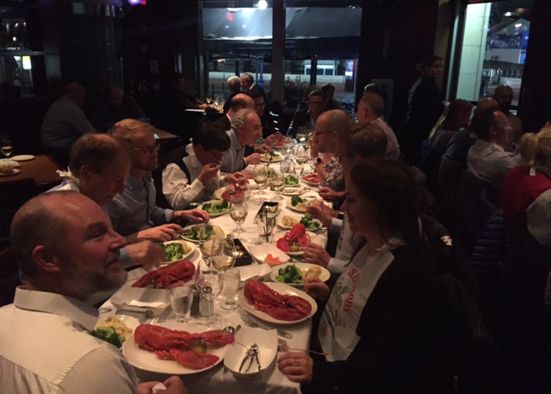
“This trip is definitely something I will remember when I retire”
- Participant

Slide 13
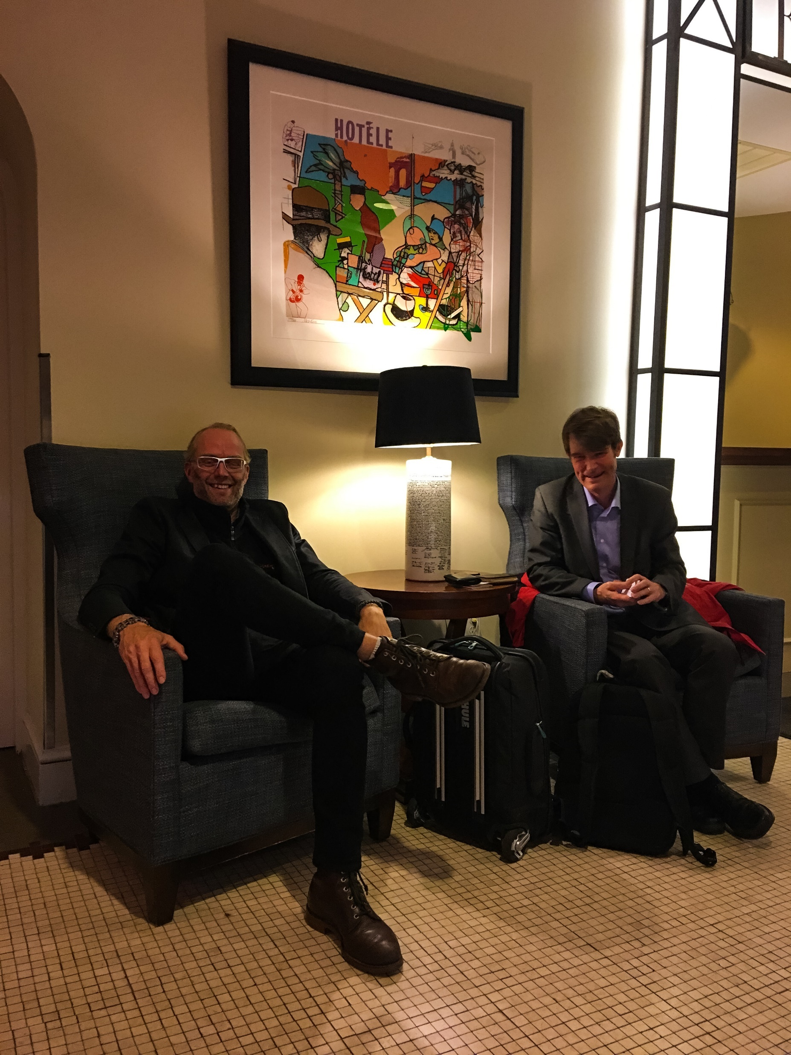
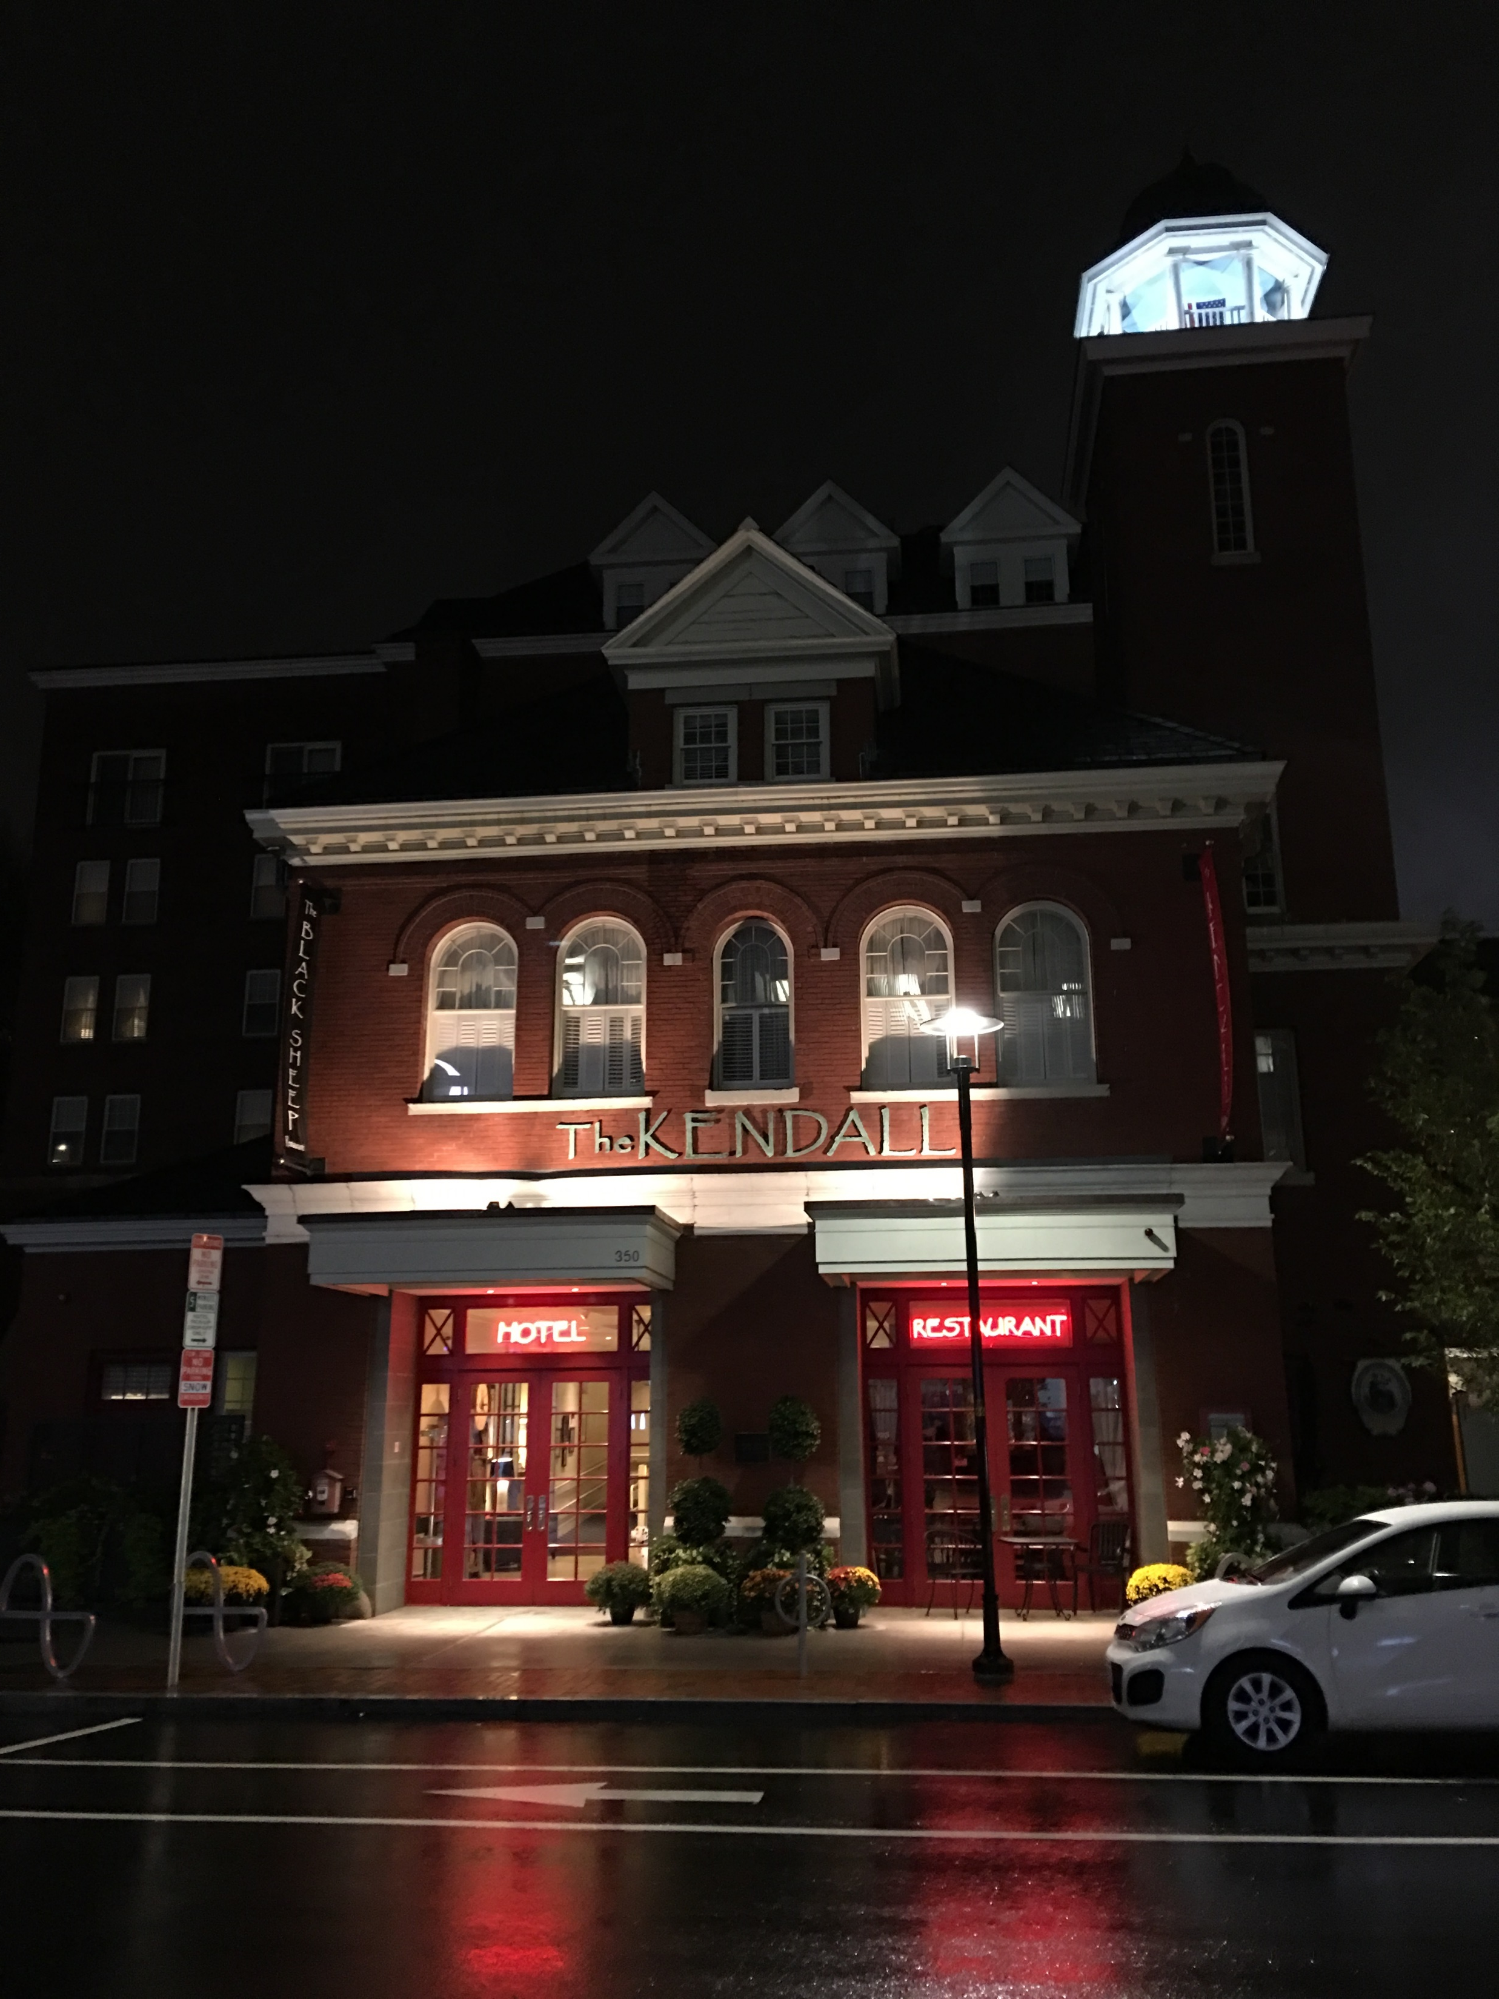
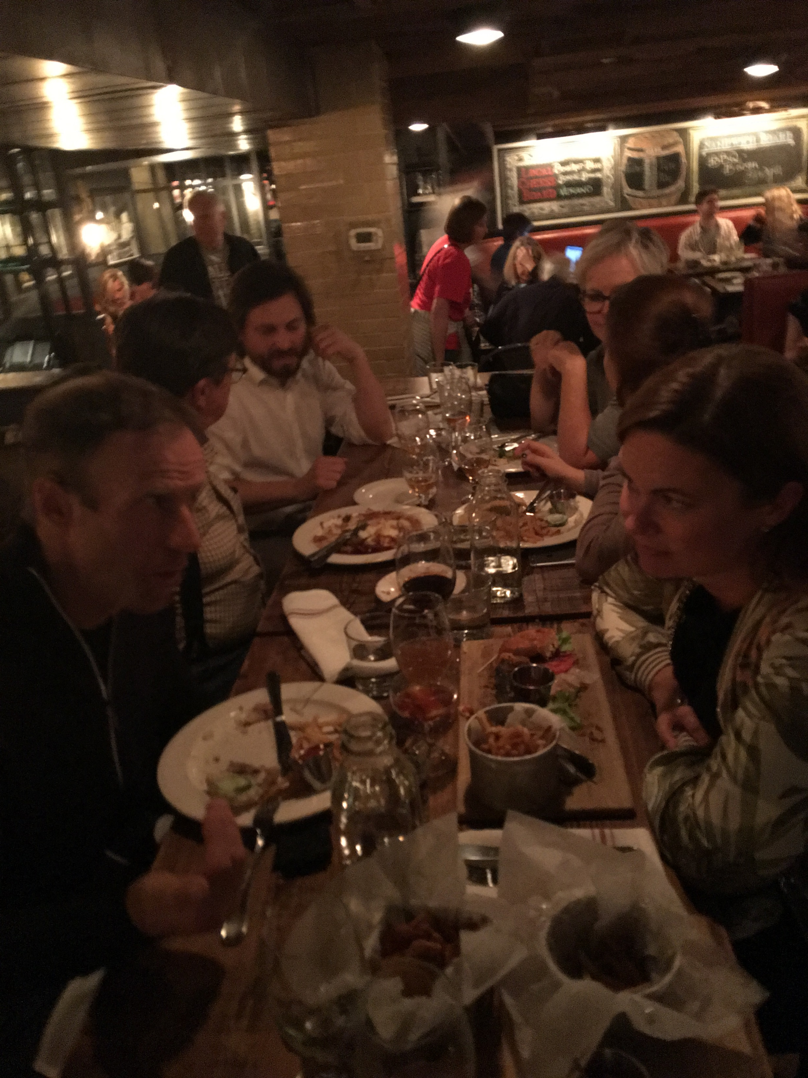
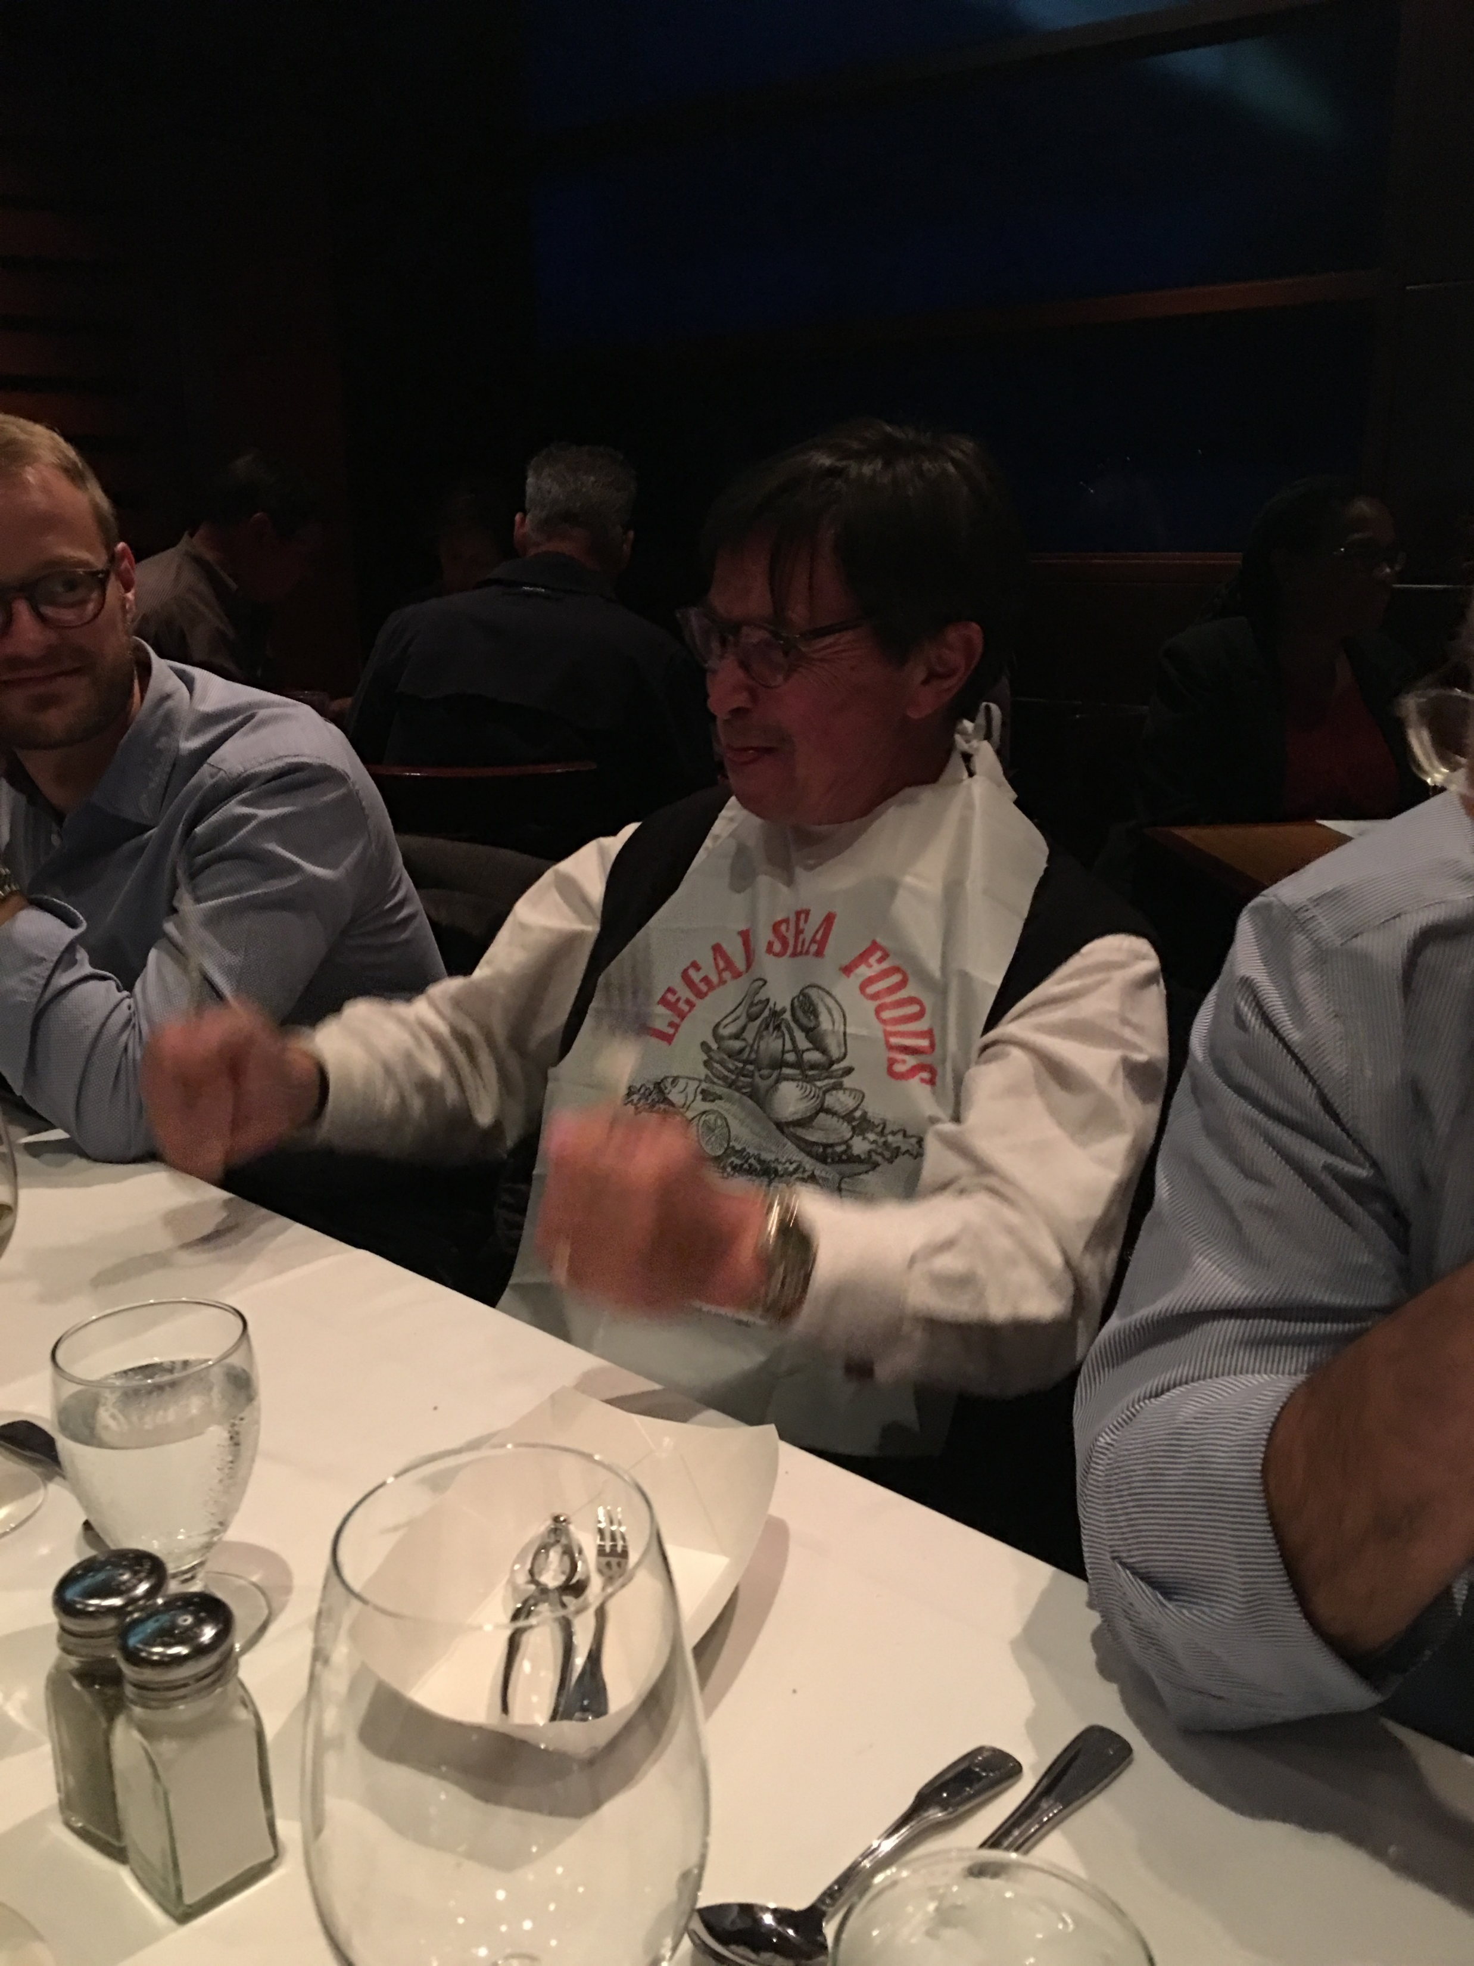
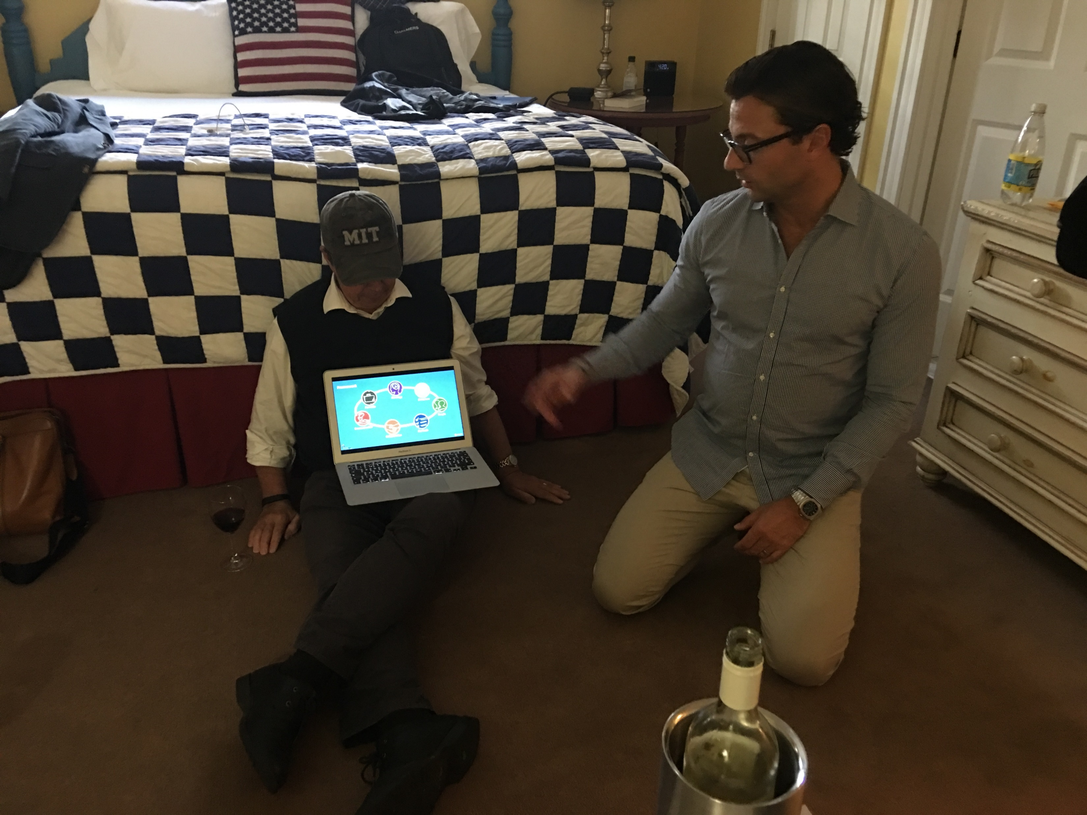
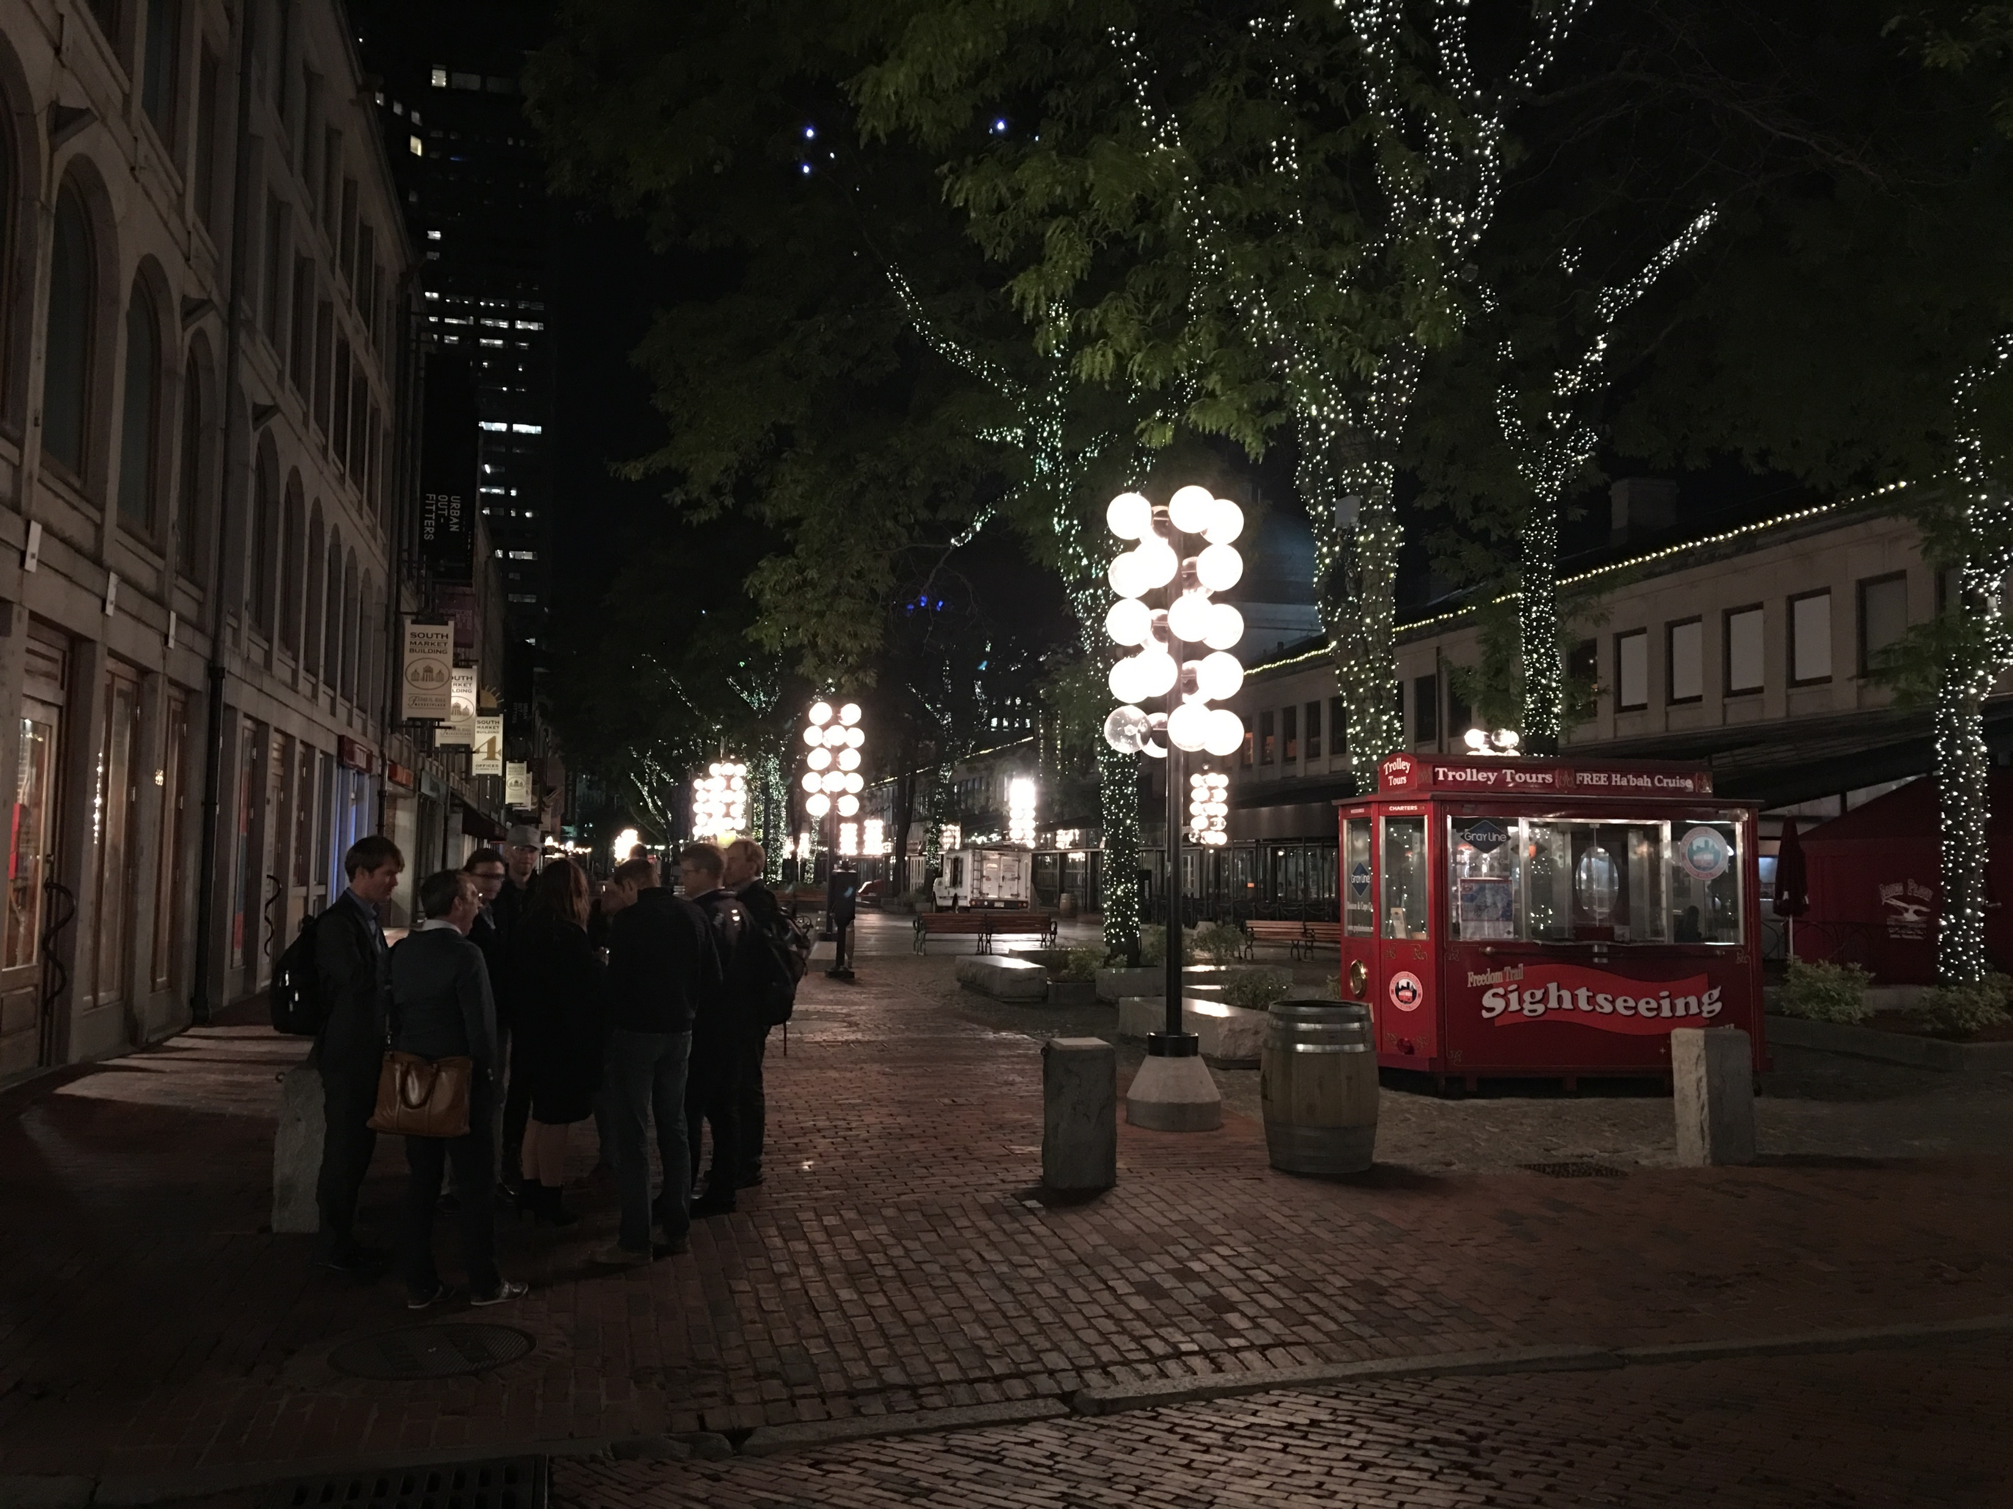

Slide 14
Many thanks to the Chairman of Innovation Pioneers, Niclas Ingeström and Shirine Bauer for summarizing the trip in this presentation!
Another thanks to all participants who joined us on this memorable trip- it would not have been the same without this dynamic, qurious and open group!
However, this trip would not have happened if it was not for Innovation Pioneers Kim Silvasti who made everything happen.

