Slide 1
28-30 September 2016
This presentation includes key takeaways from Innovation Pioneers first arranged trip to renowned Massachusetts Institute of Technology- MIT in Boston. This unique opportunity was offered to all member organizations of the network when MIT shared their profound knowledge of entrepreneurship and how a system of partnerships between an institution of Innovation, companies and organizations work.
A presentation by Niclas Ingeström, Stena and Shirine Bauer, Googol

Slide 2
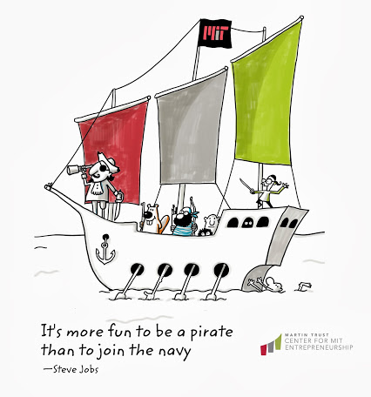
- Martin Trust Center for MIT Entrepreneurship
The Martin Trust Center for MIT Entrepreneurship provides the expertise, support, and connections MIT students need to become effective entrepreneurs. We serve all MIT students, across all schools, across all disciplines.
http://entrepreneurship.mit.edu/
Mr William (Bill) Aulet
Managing Director at Martin Trust Center
Elaine Chen
Entrepreneur-in-Residence, Professional Advisor and Senior Lecturer
Sarah Jane Maxted
Executive Director, MIT Regional Entrepreneurship Program & MIT Innovation Initiative Team Member (MIT REAP)

Slide 3
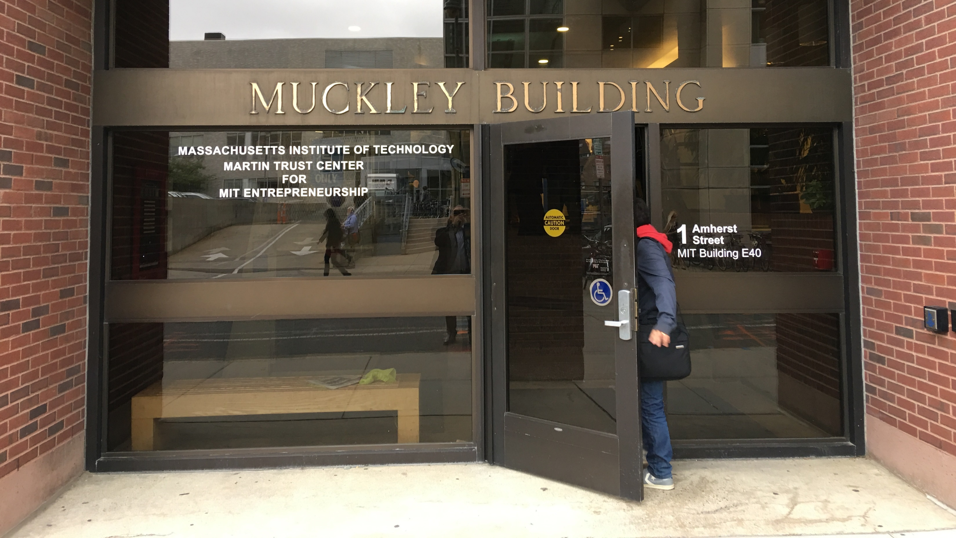

Slide 5
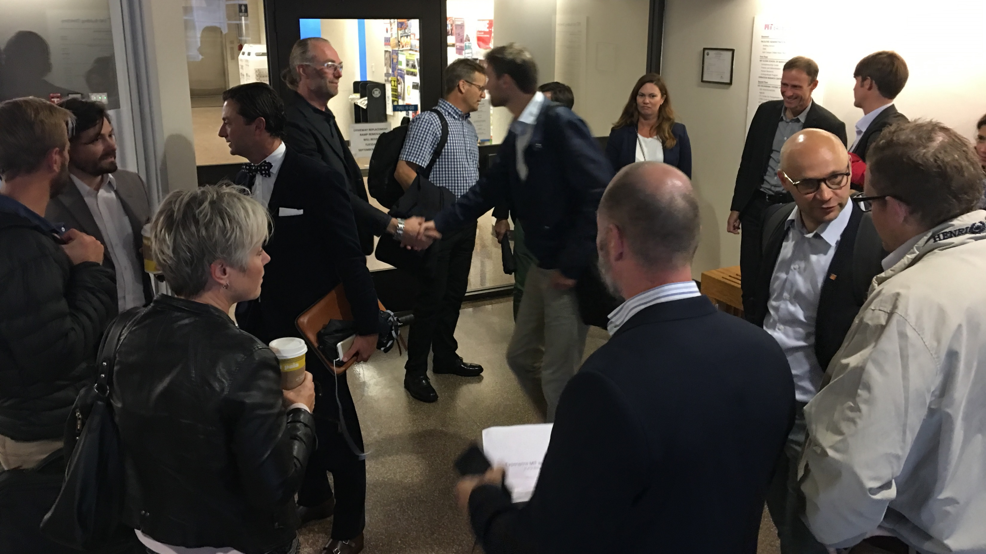

Slide 6
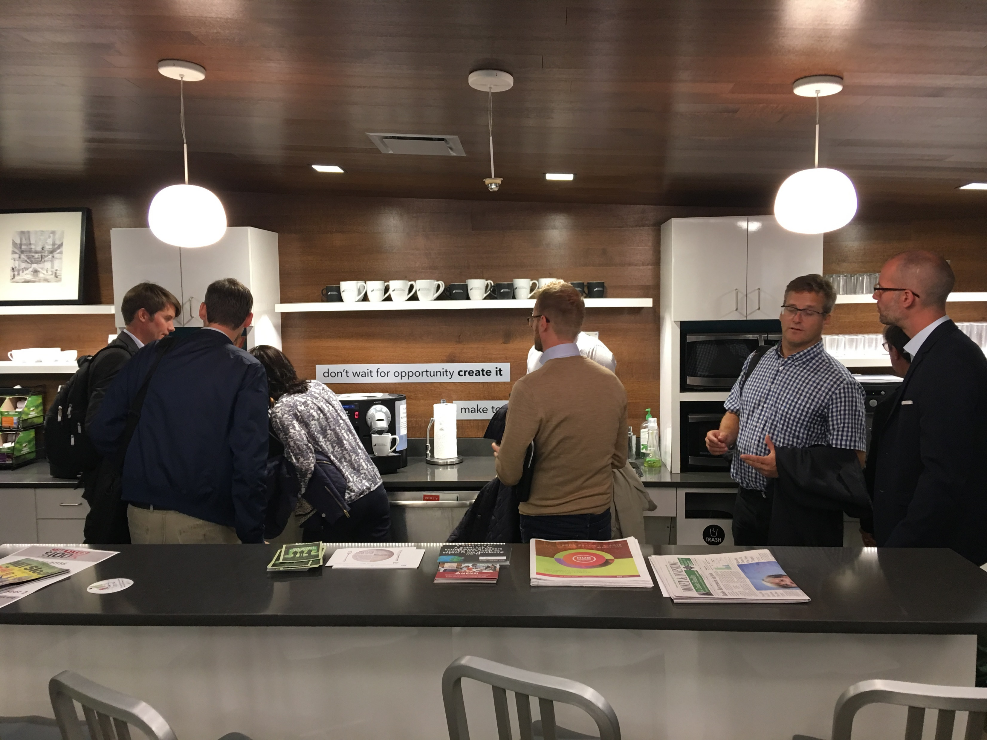
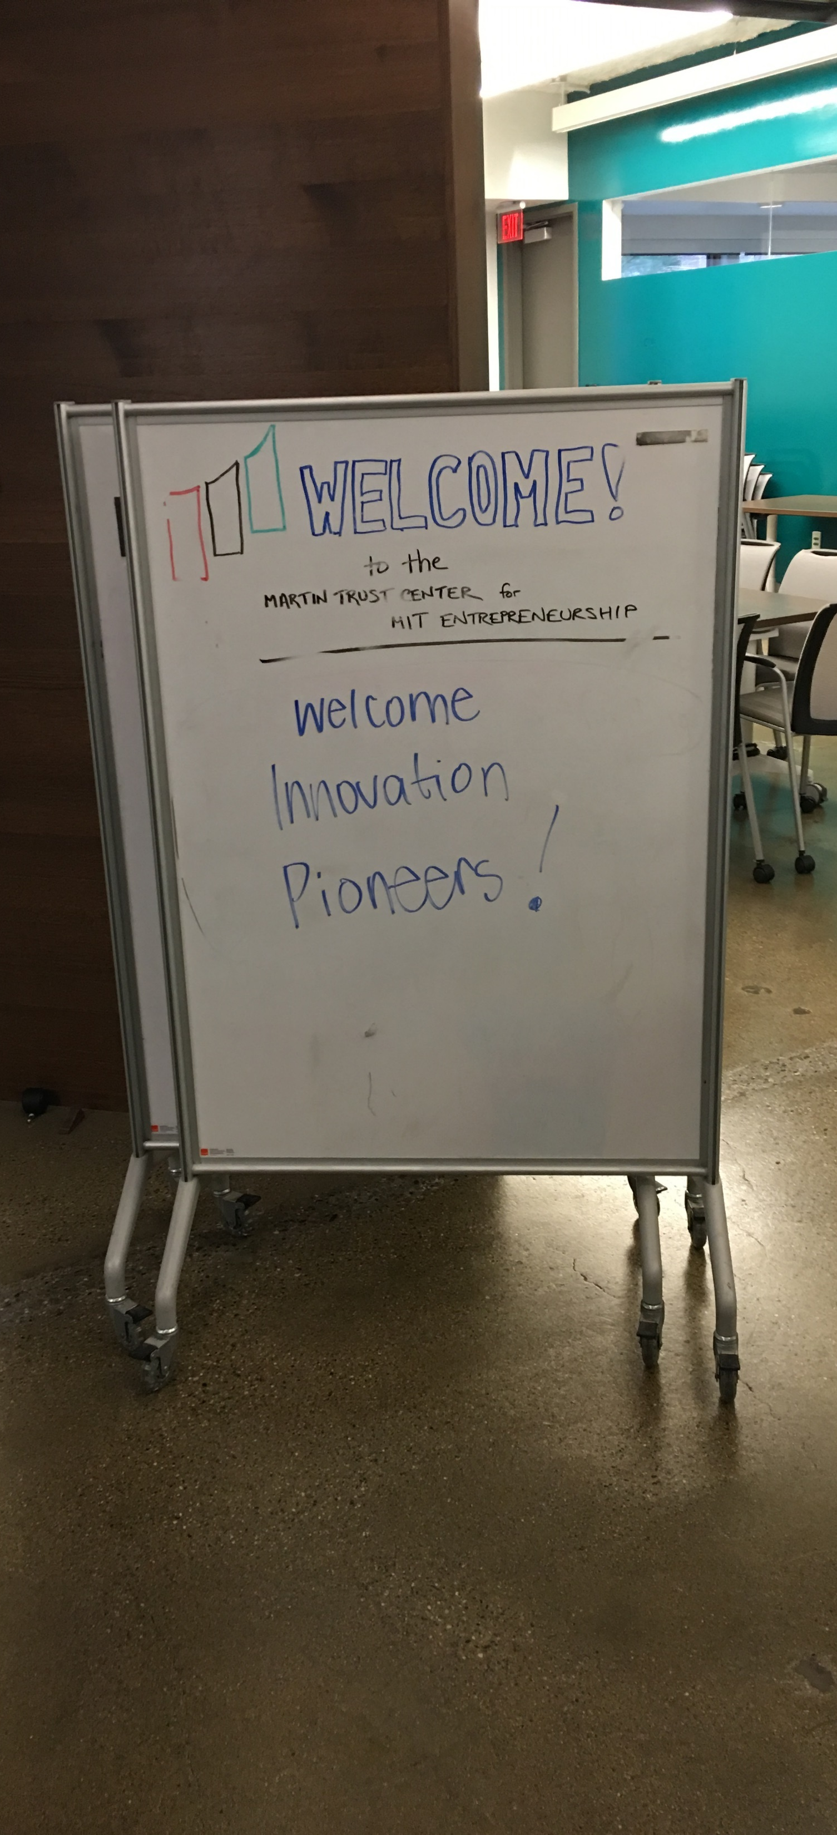

Slide 7
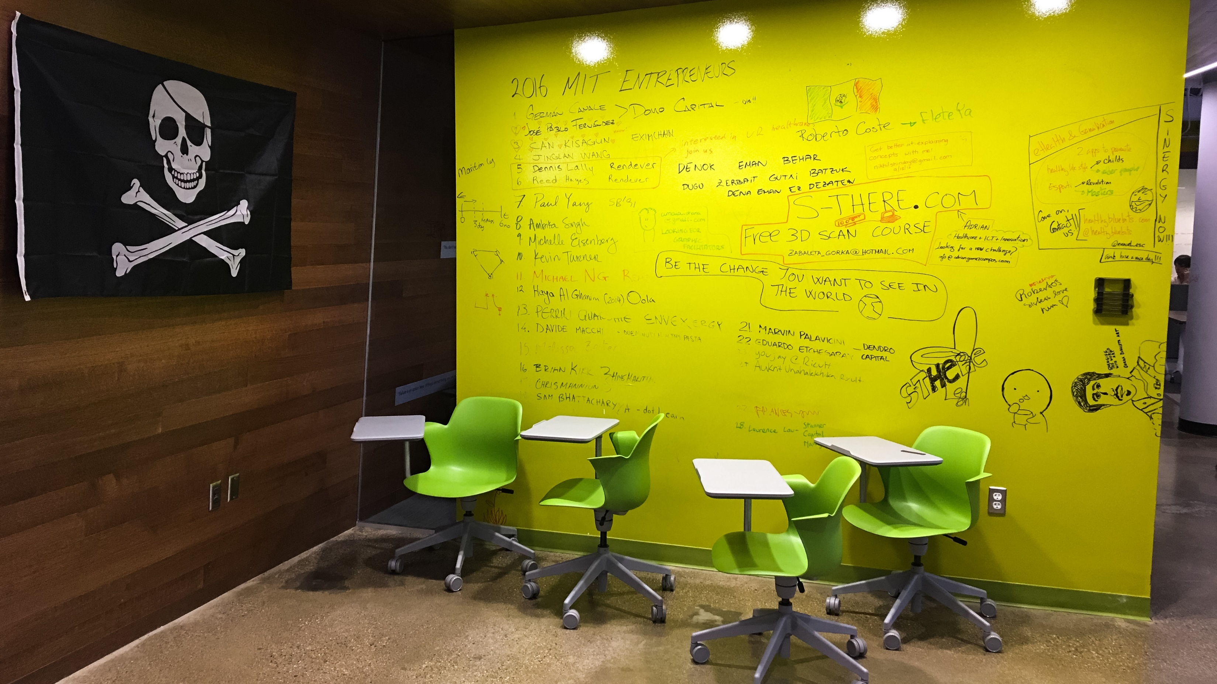

Slide 9
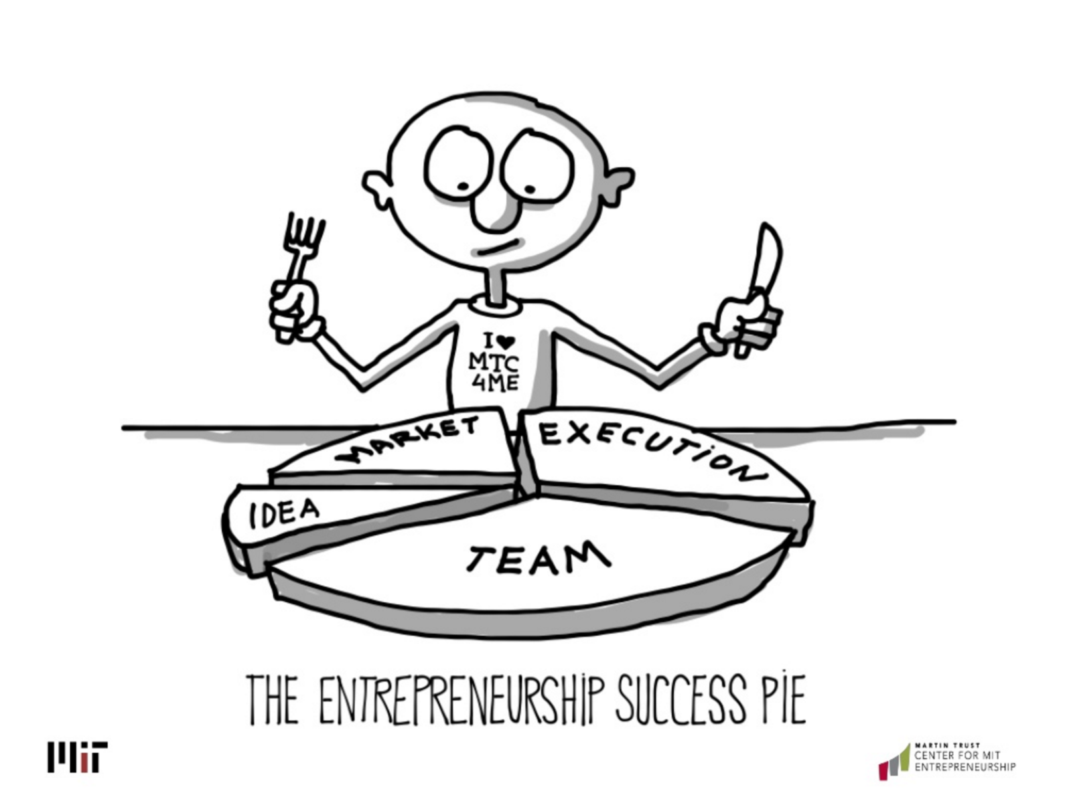
“Martin Trust Center focus on the commercialization process of innovation”

Slide 15
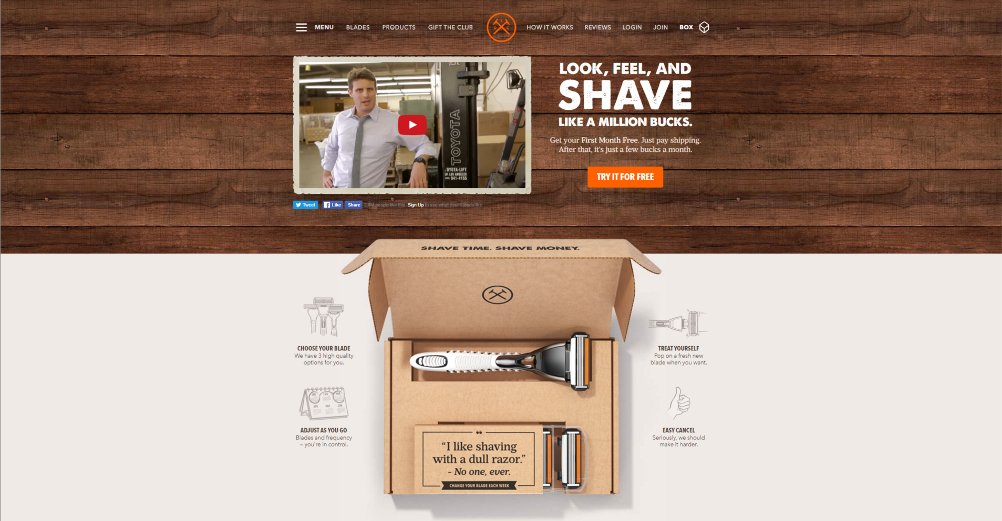

Slide 17
Link to a similar presentation on SlideShare by Bill Aulet - ”Entrepreneurship Education”

Slide 18
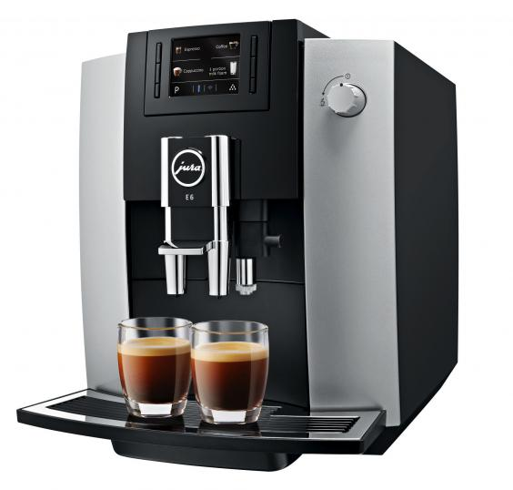
Comments Martin Trust Center for MIT Entrepreneurship
If the interior looks like a board room, it defeats innovation and creativity
Write on walls.
Do not worry about failing.
Have crazy and diversified people.
Open space without security.
Best coffee machine in the world.
Embrace to do crazy stuff.
Loud + quiet places.
Teach about entrepreneurship.
The idea is not so important in entrepreneurship, team market execution is more important.
The worst nightmare for established businesses are the crazy startup.
Hungry dogs hunt best.
You have nothing to lose, hard in big cooperation's.
Most use story telling do teach entrepreneurship.
Dollar Shave Club www.dollarshaveclub.com
Know your customer, New business model, Billionaire, Funny, Gilette scared and they cannot do this, will kill their own business, The only thing Gilette can do is to cut of the source
It must be a mix of external and internal people

Slide 19
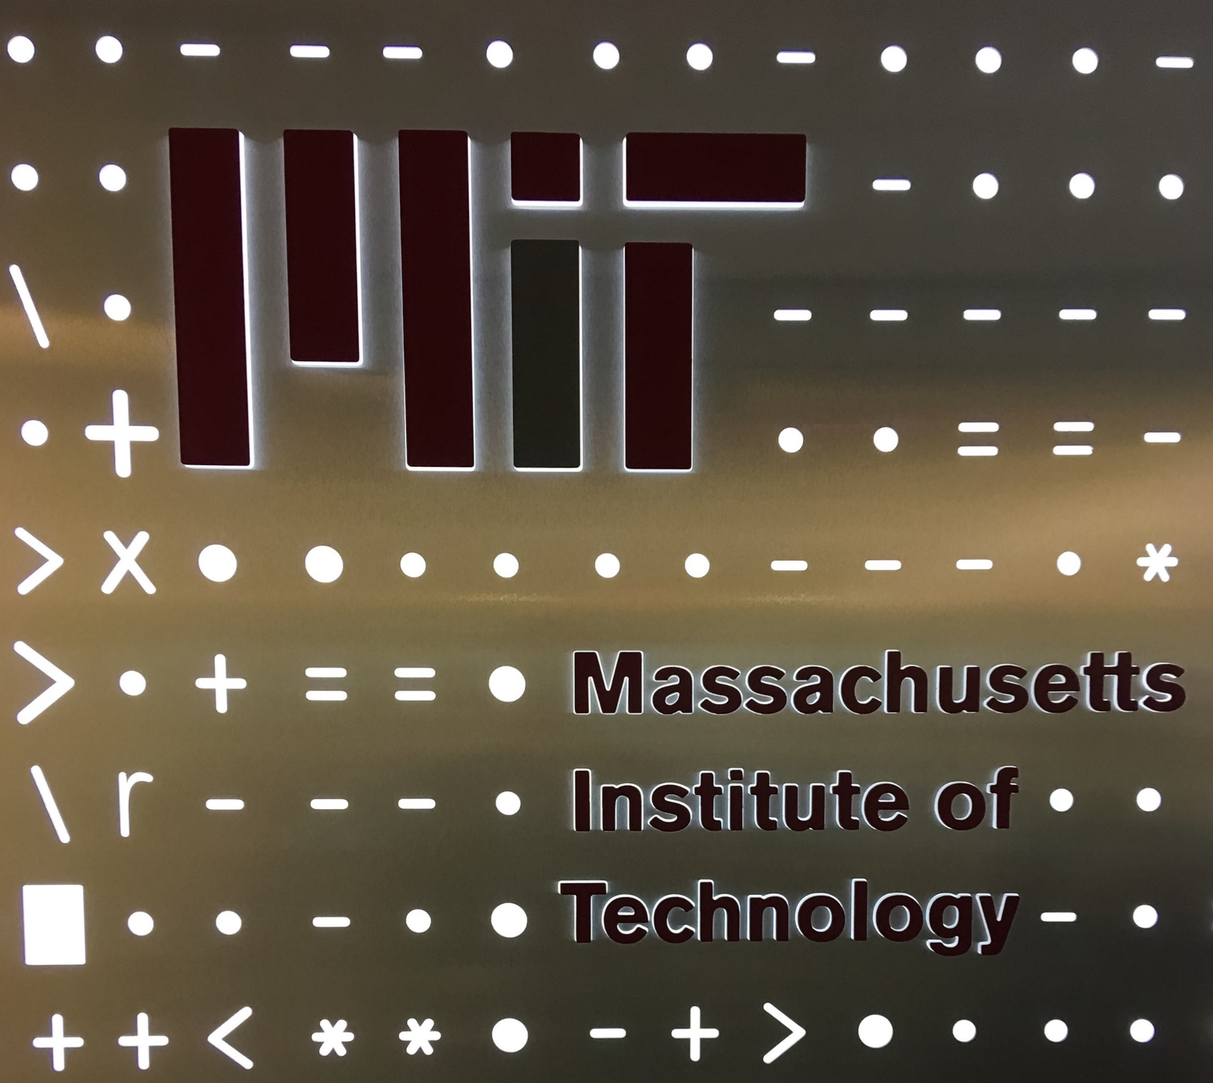
- MIT Industrial Liaison Program
The MIT Industrial Liaison Program (ILP) is dedicated to creating and strengthening mutually beneficial relationship between MIT and corporations worldwide. Established in 1948, the ILP continues to be a key player in making industrial connections for MIT.
Over 200 of the world's leading companies partner with the Industrial Liaison Program to advance research agendas at MIT.
With continued acceleration of advances in technology and knowledge discovery, and a more demanding corporate funding environment, the ILP is committed to creating productive interactions with industry. The ILP continually evolves to meet the interest, needs, and aspirations of MIT faculty and corporate partners.
http://ilp.mit.edu/
Mr. Randall S Wright
Senior Industrial Liaison Officer
Mr. Michael Schrage
Research Fellor, MIT Center for Digital Business
Prof. Maria C Yang
Associate Professor of Mechanical Engineering and Engineering Systems

Slide 22
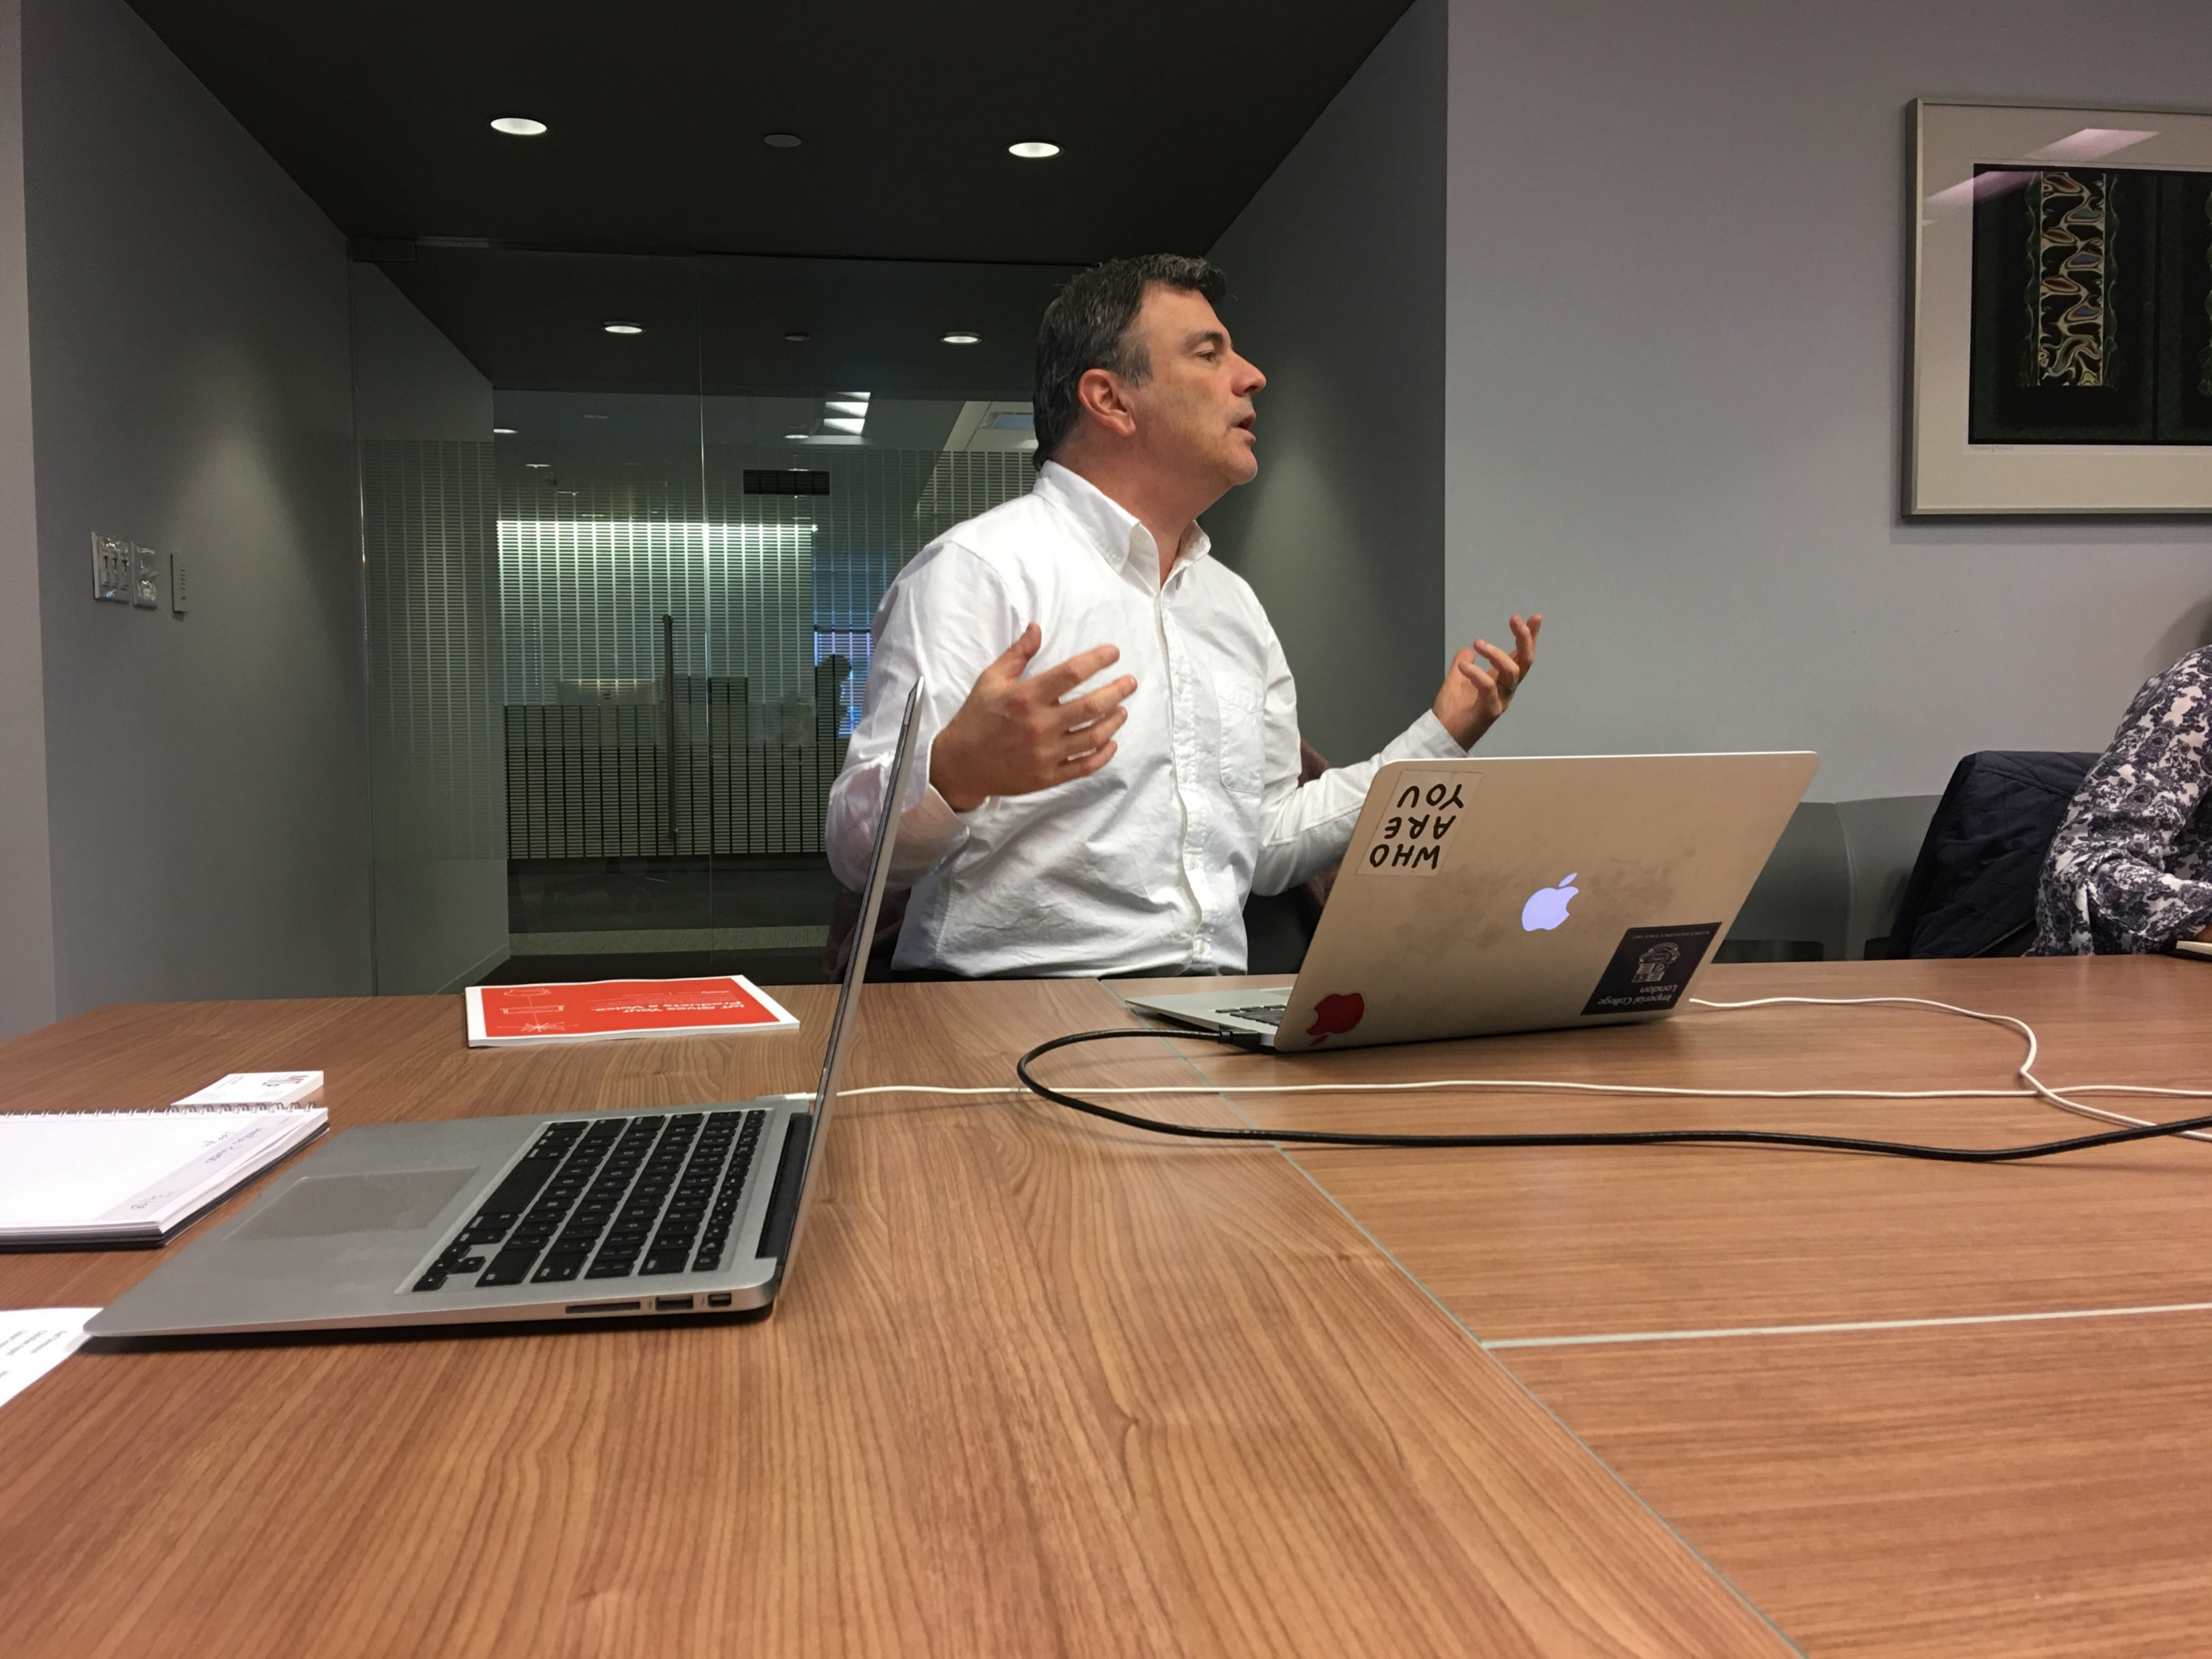
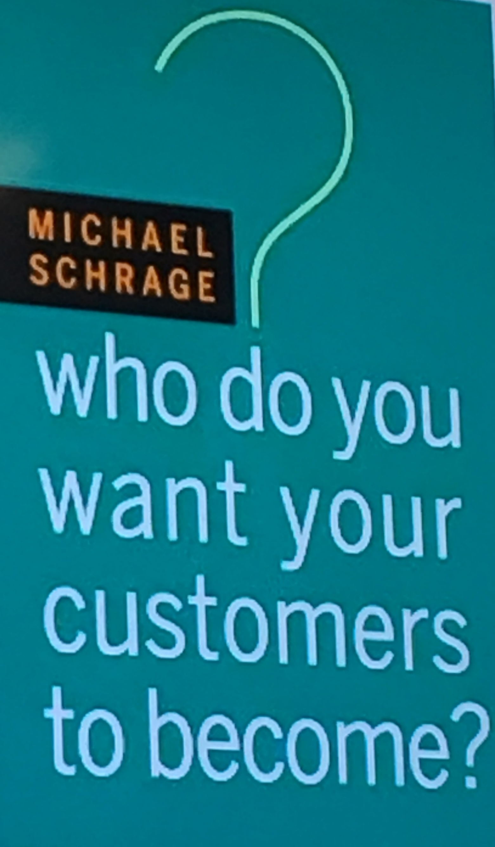

Slide 23
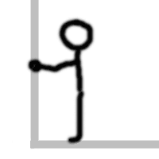

Slide 24
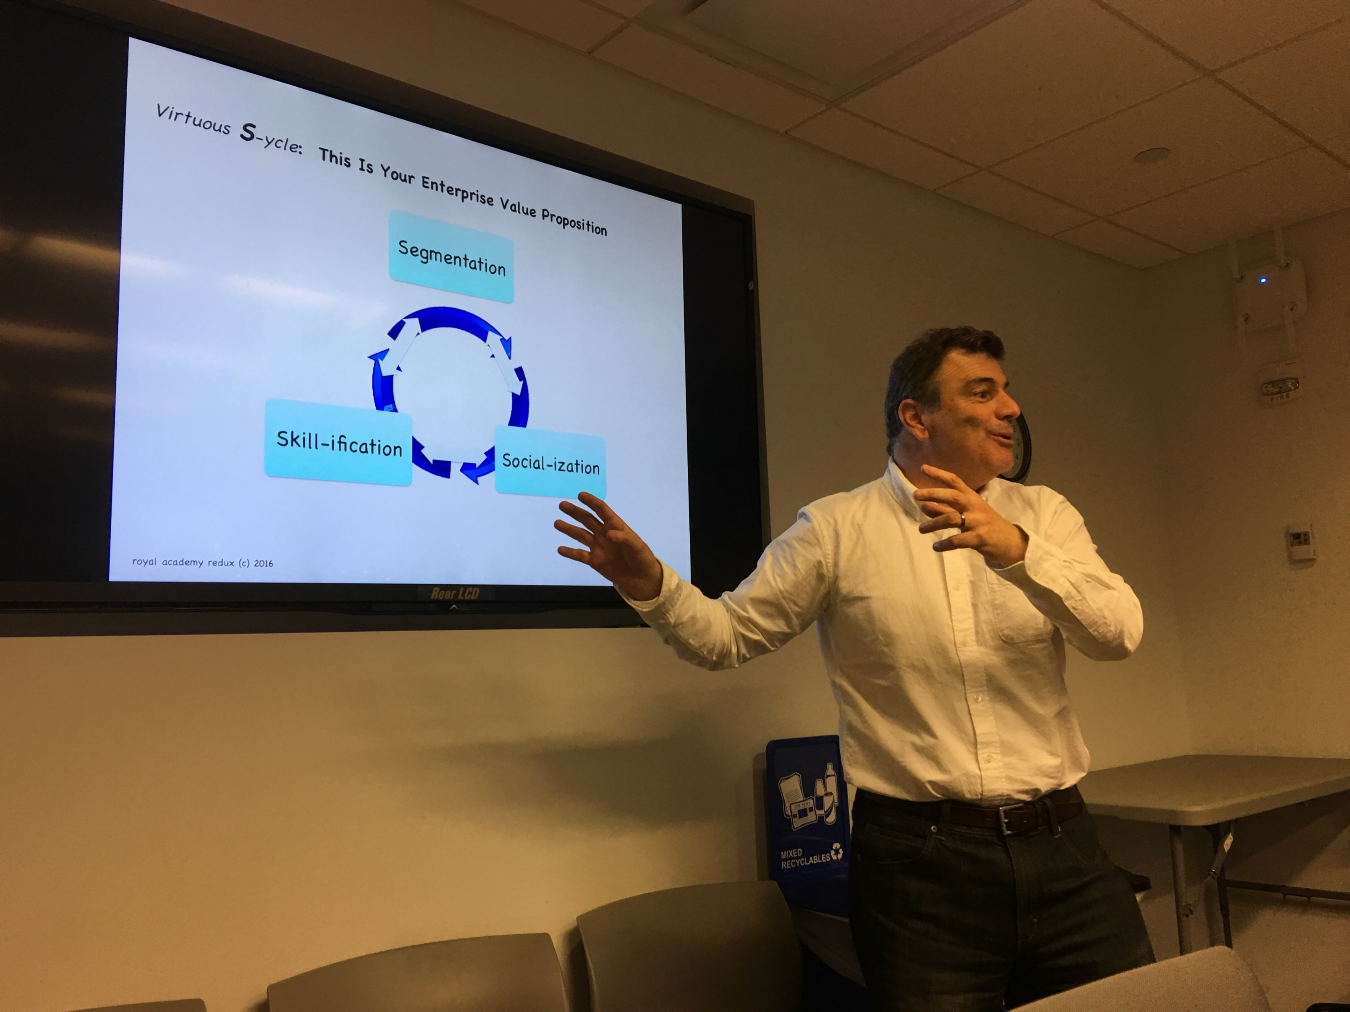

Slide 25
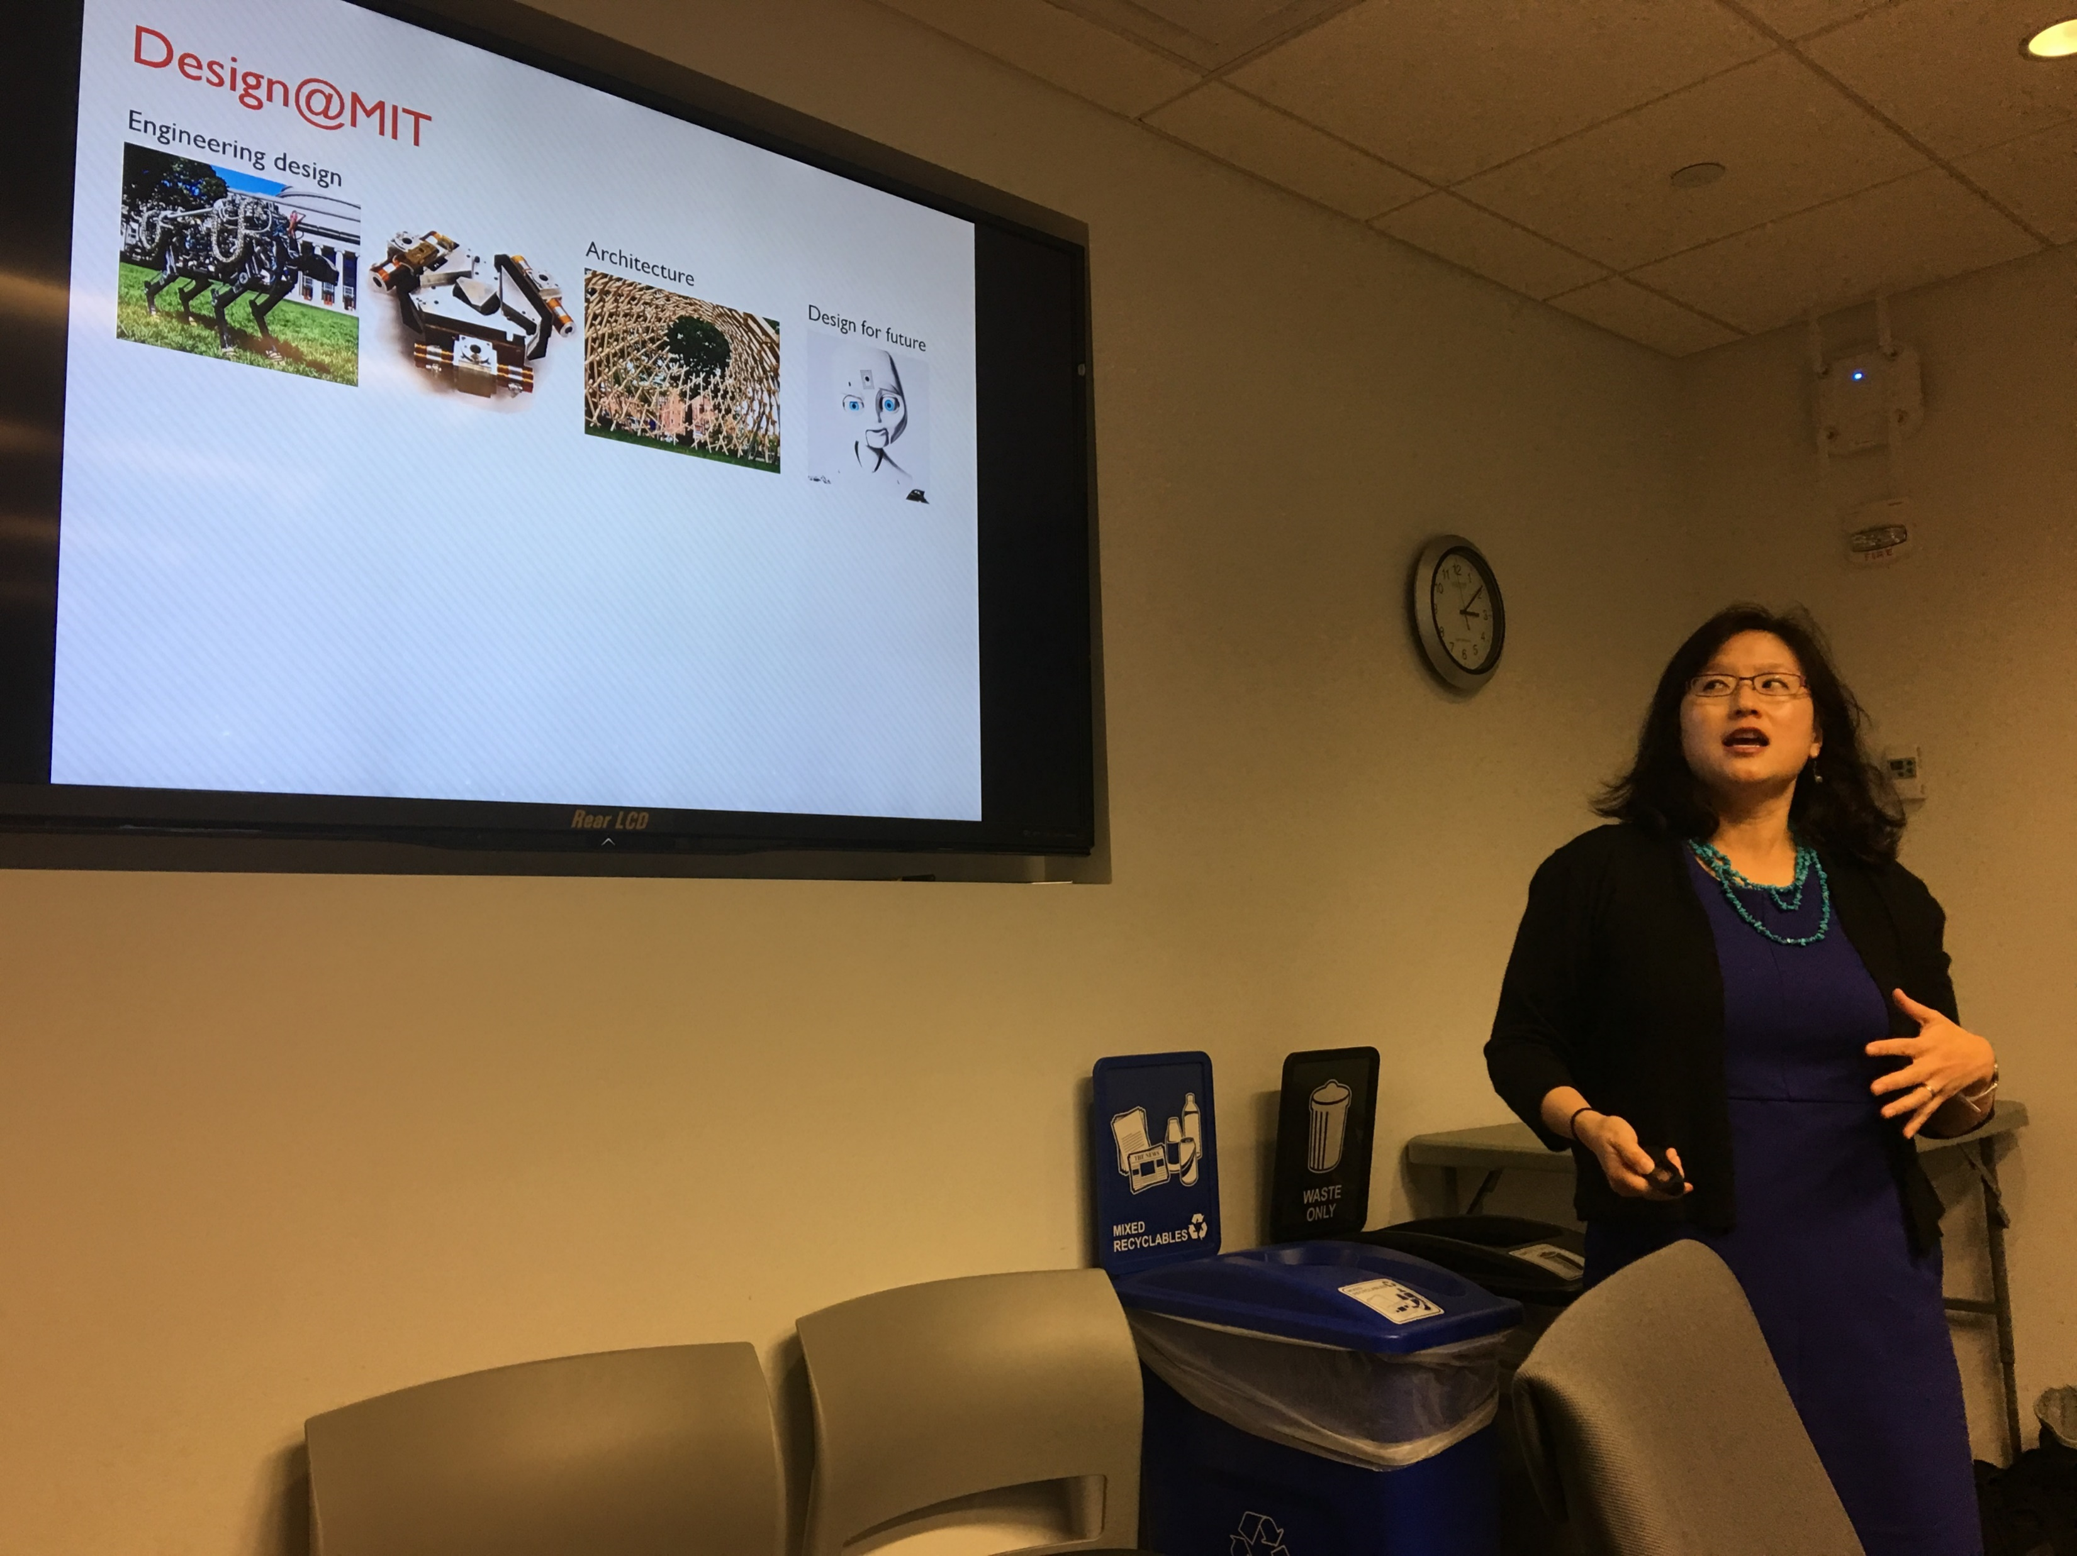

Slide 26
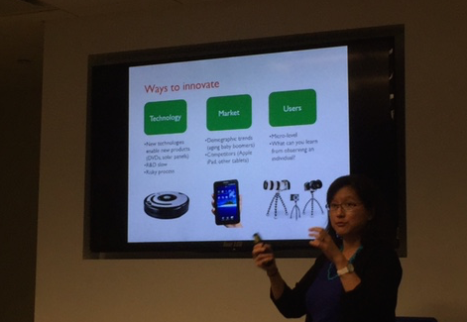
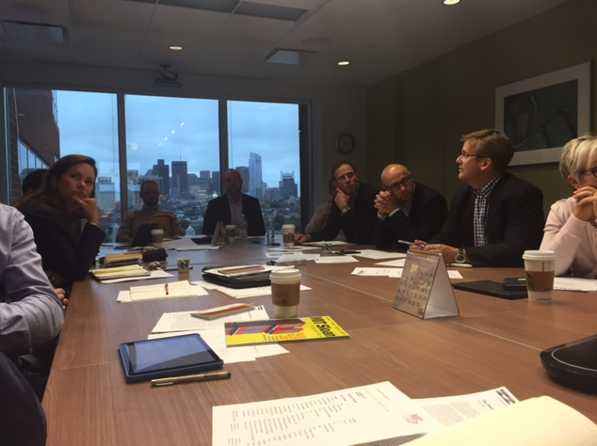

Slide 29
Comments MIT Industrial Liaison Program
Everyone must do experiments
MIT want to work with big issues and solving problems with big impacts
Google maps, touch screen, etc started at MIT
MIT = think with your hands = build something
Patents and licensing speeds up commercialization
Models, prototypes and simulation
How do you scale?
The human capital are the most important
Customer human caring
Cheap discriminates
Recommendation engines
Khan Academy
Vision statement for customer, improves our customer
From R&D to experiments & scale
Make it real
Ways to innovate: tech, market, user
Act of design
Is a great idea a great idea?
Design a way to enjoy flowers in your home
Feedback online for new idea´s
Foam prototyping is great
MINDS IN YOUR HANDS
The doers are the major thinkers
Membership
$75.000 / year dedicated person
Idea´s comes from students
You need to put in time!

Slide 30
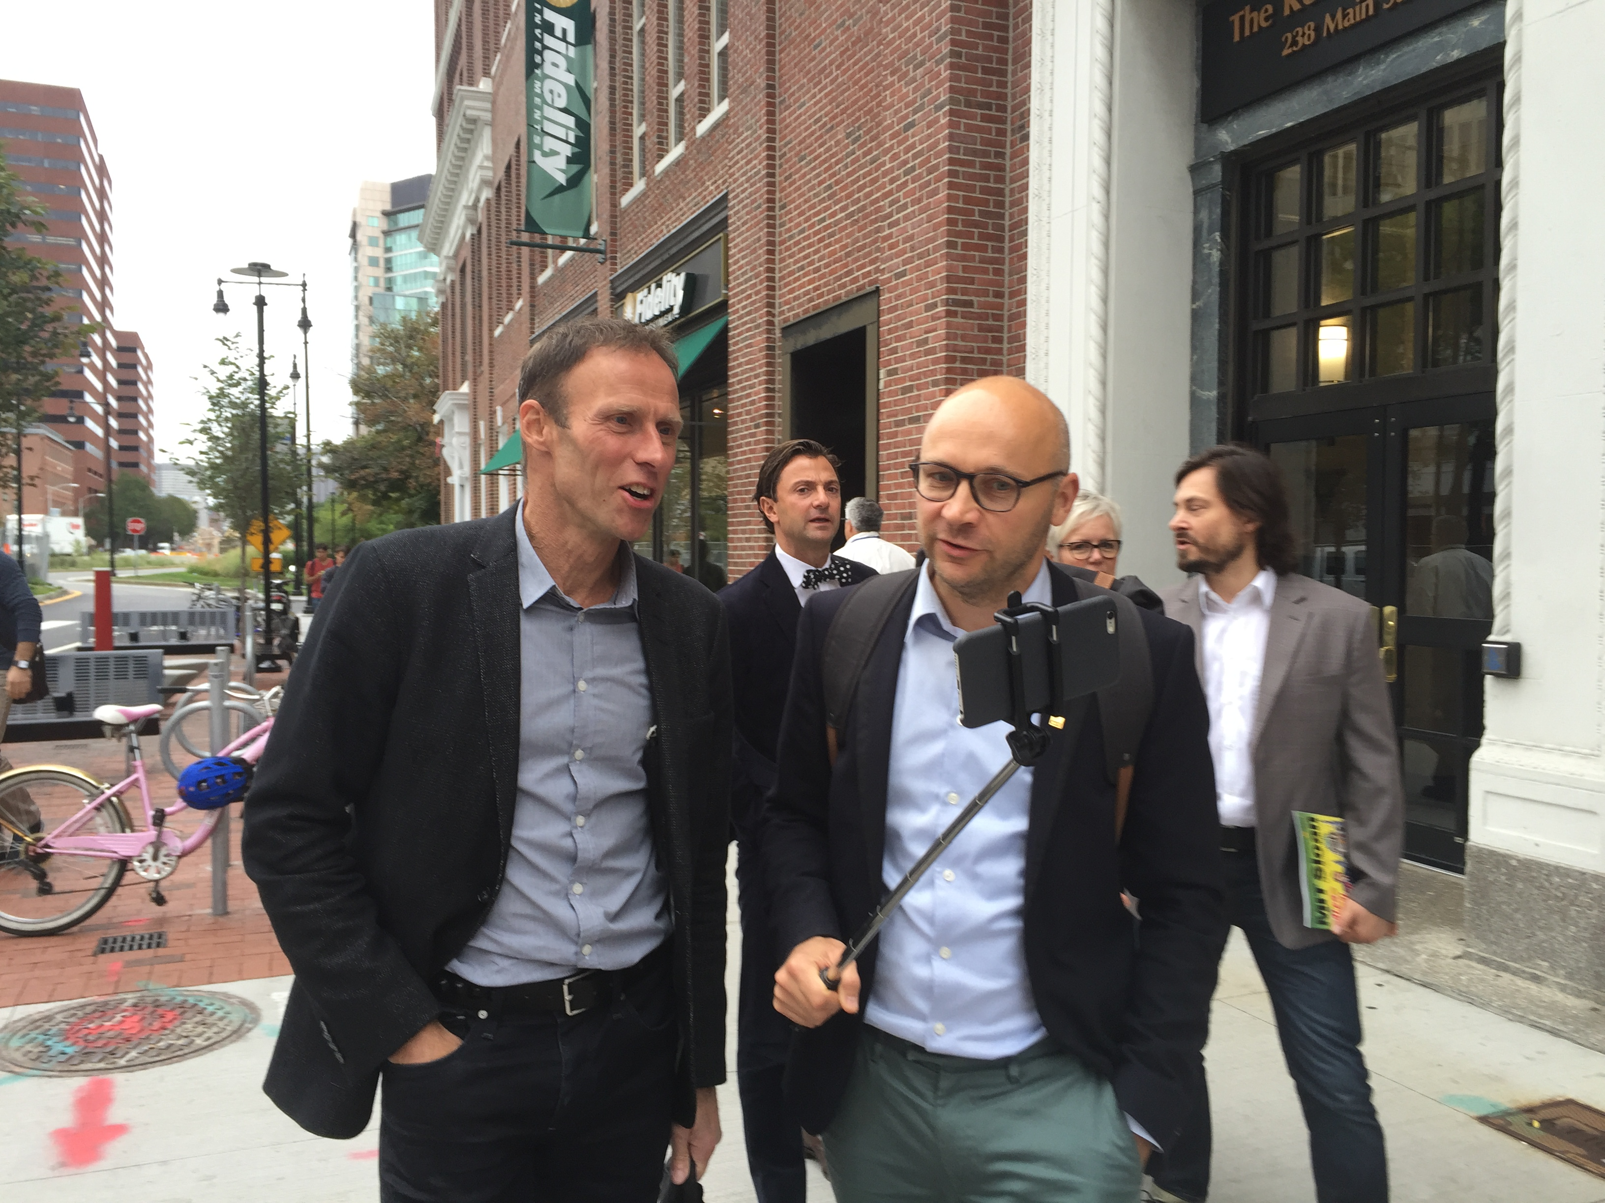

Slide 31
Many thanks to the Chairman of Innovation Pioneers, Niclas Ingeström and Shirine Bauer for summarizing the trip in this presentation!
Another thanks to all participants who joined us on this memorable trip- it would not have been the same without this dynamic, qurious and open group!
However, this trip would not have happened if it was not for Innovation Pioneers Kim Silvasti who made everything happen.

